Slide 1
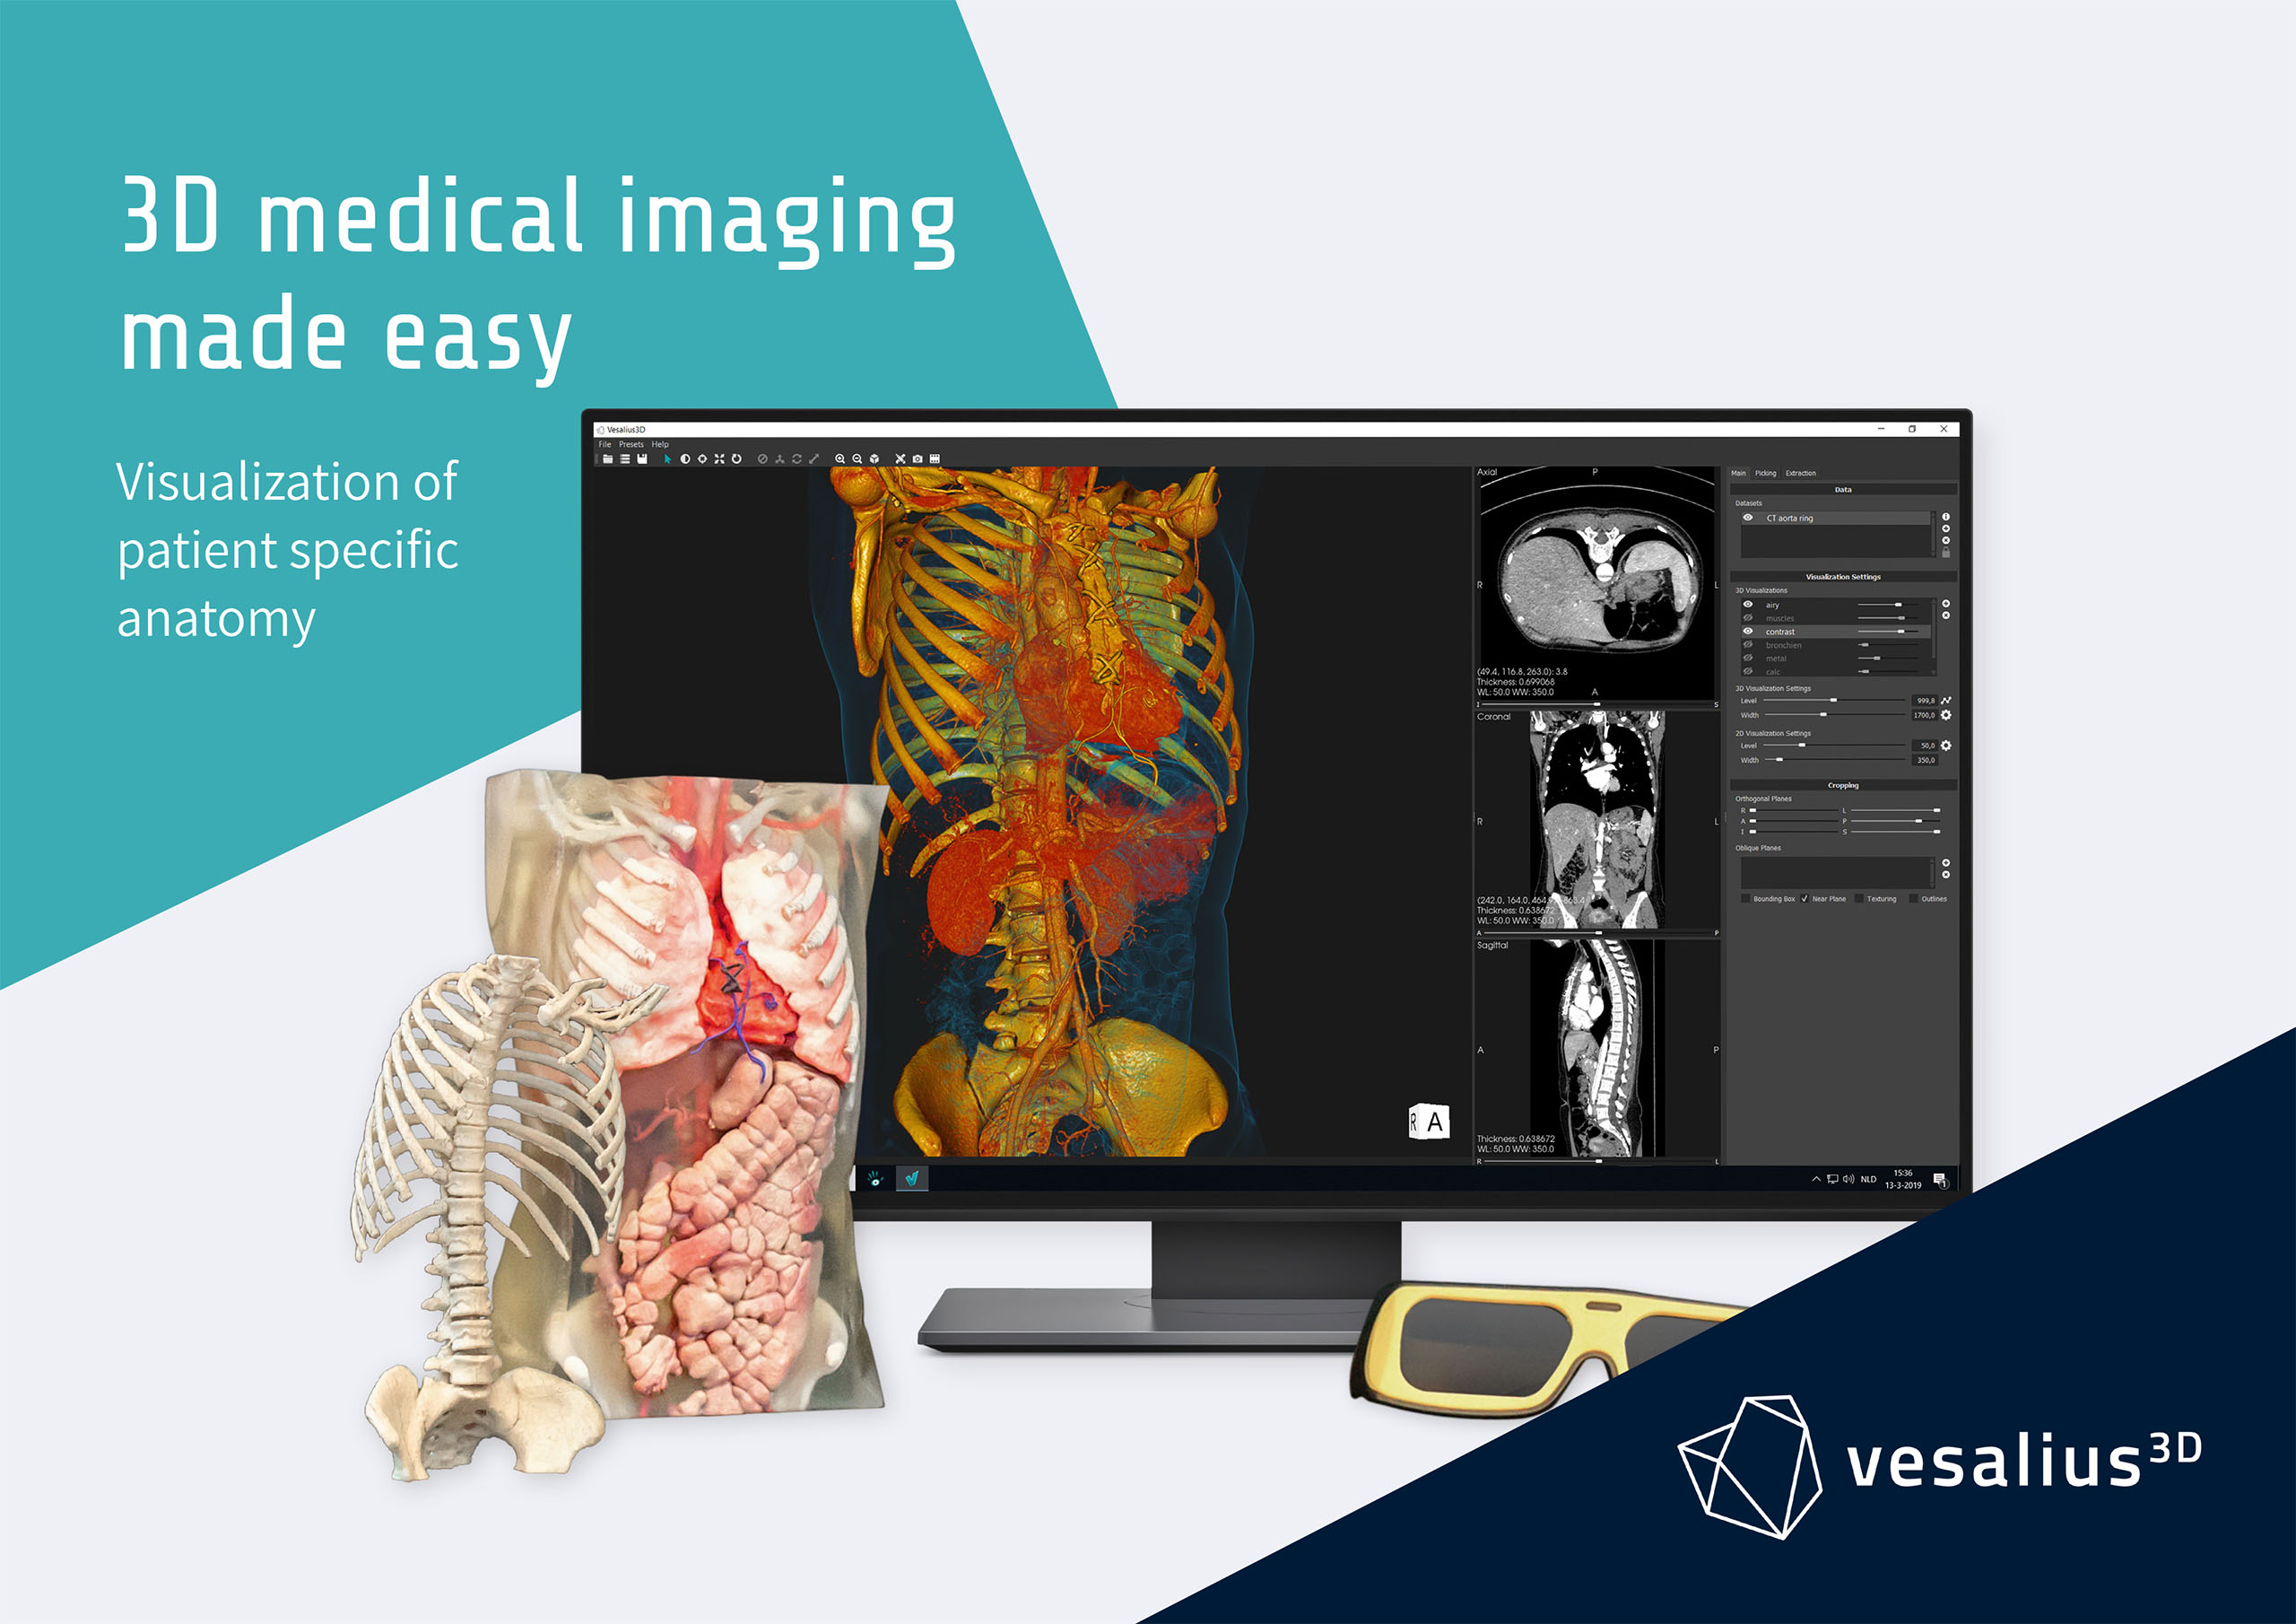


Slide 2
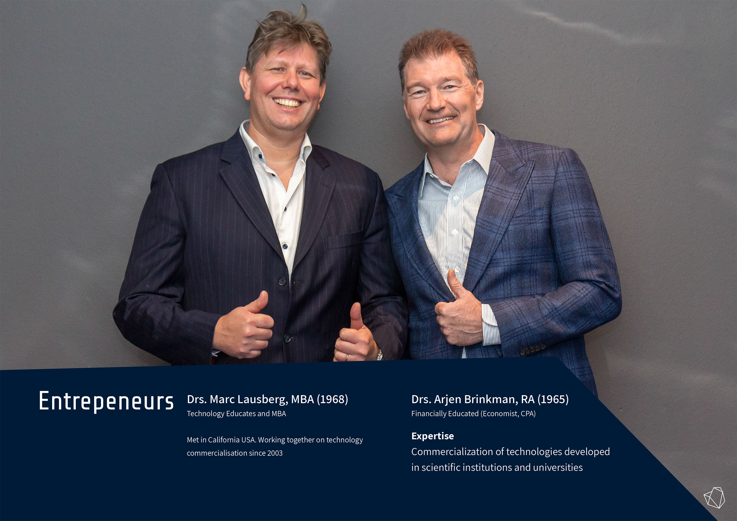
Notes:
2015 tech gekocht
Vs naar nl
Uit de hand gelopen

Slide 3
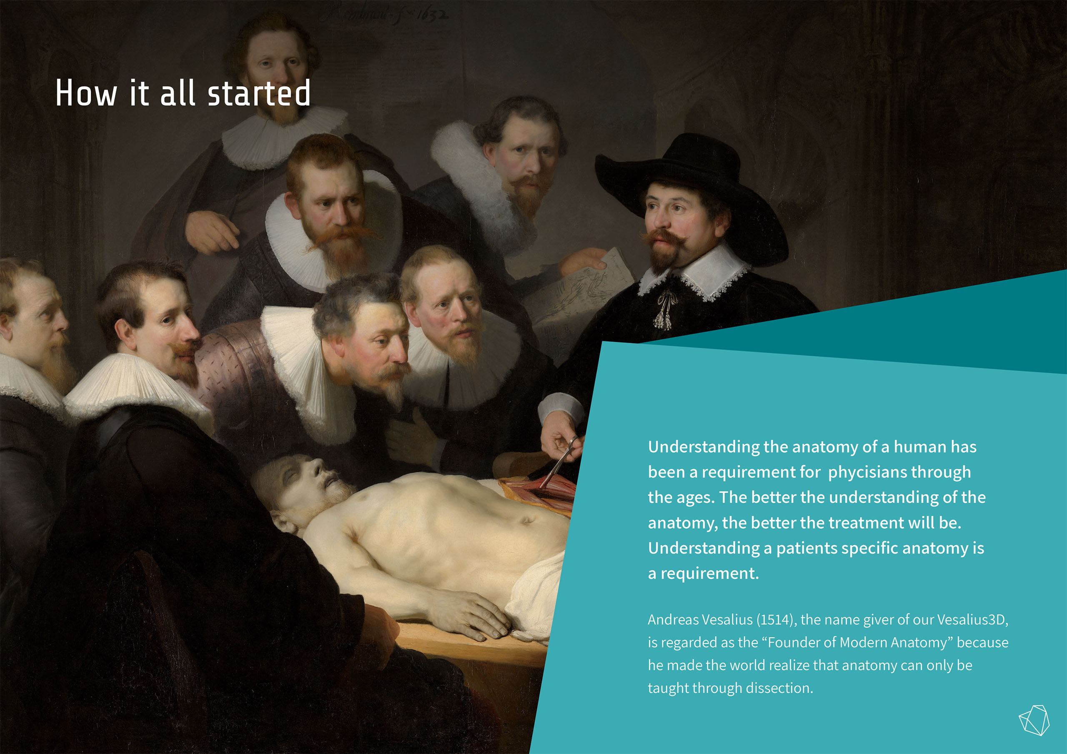

Slide 4
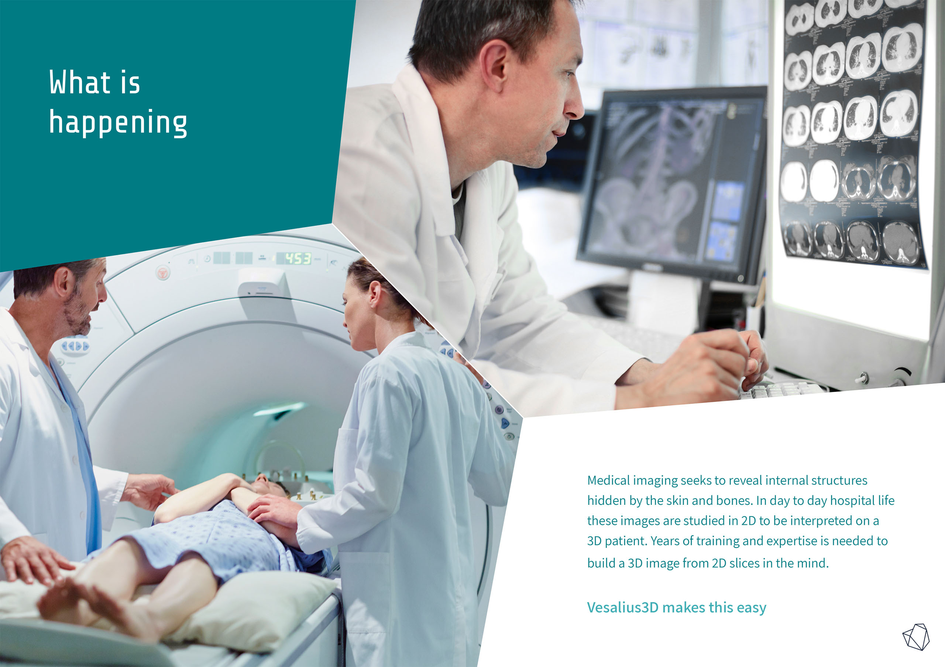
Notes:
Data (MR, CT Ultrasound) ever increasing
Need for new tools

Slide 5
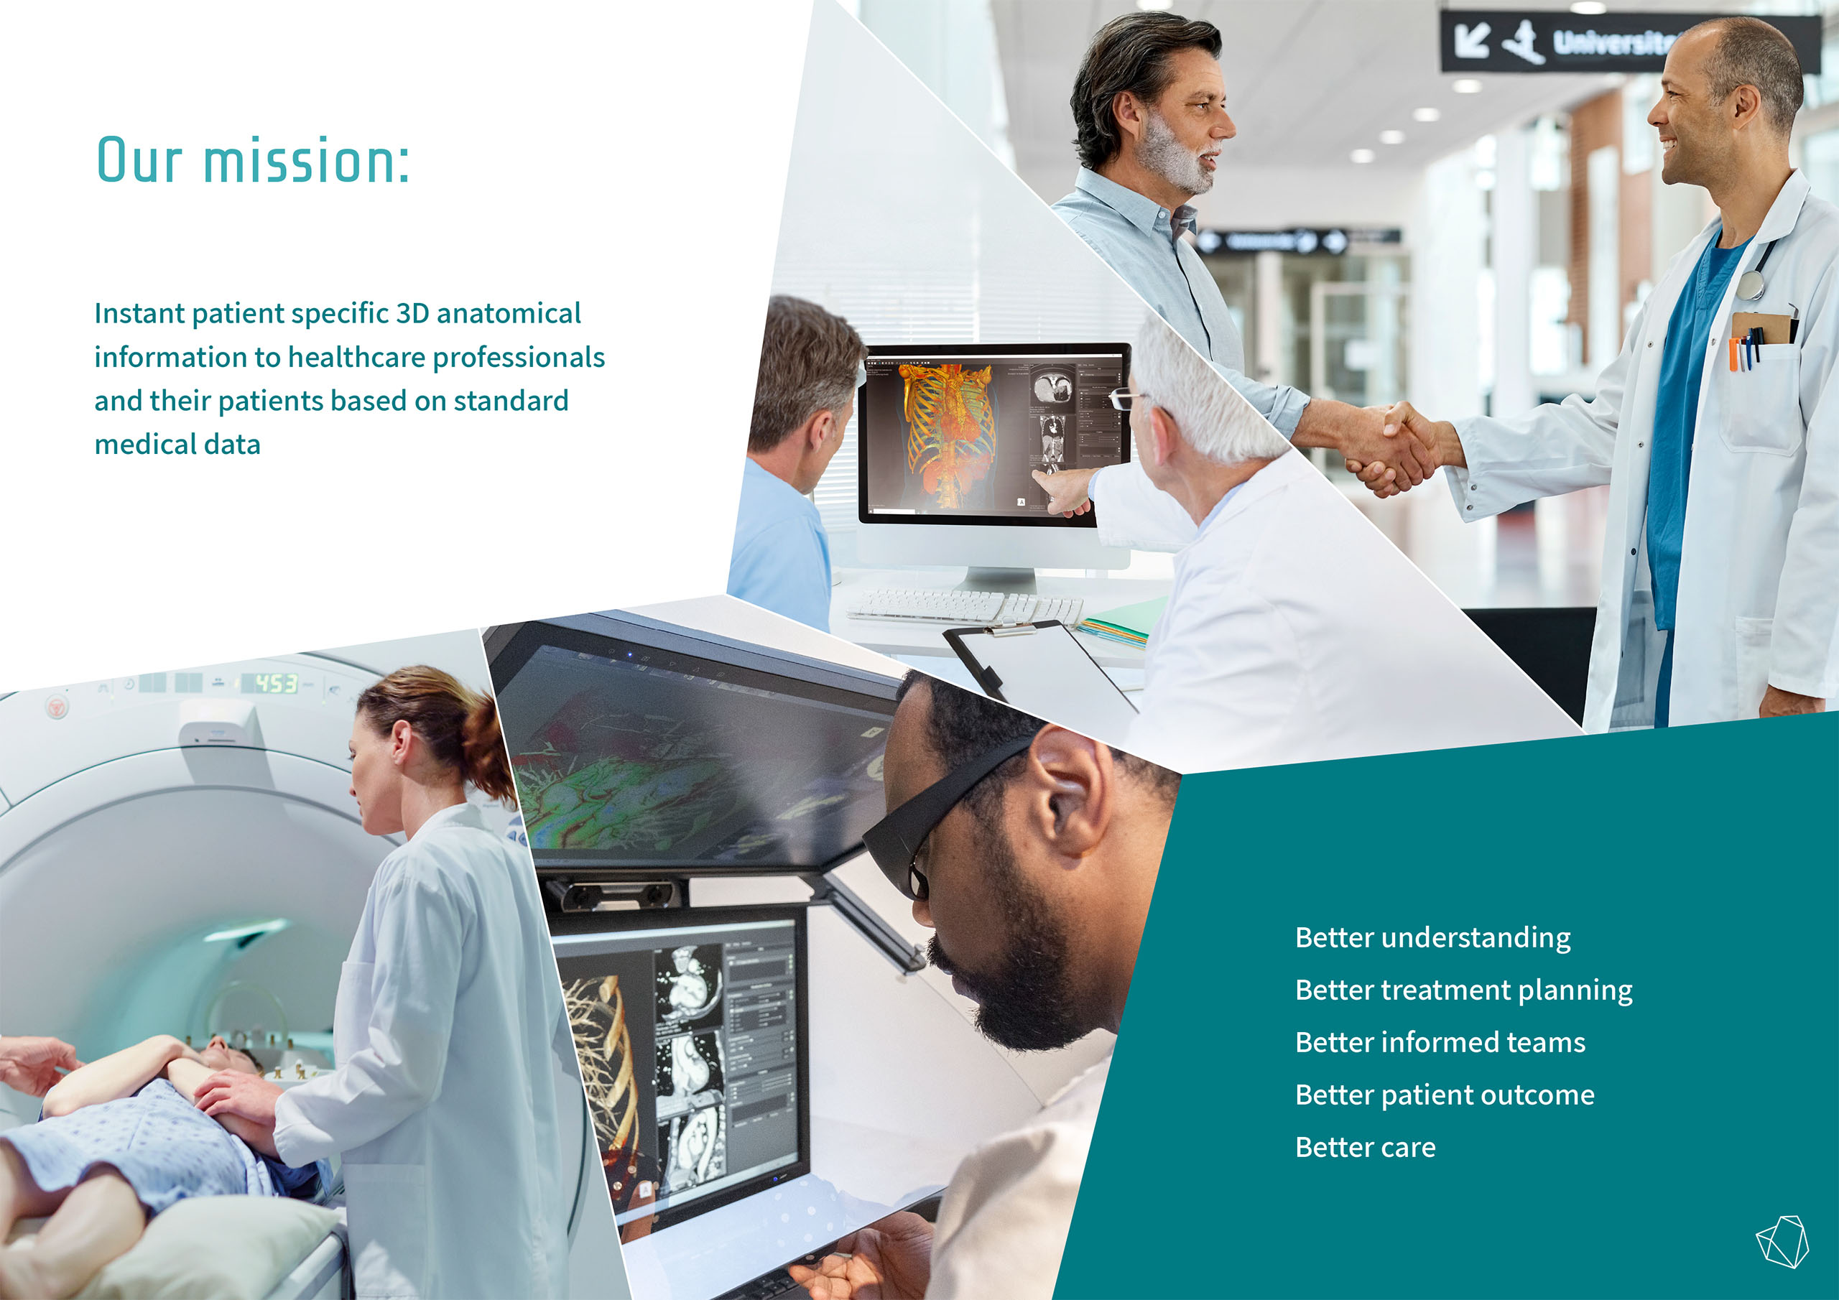

Slide 6
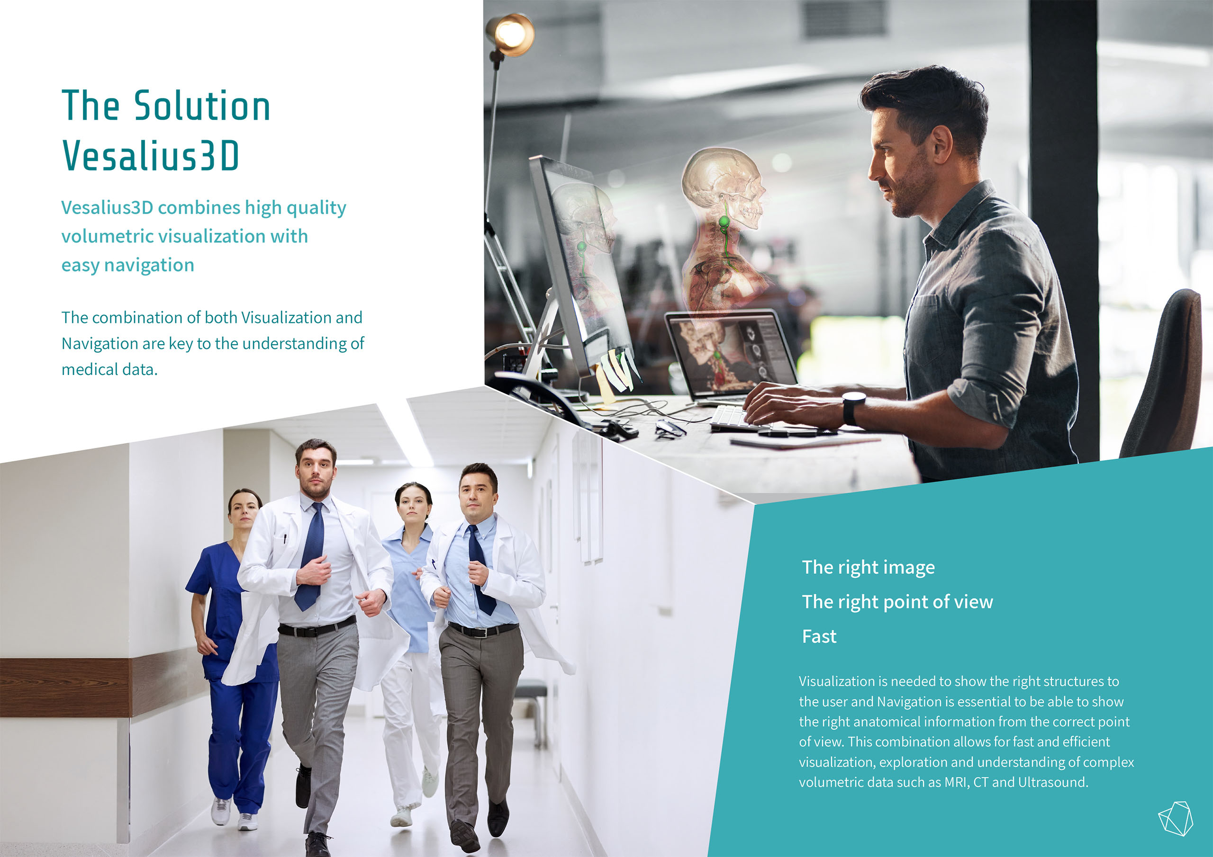
Notes:
Day to day workflow

Slide 7

Standard medical data, no preprocessing
Instant patient specific anatomy

Slide 8
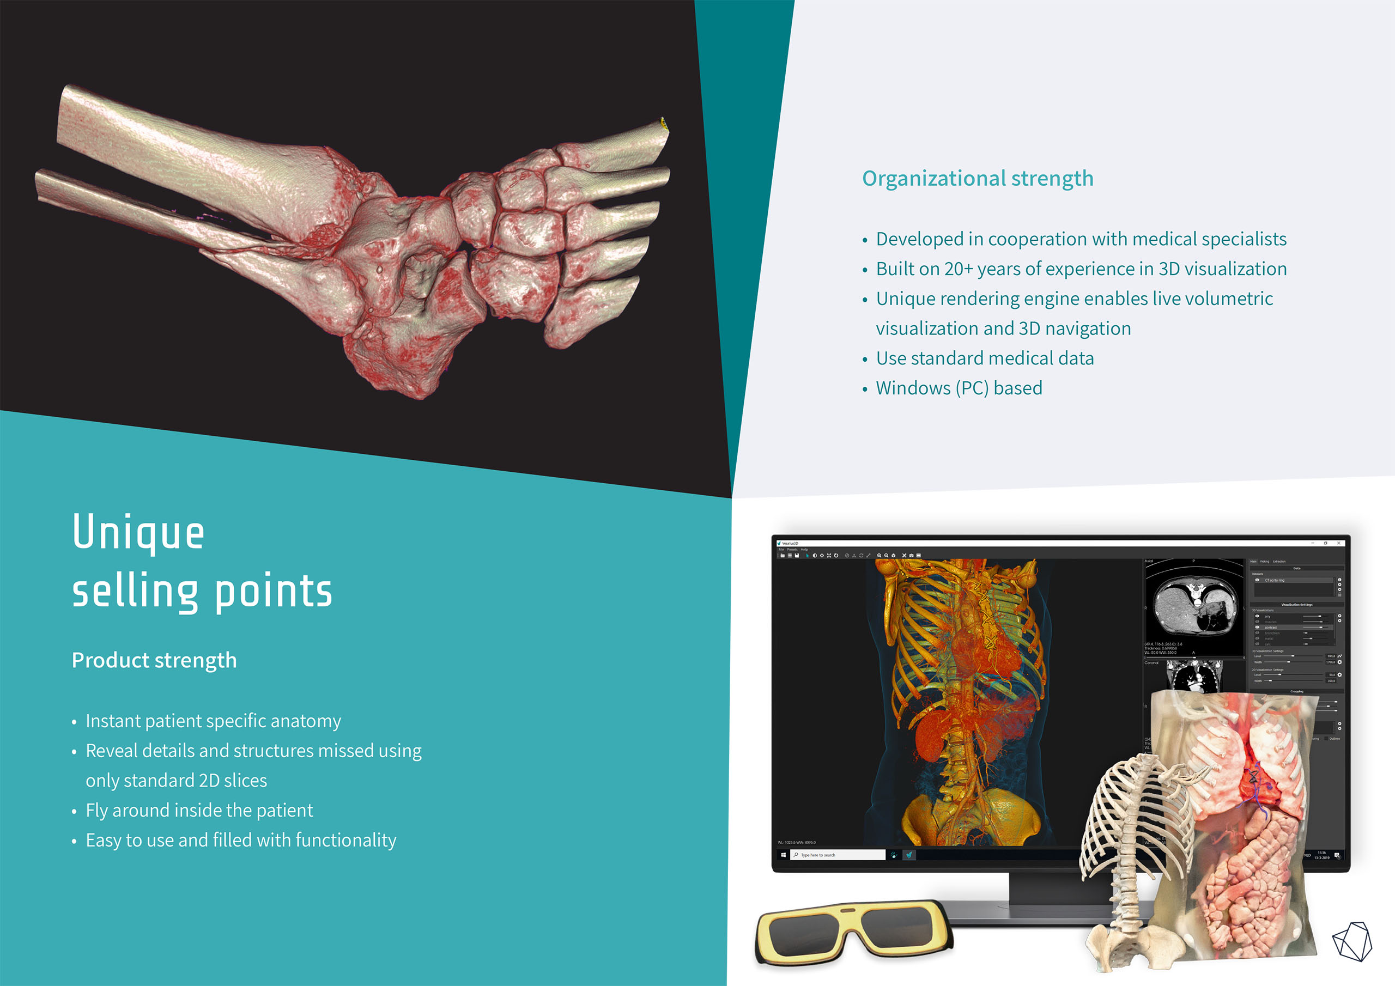
Notes:
Unique selling points

Slide 9
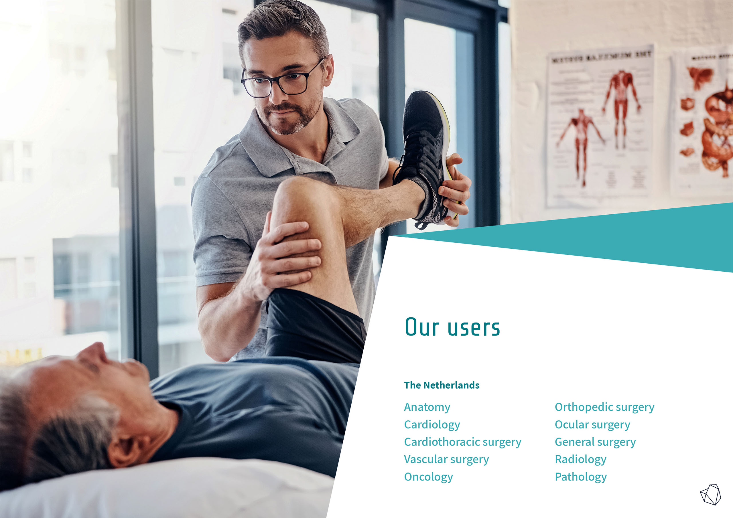
Notes:
Professional users
Software has been developed with these professionals

Slide 10
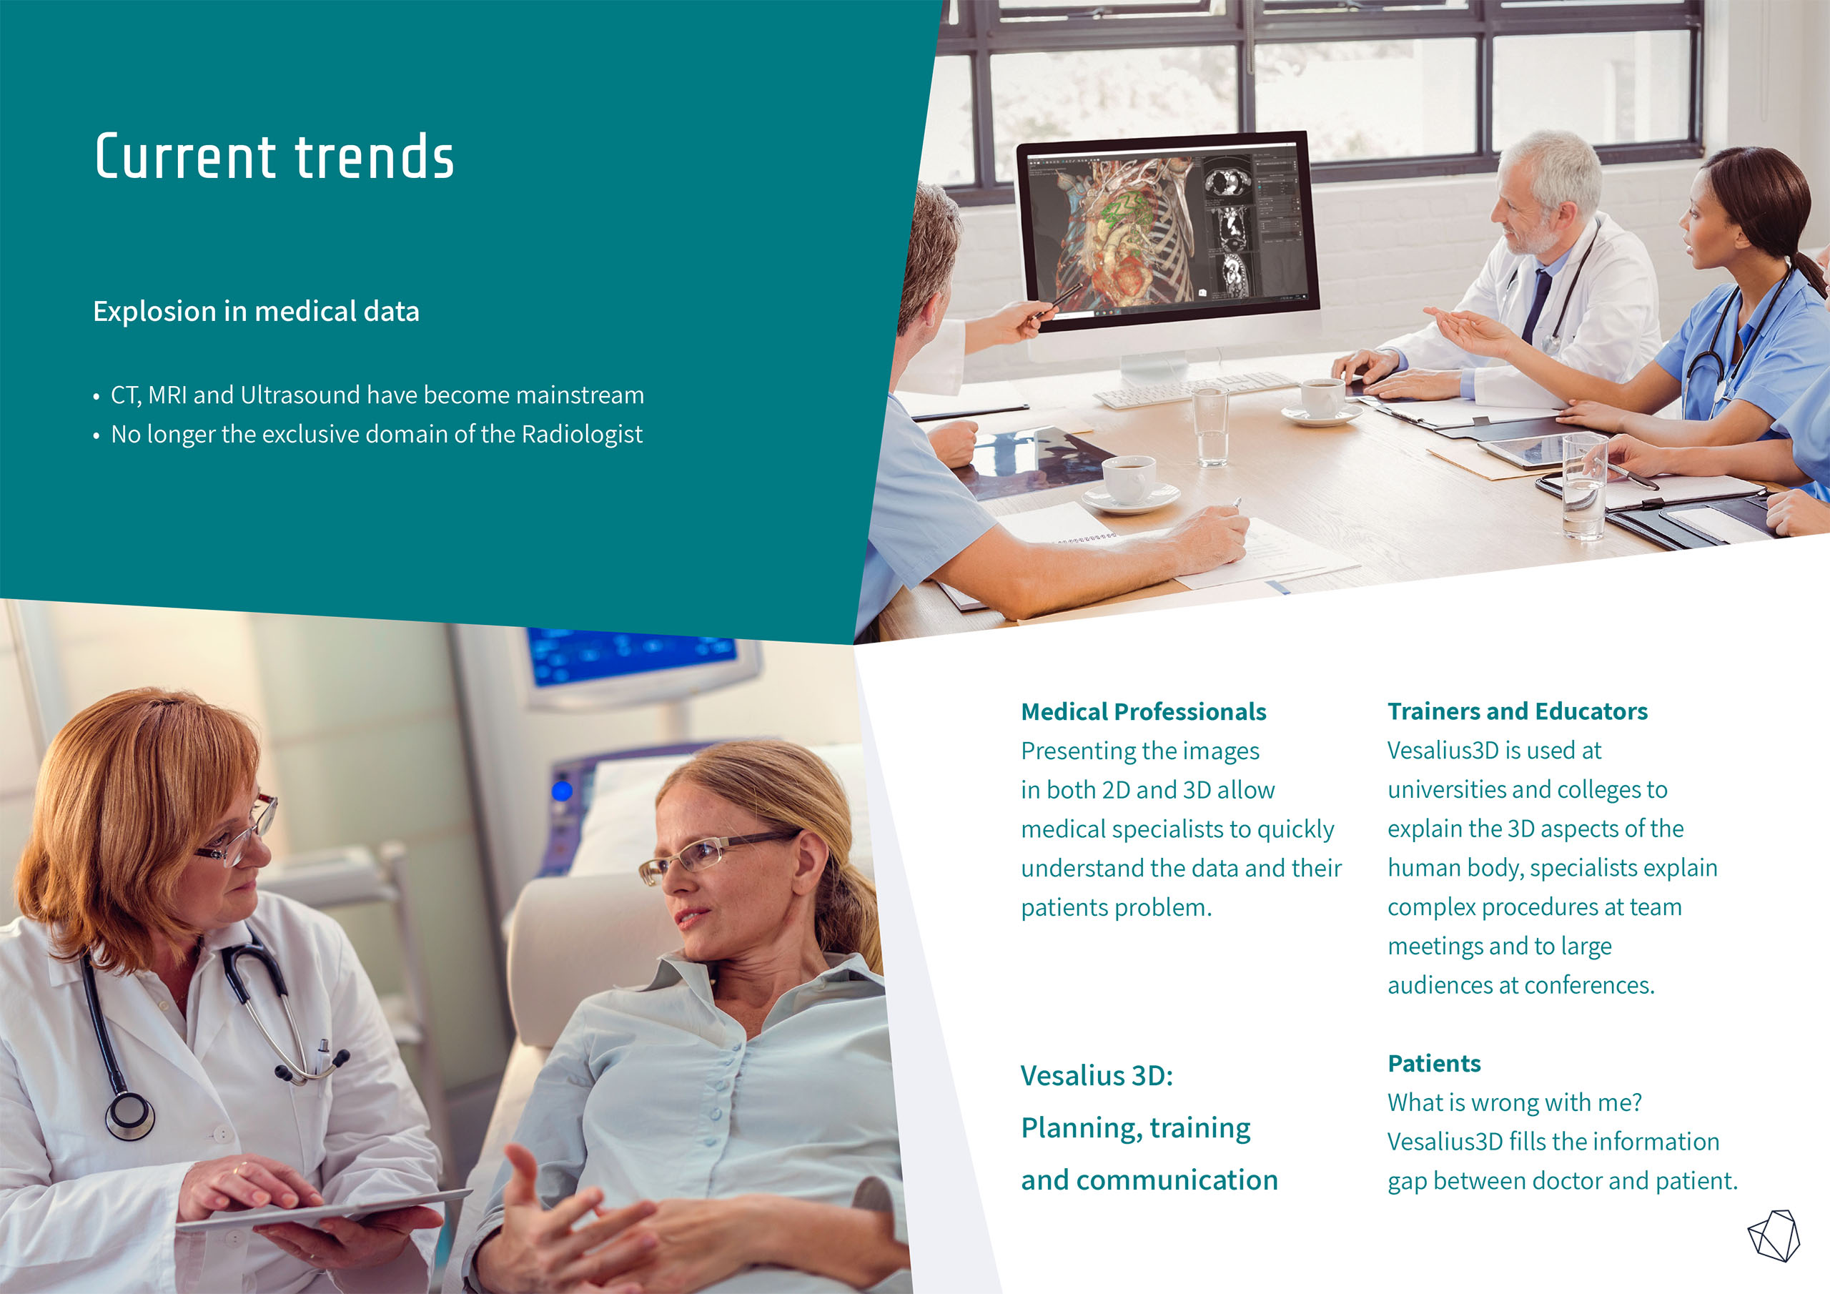

Slide 11
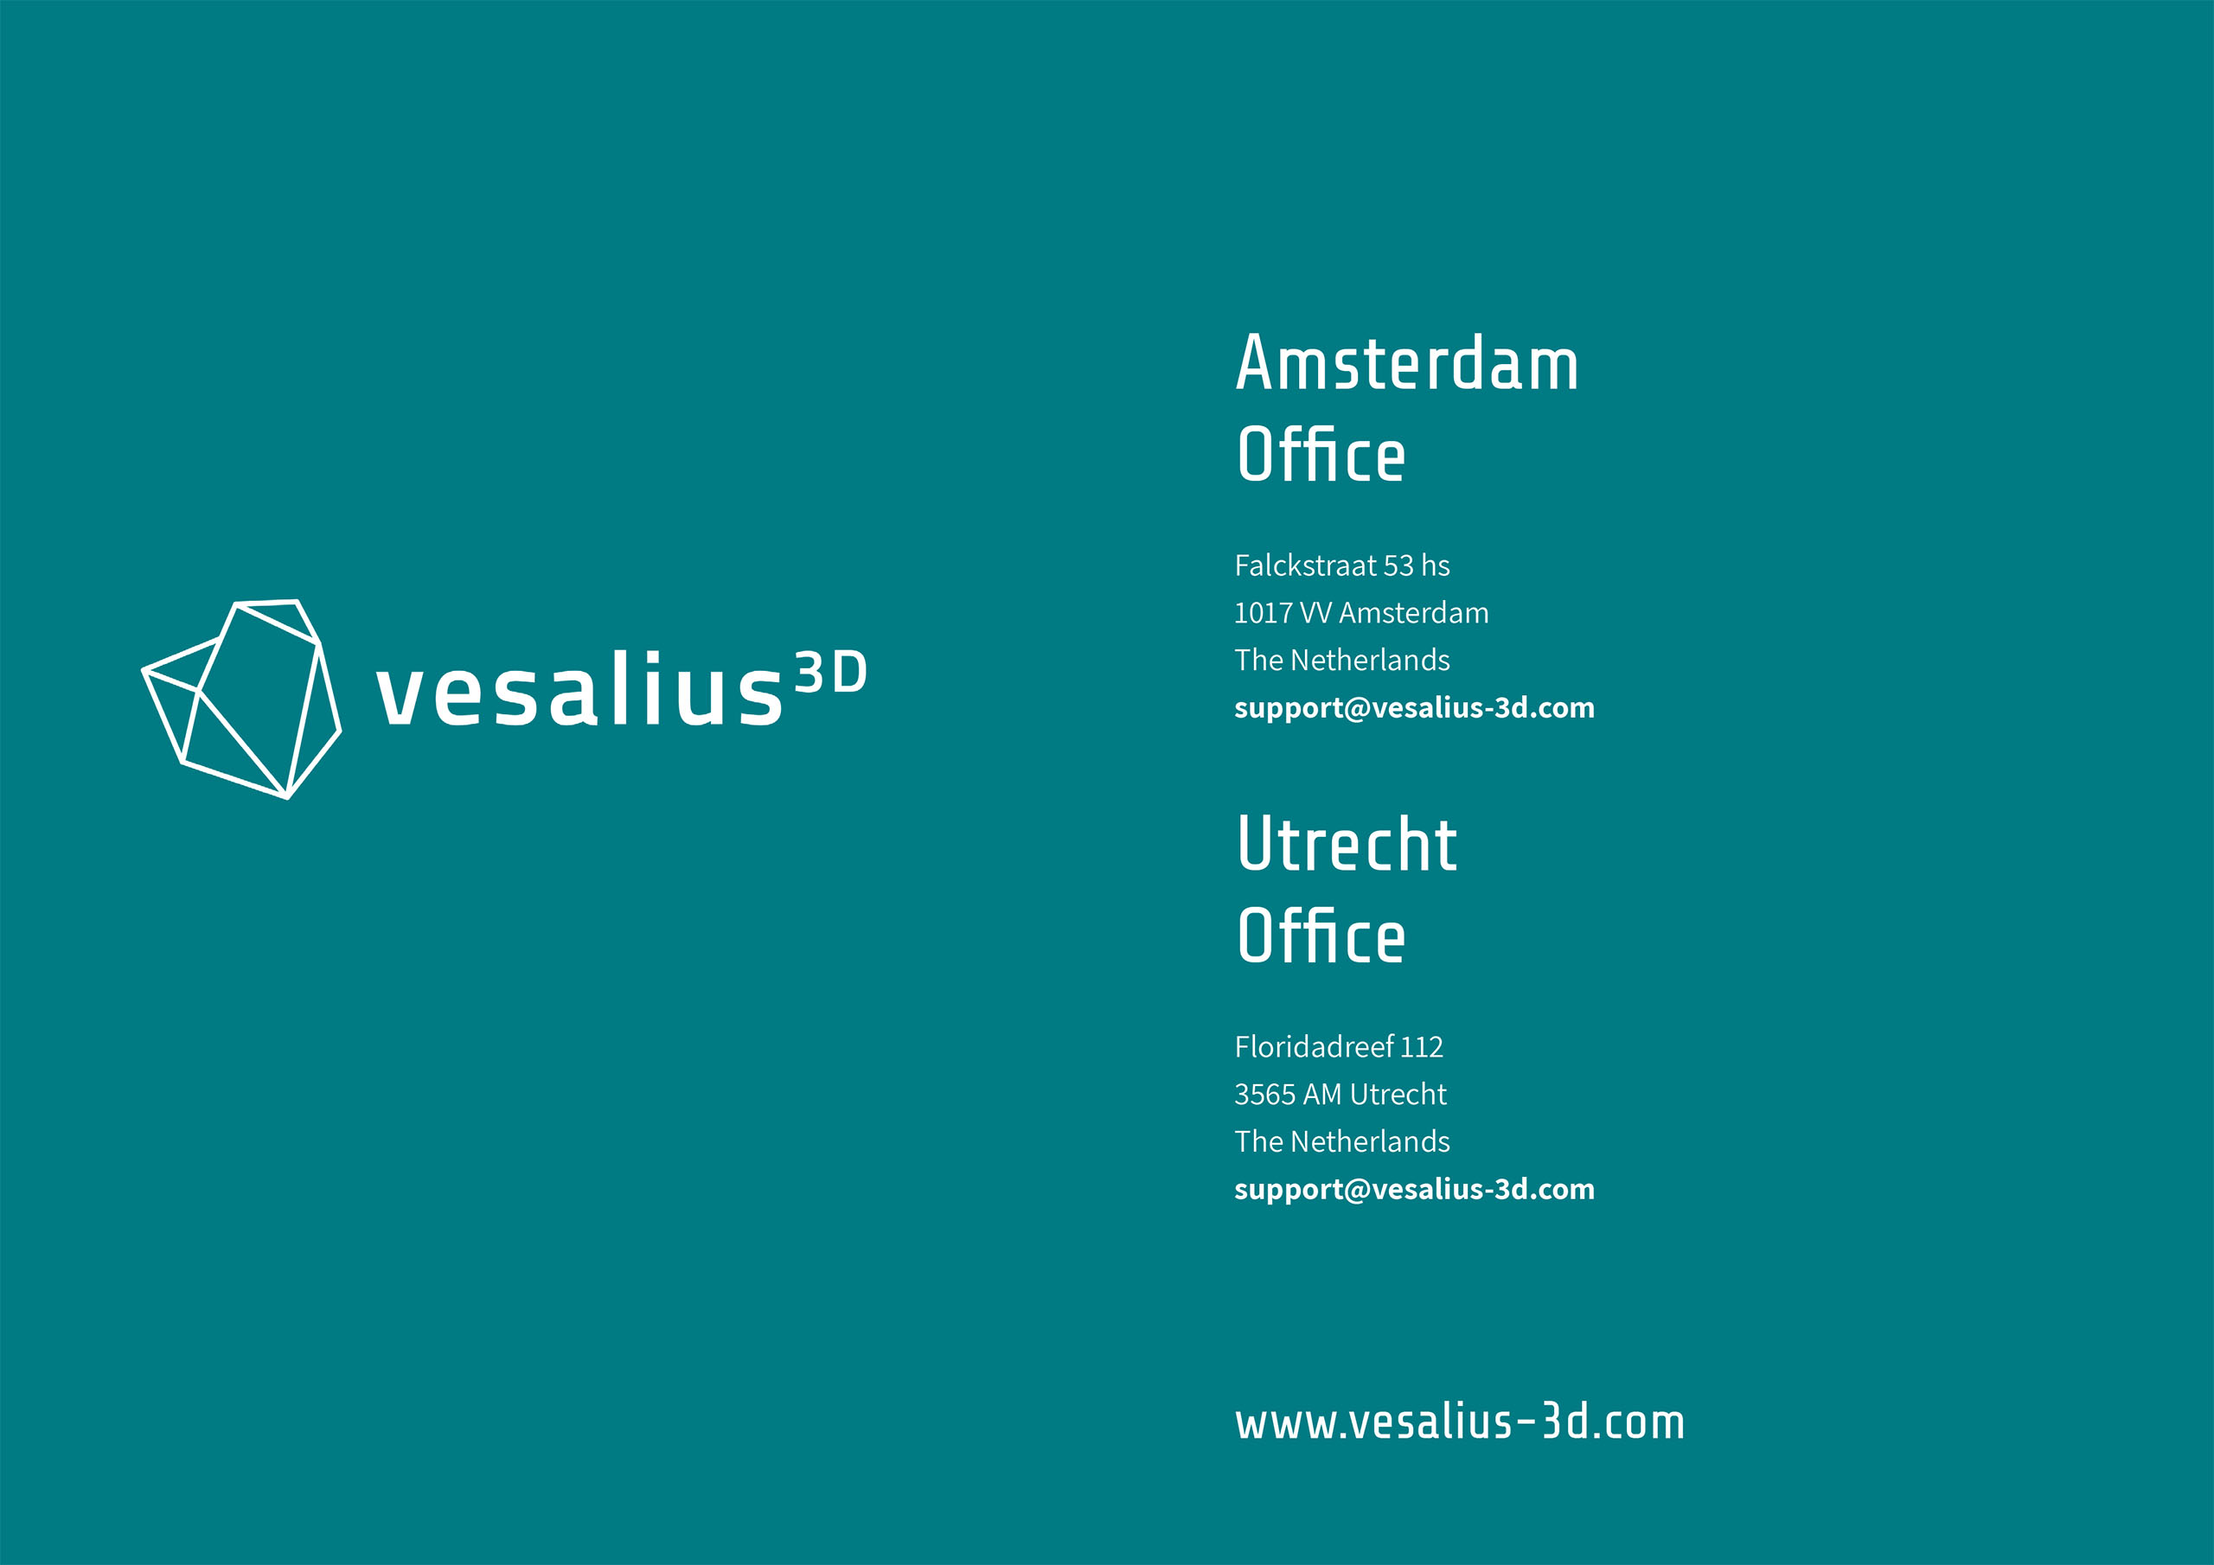
+31 20 3311214
Notes:
Vesalius3D final stages
Afronding van de van de ontwikkeling en validatie van de Mrkt en sales process
Market tests and sales validation 1st 350K, expect a 2nd trenche to big time launch software
Focus on sales and marketing
Marc and myself available to demo the software

