Slide 2



Schneider Digital – 25 years of professional hardware experience
Full-Service provider
for professional 4K / 8K
3D- and VR-Hardware
More than 25 years of experience
in graphics- und high-performance-hardware solutions
More than 15 years of experience with 3D-stereoscopic monitors and desktop VR systems
Integrator for multi-monitor display walls und VR rooms

Slide 3
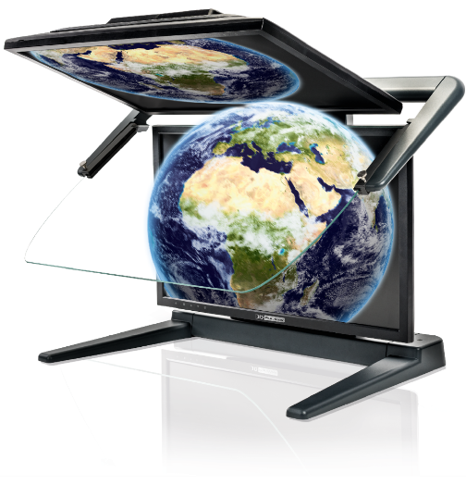
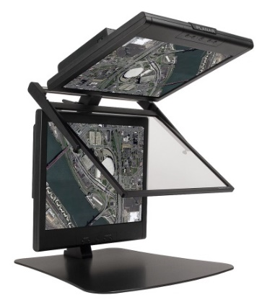
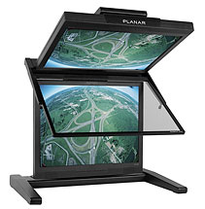
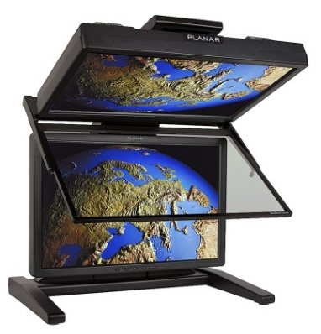
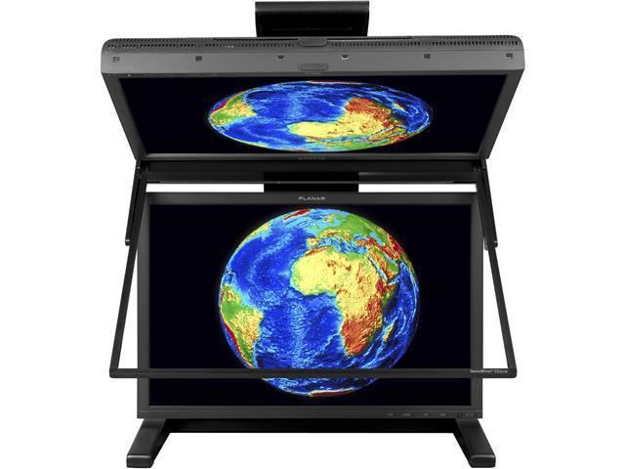


15 years of experience with passive 3D stereo systems
2005
2016
3D PLANAR
SD1710 / 17”
3D PLANAR
SD2020 / 20”
3D PLANAR
SD1710 / 24”
3D PLANAR
SD2420W / 25”
FHD-2,5K-4K / 22-24“, 27-28“

Slide 4
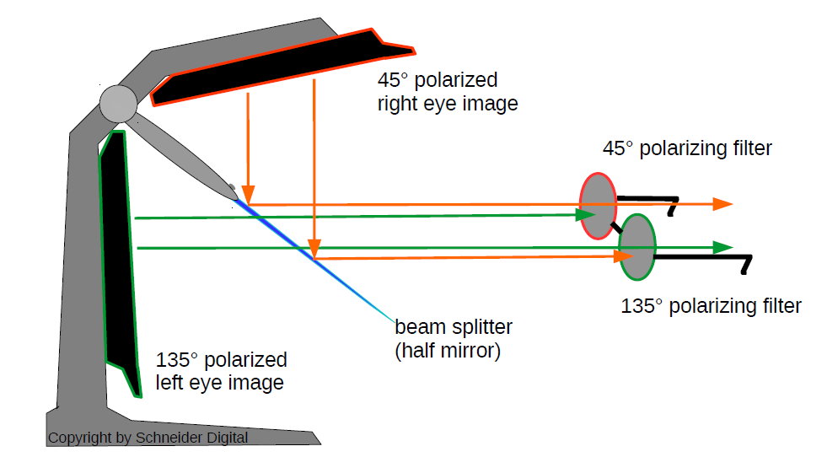
Passive, dual screen 3D-stereo principle

Slide 5

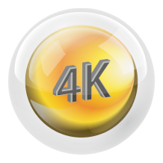







Meeting the highest requirements for all 3D-stereo applications
Highest Resolution
Flicker-Free
Daylight Suitable
Plug & Play
Compact Assembly
Wide Visual Angle
Software Certified
Functional Design

Slide 6
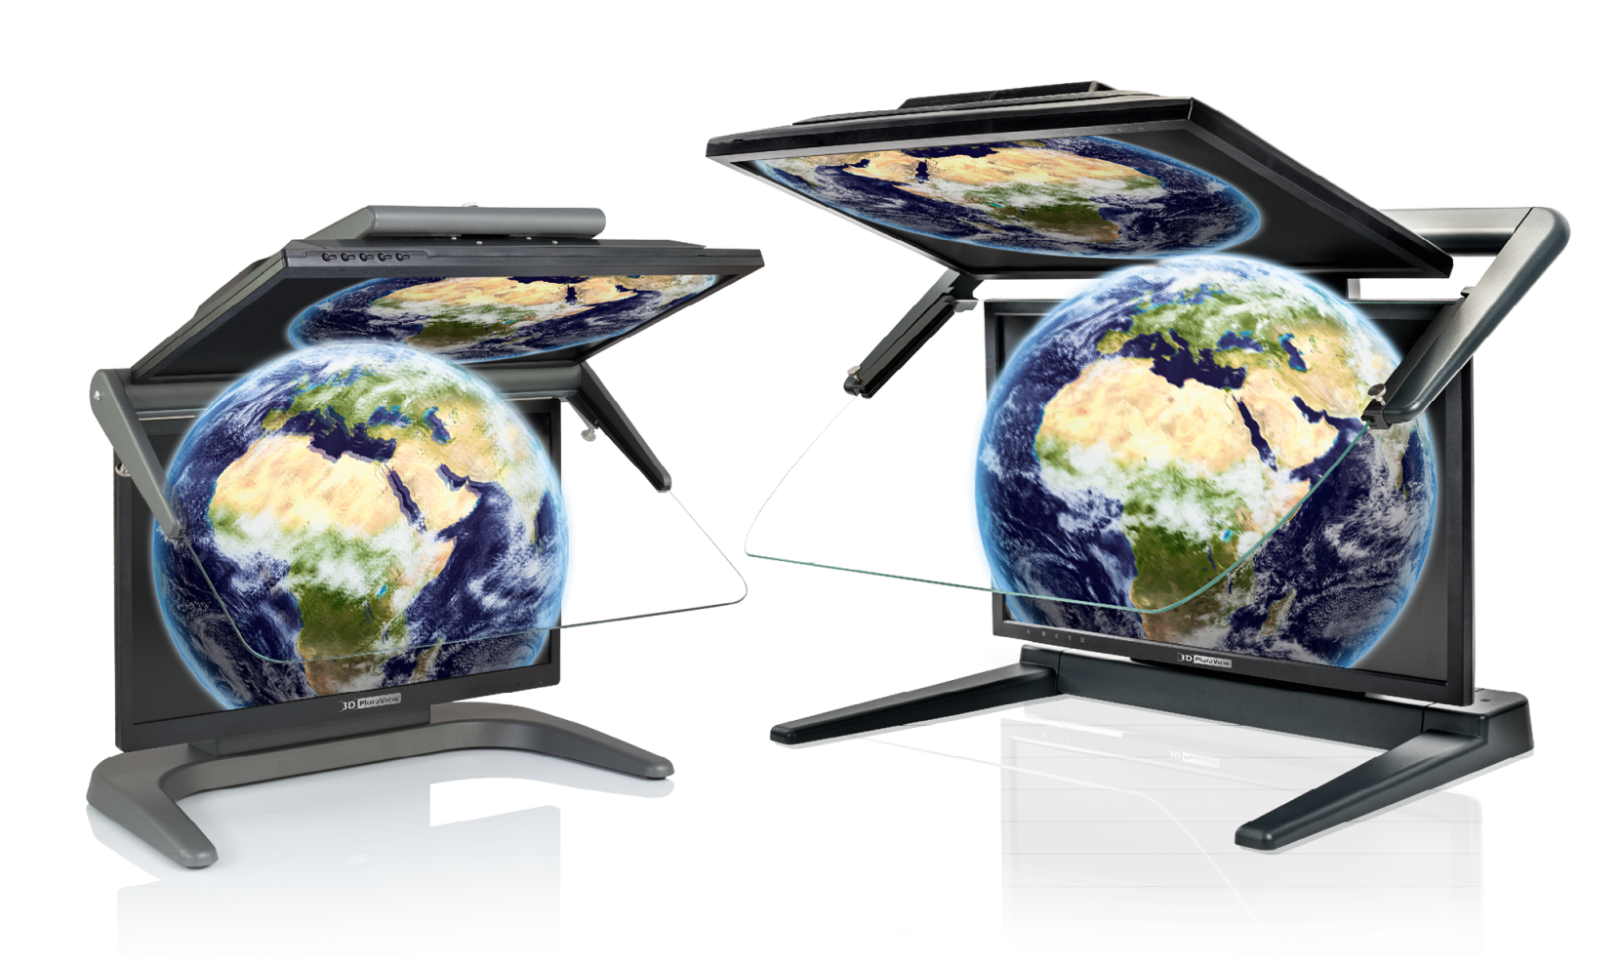
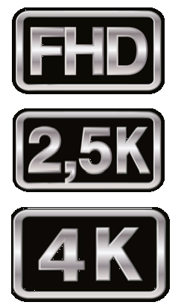
Two assembly sizes, three resolutions, four screen diagonals
22” & 24”
27”
28”

Slide 7
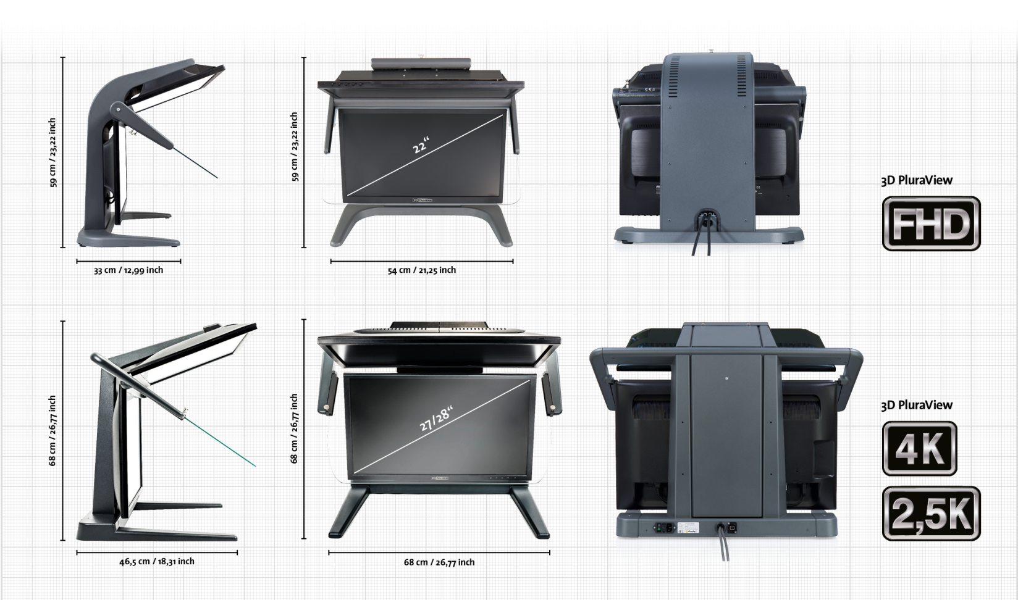
The 3D PluraView Family – Suitable for every requirement

Slide 8
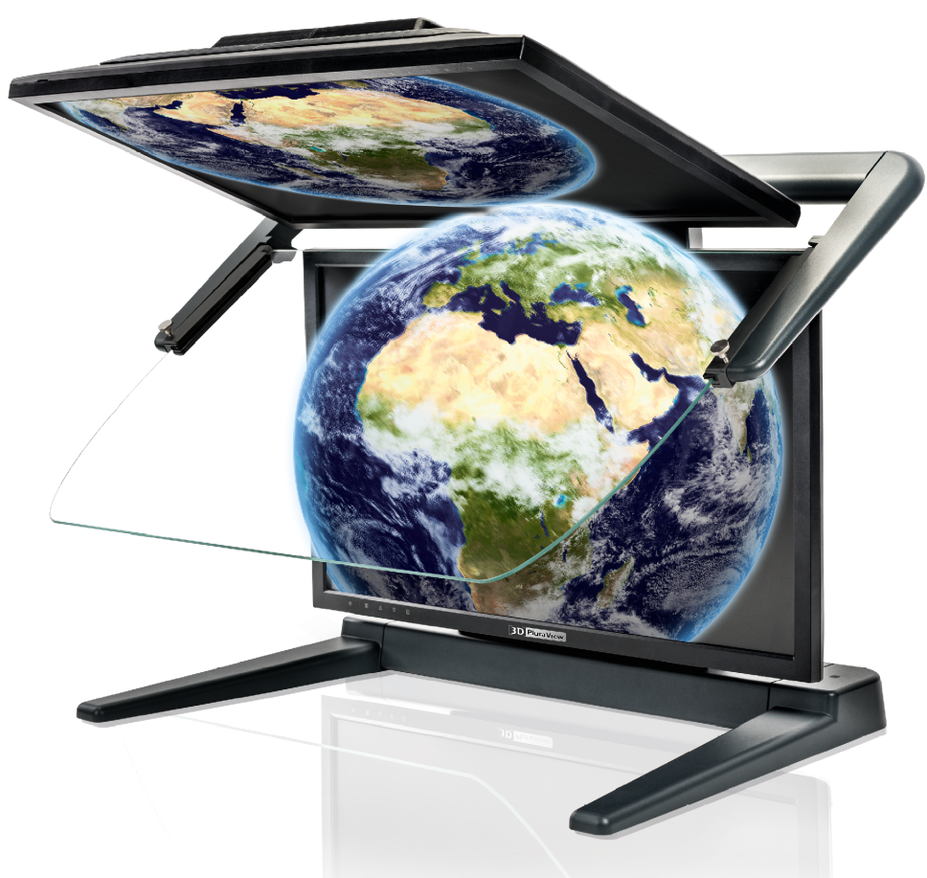

Application Areas
Perfect 3D-Stereo – High brightness & contrast, no flickering - fatigue-free
Biochemistry / Microscopy
Oil & Gas Reservoir Modeling
Simulation & VR Training
CGI / 3D Video Editing
Mechanical Design / CAD
Archeology
3D City Model Visualization
BIM & Laser Scanning (LiDAR)
Photogrammetry / Stereo Imagery
GIS / Mapping, 3D Data Integration
Medical: CT, MRI, Ultrasound for
Surgery Planning & Training
Bio-Tech / Molecular Chemistry

Slide 9

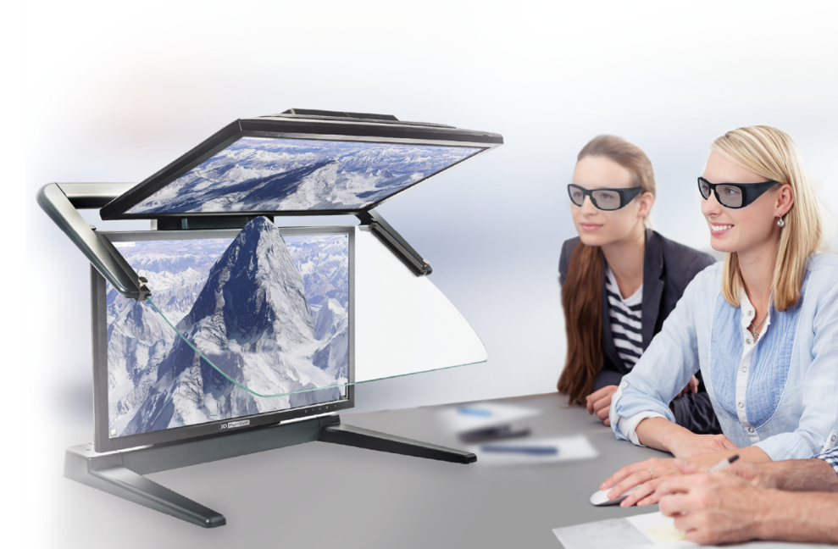
Limitations of alternative 3D Displays
Active LCD shutter glasses provide a comparatively dark 3D-stereo image → single screen and dark phase when switching
High-frequency shuttering strains the eyes and causes discomfort and fatigue over time
Head-Mounted Displays (HMD) are relatively heavy, can cause motion sickness, professional software currently have no data capture/data editing interfaces working with HMDs
Line-by-line polarized single screens only have 50% vertical resolution, i.e. pixel-accurate work is almost impossible, fonts and menus are hard to read
Autostereoscopic monitors work without glasses but have
fixed viewing locations, where the distance and
angle to the monitor allow stereo viewing.
Stereo with eye-tracking works only for a single user!

Slide 10
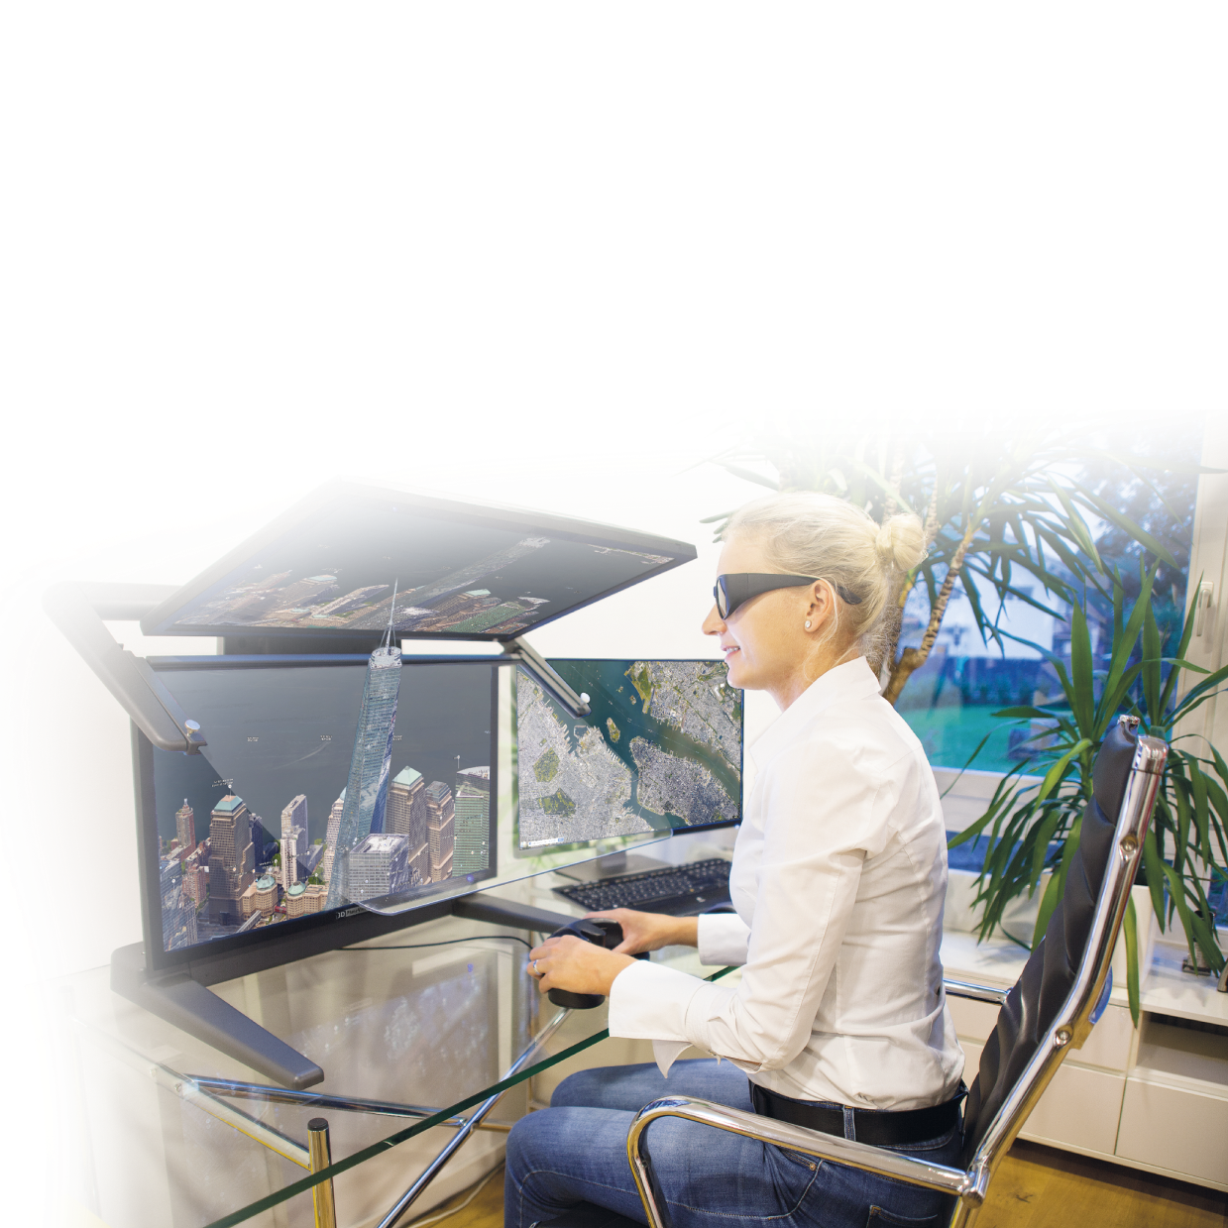
Advantages & Benefits
Choose the reference in stereo visualization!
Passive-stereo displays with dual screens are proven to be the best stereo desktop solution of all systems
3D PluraVIEW users can work relaxed in a normal office environment
due to the high image brightness
The flicker-free 3D-stereo display with up to 4K resolution
substantially increases user motivation and productivity
Many users have long-term experience with PLANAR and
PluraView stereo monitors since 2005
The 3D PluraView models with up to 4K resolution per screen
enable new functionalities in BIM, LiDAR and Medical applications
NEW! The VR PluraView with Head & Object Tracking as a professional addition to Head-Mounted Devices

Slide 11



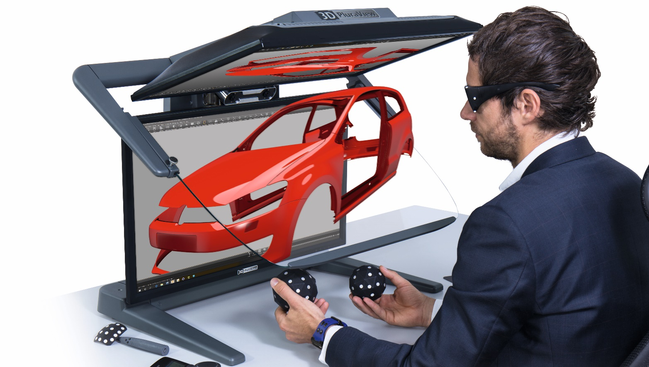
VR PluraView 4K
Multi-User interaction during VR Team-Meetings
Head & data glove tracking for an intuitive VR experience
Object manipulation with spheres and pens
Absolutely flicker-free for fatigue-free interaction
Maximum brightness for normal office environments
Complement the use of Head-Mounted Devices

Slide 12
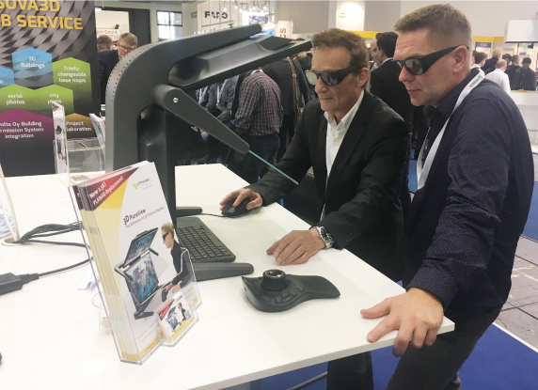
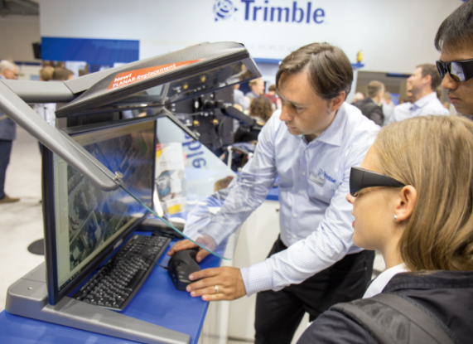
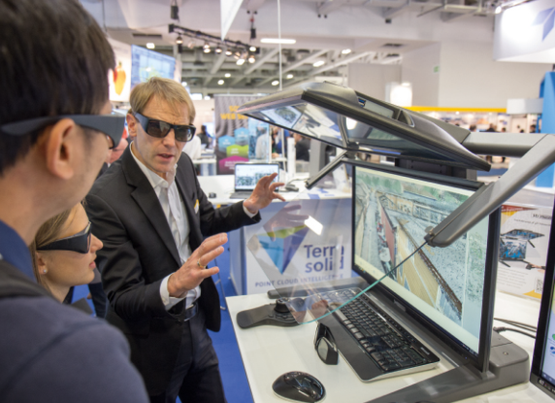
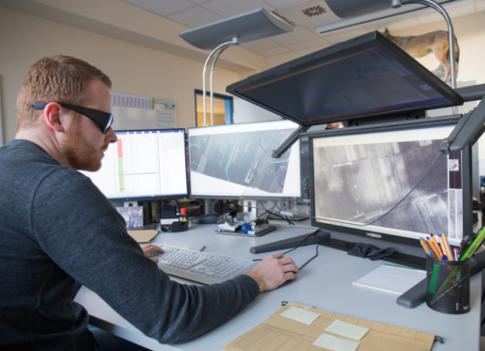
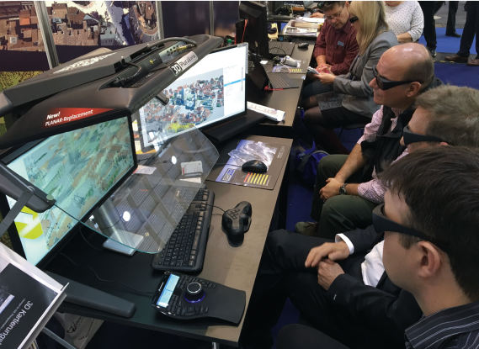
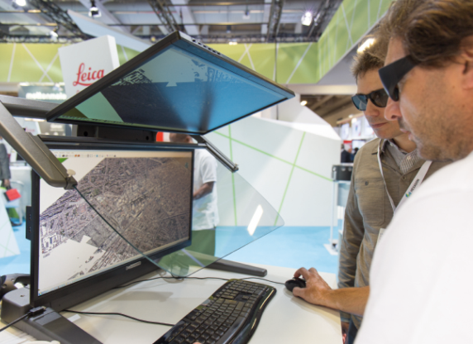
Application Examples & References
RhinoTerrain RhinoCity
Trimble DTMaster
Terrasolid TerraStereo
esri ArcGIS Pro
DAT/EM Summit Evolution
Leica Geosystems HxMap

Slide 13
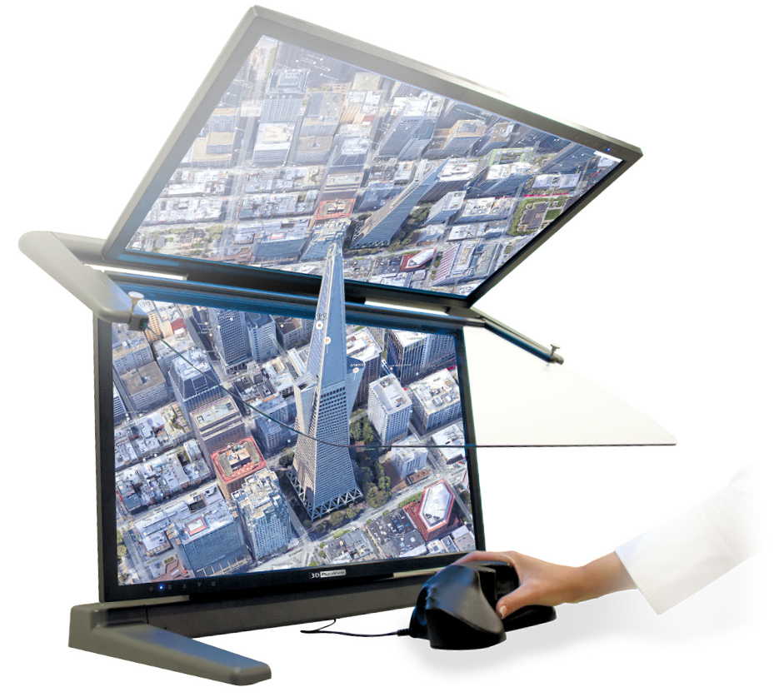


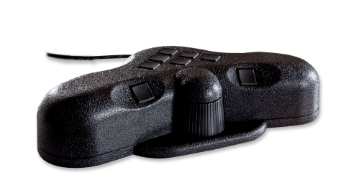
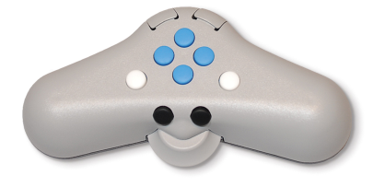
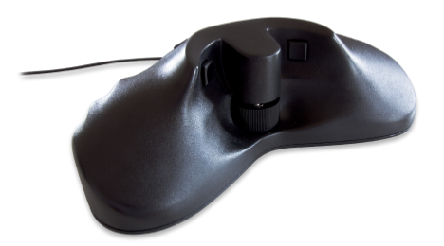
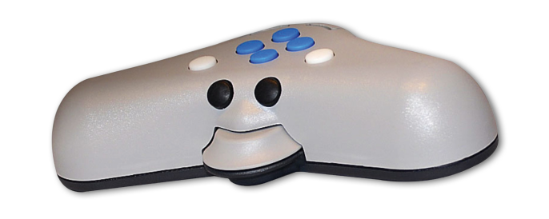
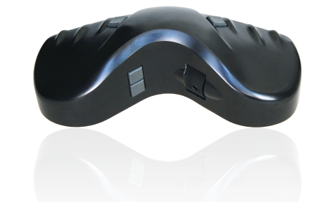
Complete Solutions – 3D Controllers
For GIS and Photogrammetry data capture

Slide 14

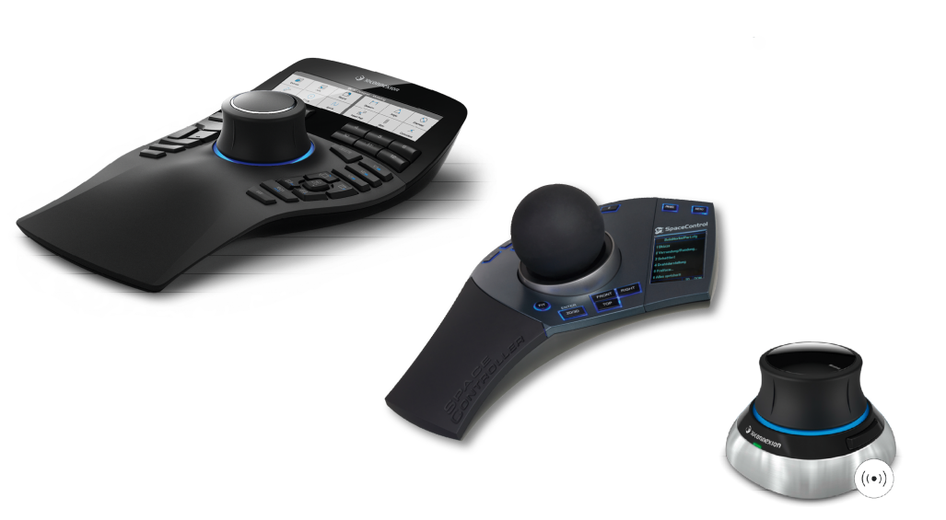
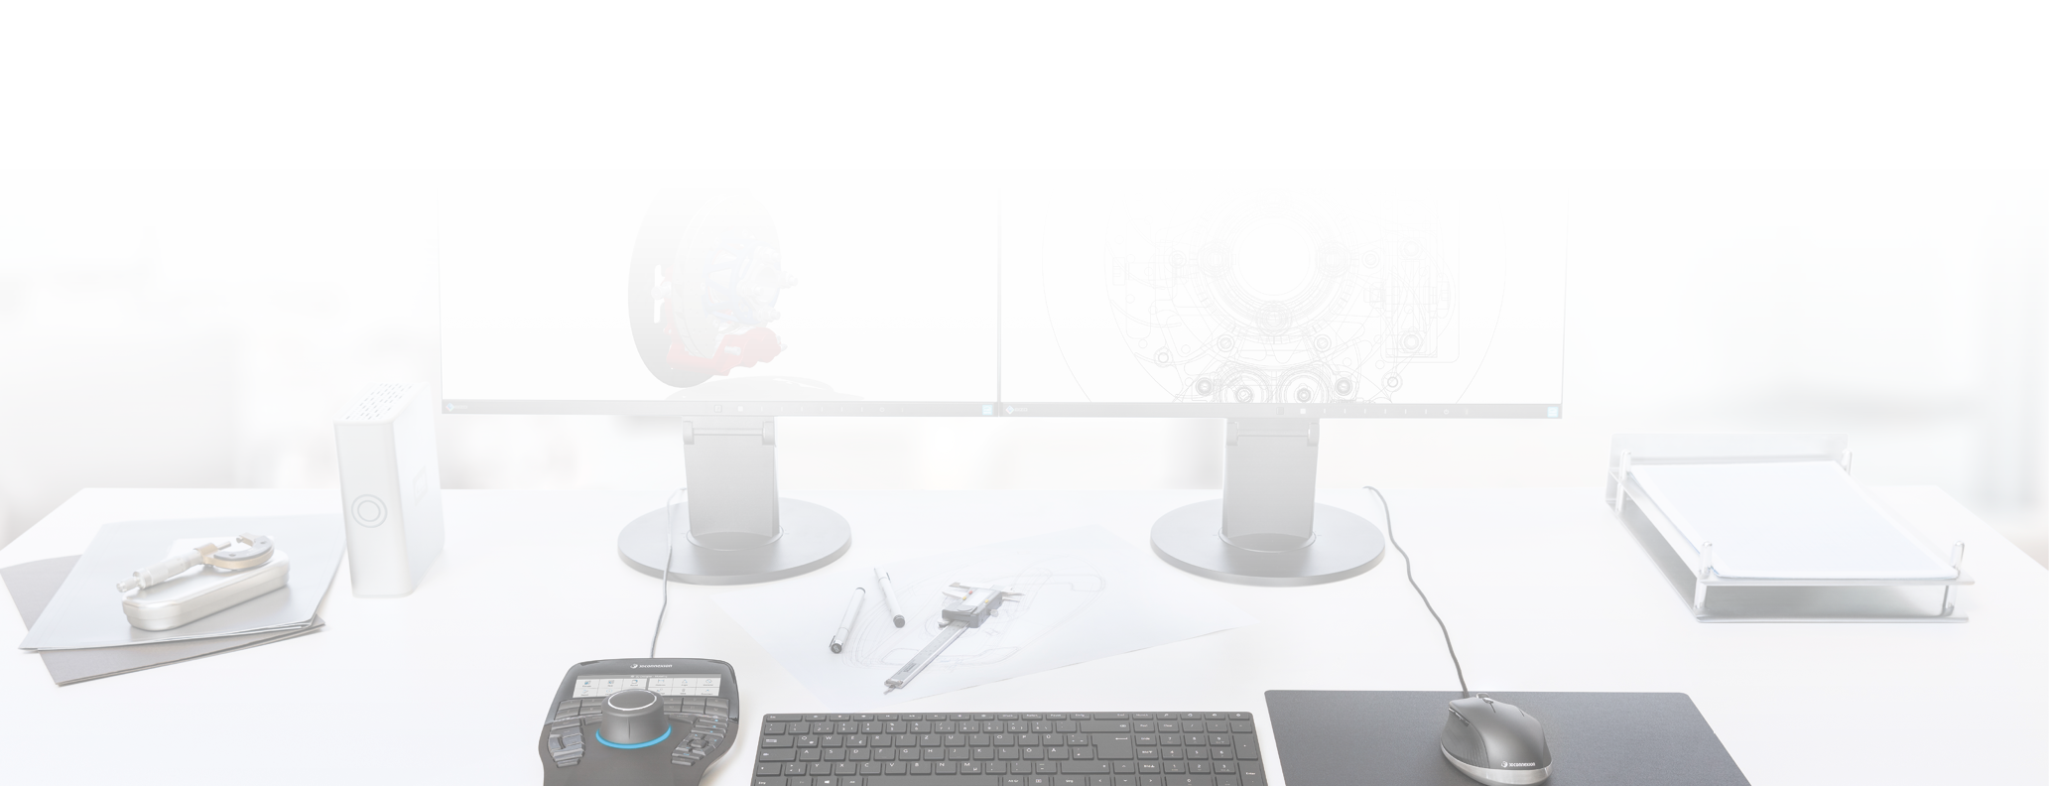


Complete Solutions – 3D Controllers
3D controllers for navigation in CAx and simulation environments

Slide 15
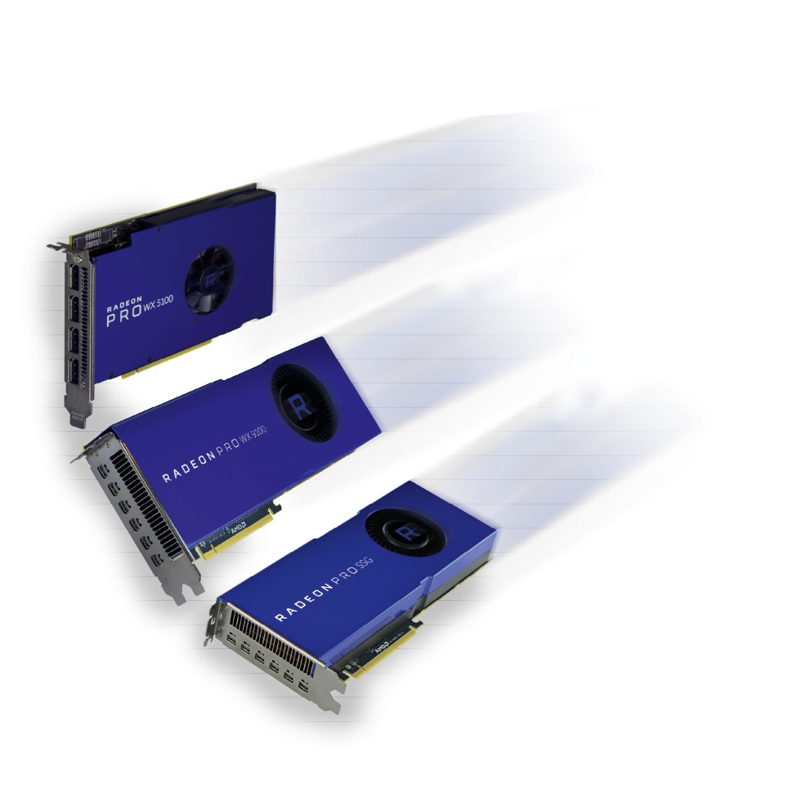
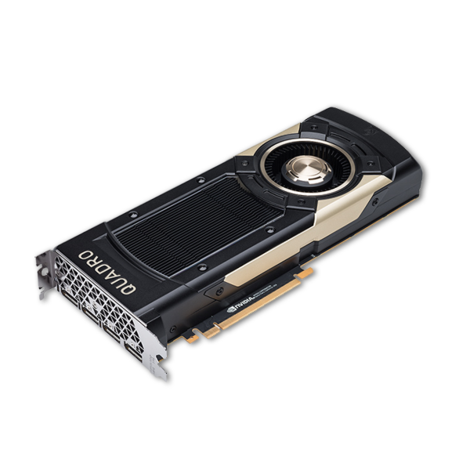

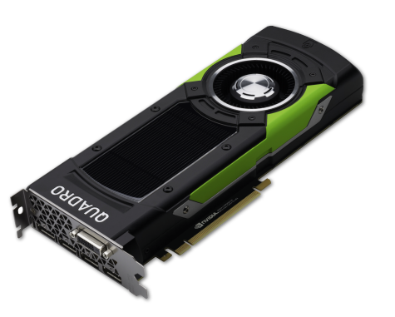






High-end graphic cards
AMD RadeonPRO & NVIDIA Quadro for quad-buffered stereo

Slide 16
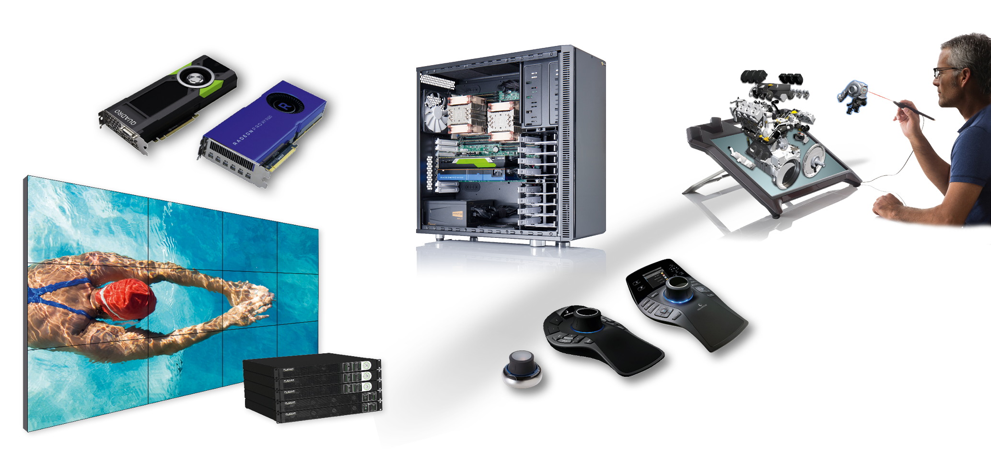
Schneider-Digital, the full-service solution provider for…
… for professional 4K, 3D and VR hardware

Slide 17

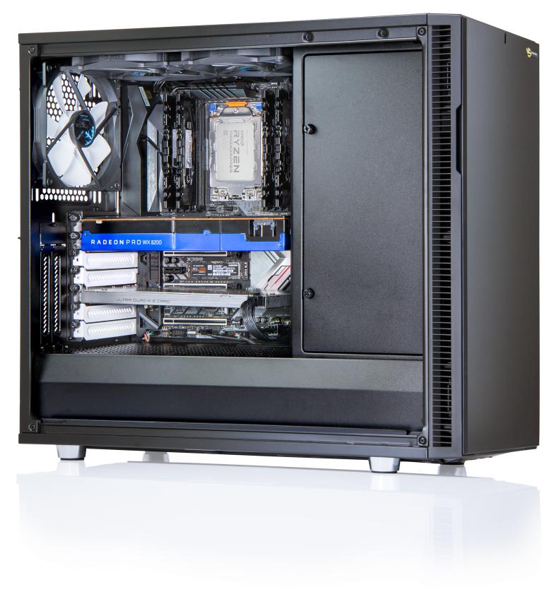



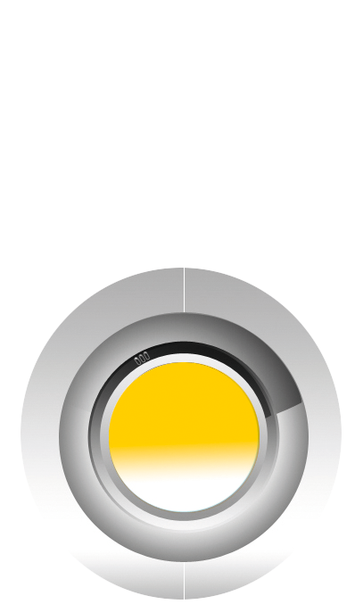
Performance-Workstations
High-End Workstation-Solutions for professional environments
Latest Intel Xeon, AMD EPYC or AMD Ryzen, AMD ThreadRipper processor technology
High-speed processors (up to 2x 28 cores on Intel platform, up to 2x 32 cores on AMD EPYC)
Up to 4 TB fast DDR-4 ECC memory
Up to four high-end graphics cards for CUDA
or OpenCL applications in a workstation
High performance RAID with up to 12 Gbps.
Transfer rate (SAS 3.0 technology) on request also
with lightning-fast SSD (Solid State Disks)
with up to 10 TB of disk space per unit
Optionally - ultra-fast 10 GBit LAN for connection
to file servers
Highest quality for all components
Offer includes server and cluster solutions

Slide 18
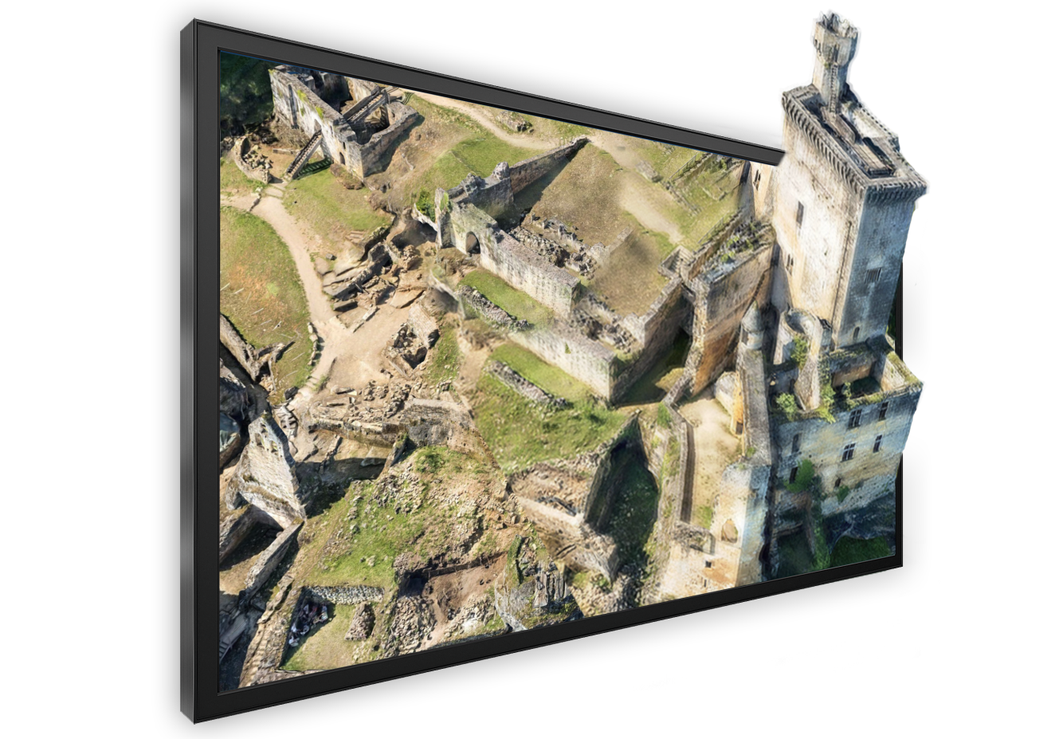

86“ 3D-Stereo Touchscreen (UHD, 4K)
Application areas:
Conference rooms
Events & Trainings
Hardware requirements:
Same as for the 3D PluraViews
Only requires a single DP cable
Software requirements:
Same as for the 3D PluraView
86“ LCD-Display
Size 2m x 1.15m
Passive 3D-Stereo und Tracking
32-point multi-touch system
Line-polarized
UHD (3.840 x 2.160) @ 60Hz

Slide 19
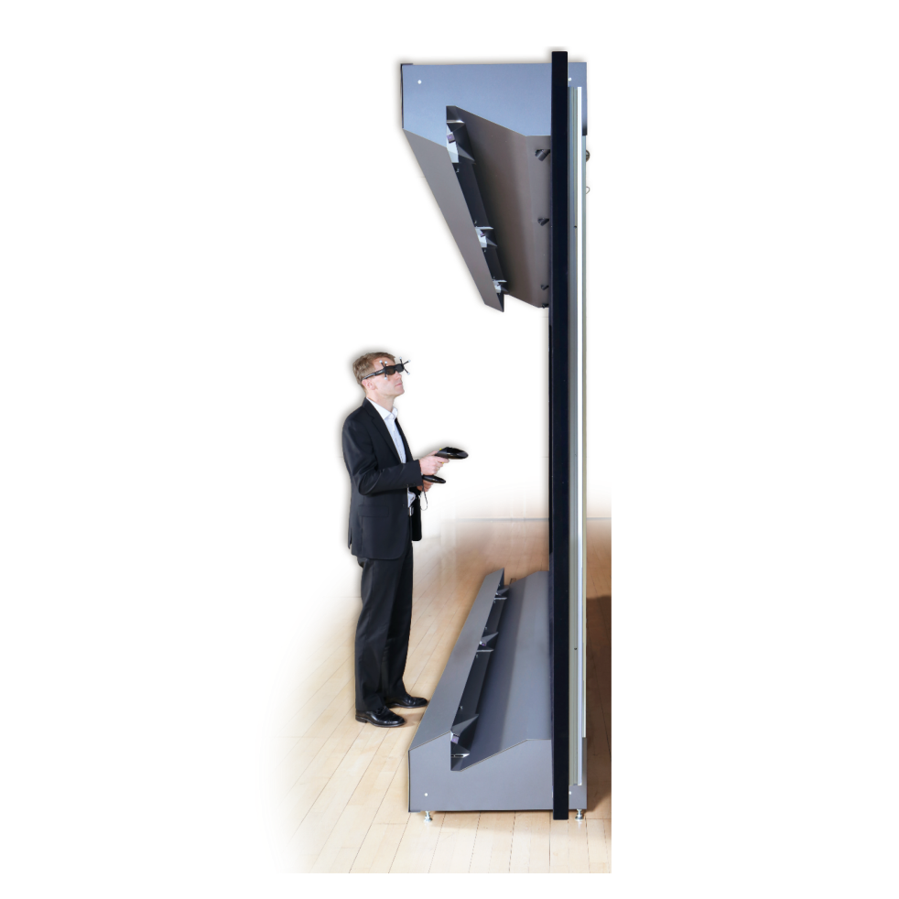
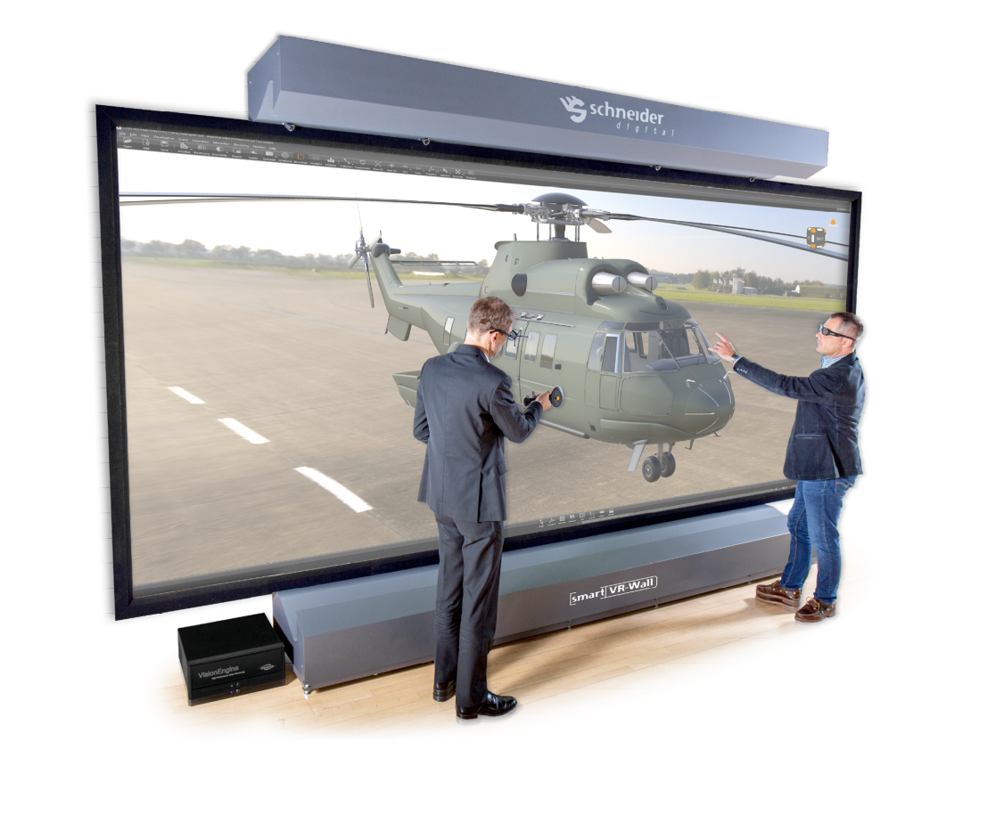

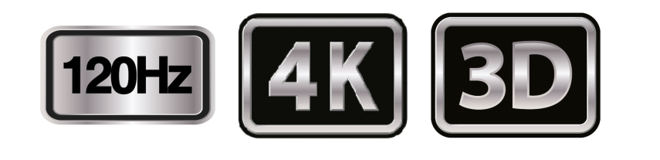
LASER smart VR wall
Cutting-edge laser projection technology
for a service life of more than 10 years
Highest brightness, six 4,000 ANSI lumen projectors
120 Hz technology
Full 4K resolution even in 3D stereo
Integrated wireless media control
Freestanding construction, only 70cm depth
for large-format, high-resolution 3D-stereo

Slide 20























































3D PluraView – Software & Partners
Some supported software applications
3d Zephyr STK Metashape SOCET GXP v4.5 Softpltter/KDSP Sci-X Summit Evolution ESPA 3D PyMOL sView
Stereo Analyst ArcGIS Pro OSGeo PurVIEW Maya MapInfo® Vertical Mapper™ TNTgis syngo.fourSight EON Reality
3DM Content Manager Premiere Pro Blender PMS3D Photomod StereoGIS Spidar JewelSuite RiSCAN Pro
Inpho KomVISH sure aerial / Pro Go2VR / D2P Photosoft GoCAD Kingdom VR Two Unity 3D
Open Source Project LiMON Viewer PRO Vizable uSmart LaserControl StereoCAD ContextCapture DPS / Delta AVIZO
Delmia HIM Creo View MCAD DeltaGen TerraStereo Rhino Precision 3D Topo WinATLAS Scene Micromap
More than 200 software applications supported!

Slide 21



















3D PluraView – Partners
Global Sales Partners
TerraStereo DAT/EM Systems SOLITECH AD Agisoft LLC South Schnell Tech GeoDyn Technology
Swift Integrator SARL RhinoTerrain Brisight Technology Wipco 3D Kelyn Technologies IGI – Integrated Geospatial
Pte Ltd & Solutions Innovations
DS Deutsche TP Holdings Japan Steinbacher-Consult AirborneHydroMapping TVISCompany, Geomatika Smolčak
Systemhaus GmbH Ingenieurgesellschaft GmbH LLC. doo
mbH & Co. KG

Slide 22
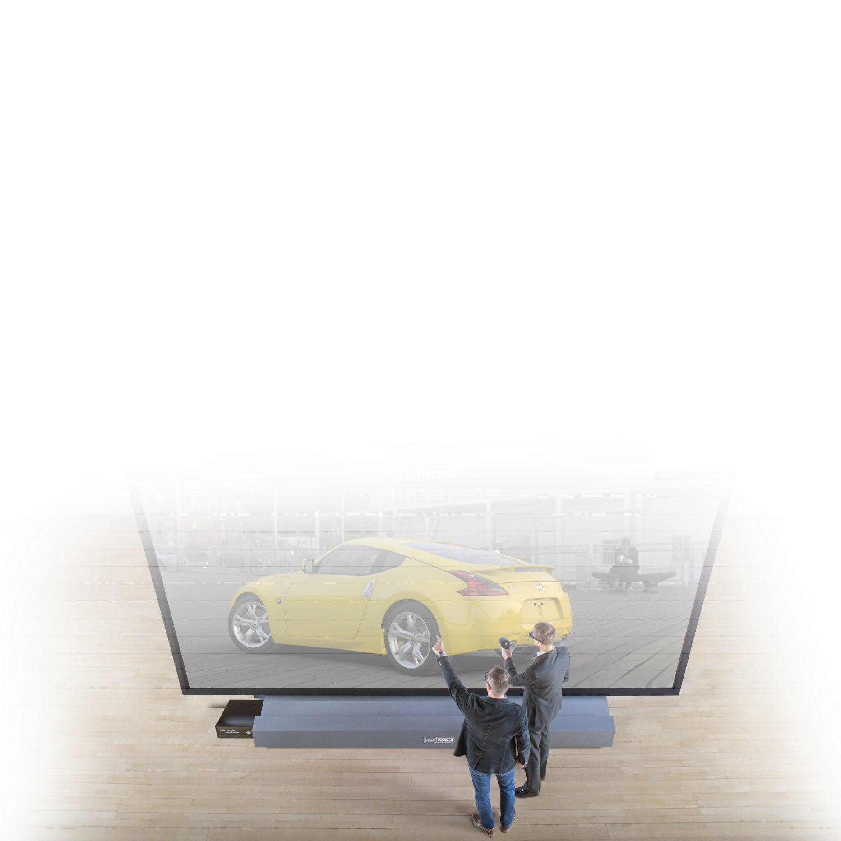

International References

