Slide 2
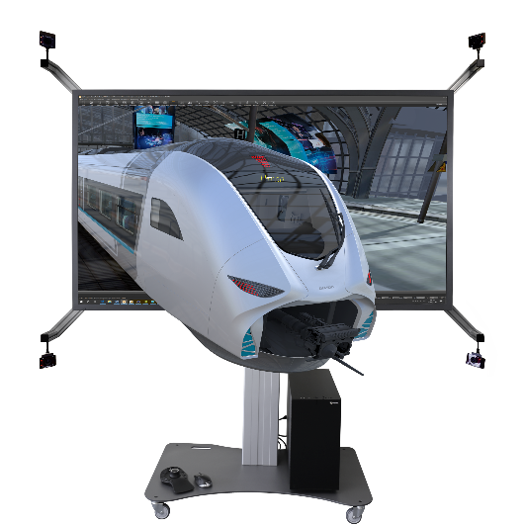
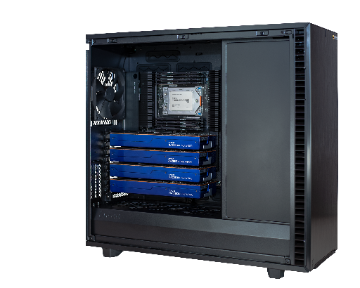
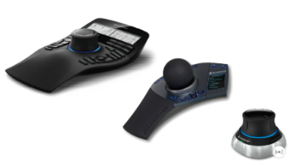
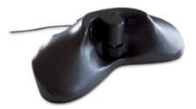
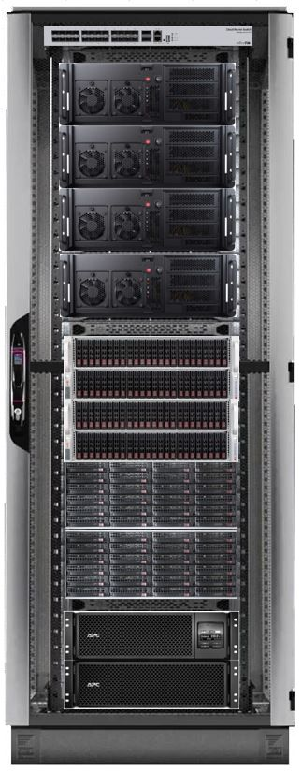
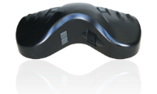
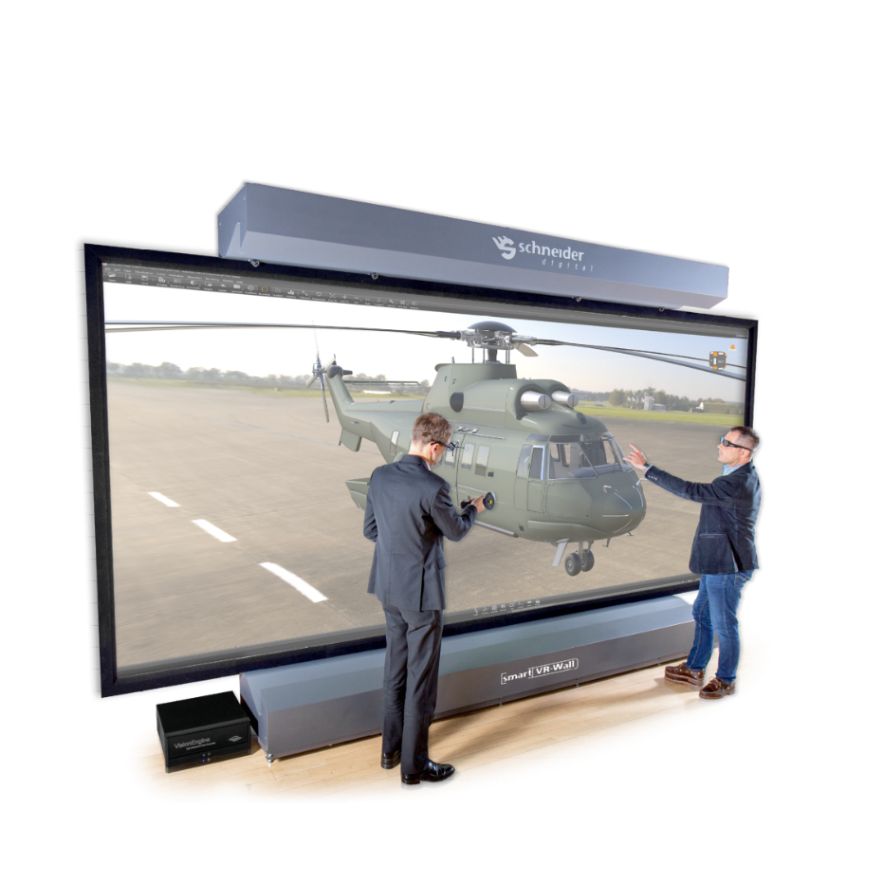
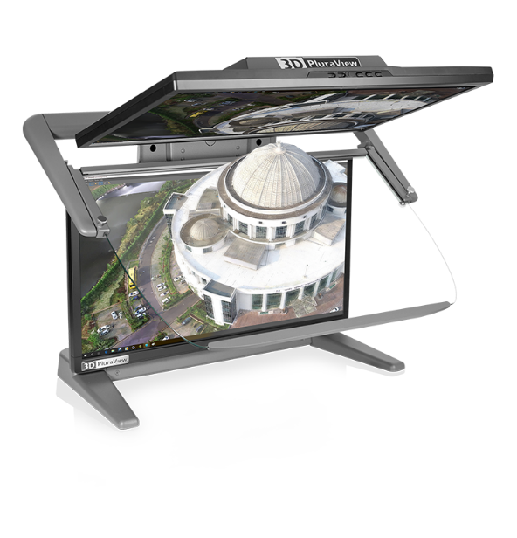
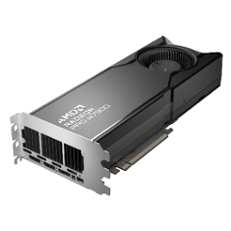
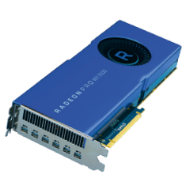
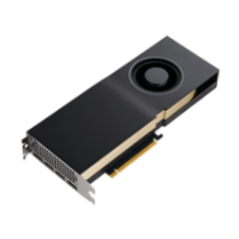
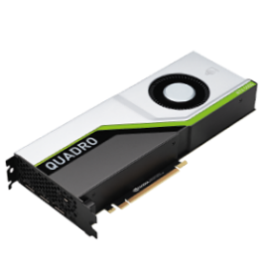
We are – a full-service GeoIT hardware provider
… for professional 4K, 3D-display and GeoIT hardware

Slide 3



Schneider Digital – 25 years of professional hardware experience
Full-Service provider for professional 4K / 8K, 3D- and VR-Hardware
More than 25 years of experience in graphics- und high-performance hardware solutions
More than 15 years of experience with 3D-stereoscopic monitors and desktop VR systems
Manufacturers of the 3D PluraView dual-screen stereoscopic Monitors since 2016
Integrator for multi-monitor display walls und VR rooms, manufacturer for smartVR and smart3D projection walls

Slide 4

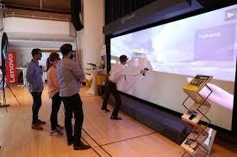
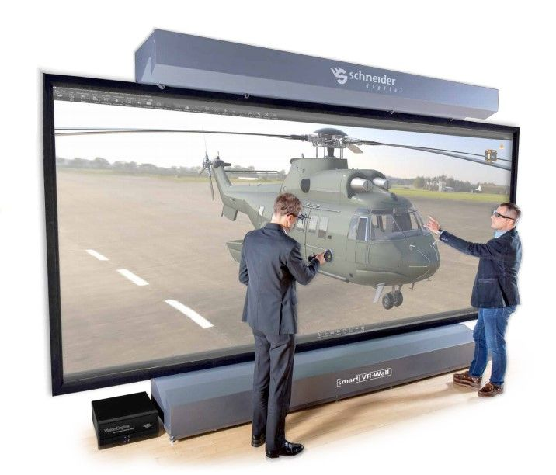
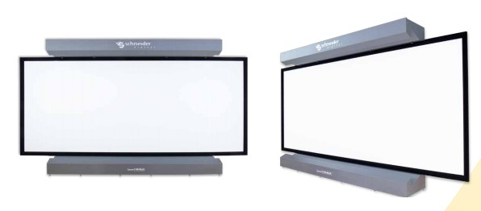
10 years of experience with Projection 3D stereo systems
2010
2016
2021
smartVR Wall Gen1
1500 ANSI Lumen per sq.m.
4K resolution, >8MPx
smartVR Wall Gen2
2000 ANSI Lumen per sq.m.
4K resolution, >8MPx
smartVR / smart3D Wall Gen3
2300 ANSI Lumen per sq.m.
6K resolution (>12 MPx)

Slide 5
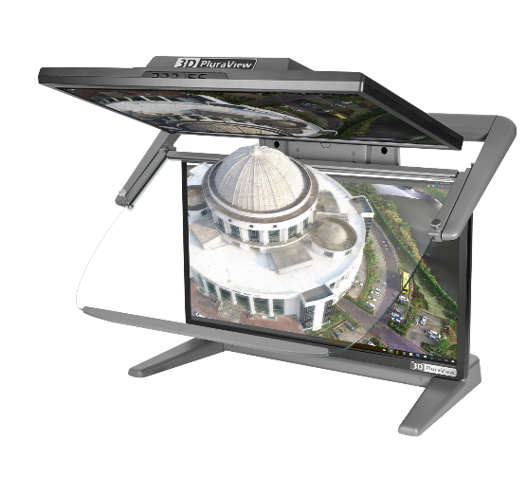
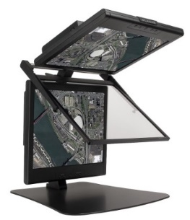
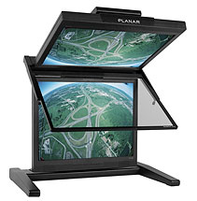
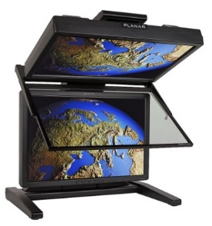
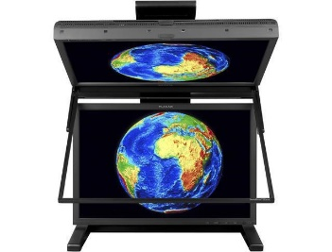


Digital Photogrammetry – 18 years of passive displays… and counting
Compatible with all operating systems – from Windows XP to Windows 11
PLANAR SD monitors and the Schneider Digital 3D PluraView
use the ‚passive Stereo‘ principle with dual screens for full stereo resolution per eye
and passive (no batteries), cross-polarized glasses.
very light-weight, comfortable glasses no flickering no headaches
bright & contrast-rich image daylight compatible
2005
2016
^{2022, 2023, 2024,…}
3D PLANAR
SD1710
3D PLANAR
SD2020
3D PLANAR
SD2220
3D PLANAR
SD2420W
22“, 24“ and 27“, 28“

Slide 6


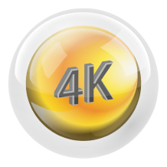


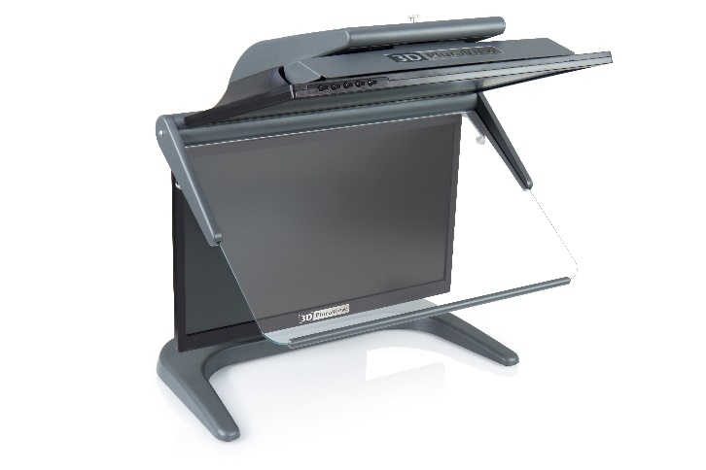




Meeting the highest requirements for all 3D stereo applications!
Flicker-Free
Highest Resolution
Daylight Suitable
Compact Assembly
2D Display: Beamsplitter up
3D Stereo: Beamsplitter down
Plug & Play
Native Software Certified
Functional Design
Wide Viewing Angle

Slide 7
Meeting the highest requirements for all 3D stereo applications!
Highest Resolution
Flicker-Free
Daylight Suitable
2D Display: Beamsplitter up
3D Stereo: Beamsplitter down
Compact Assembly
Native Software Certified
Wide Viewing Angle
Functional Design
Plug & Play

Slide 8
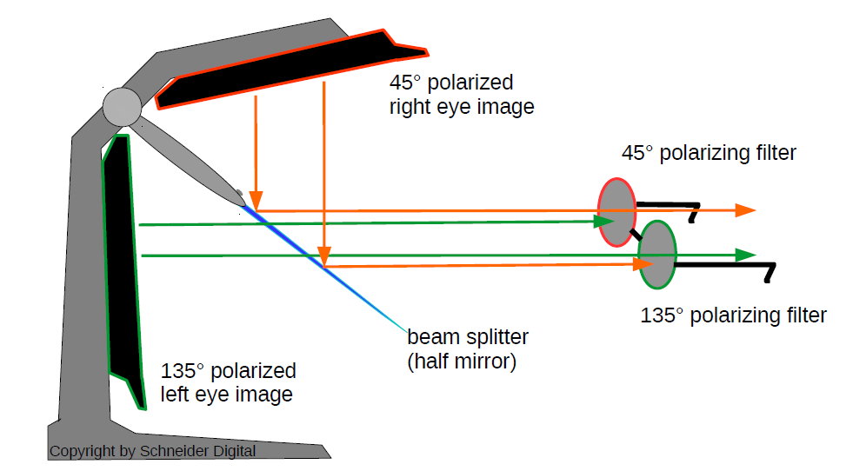
Functioning principle for passive, dual screen 3D stereo monitors

Slide 9
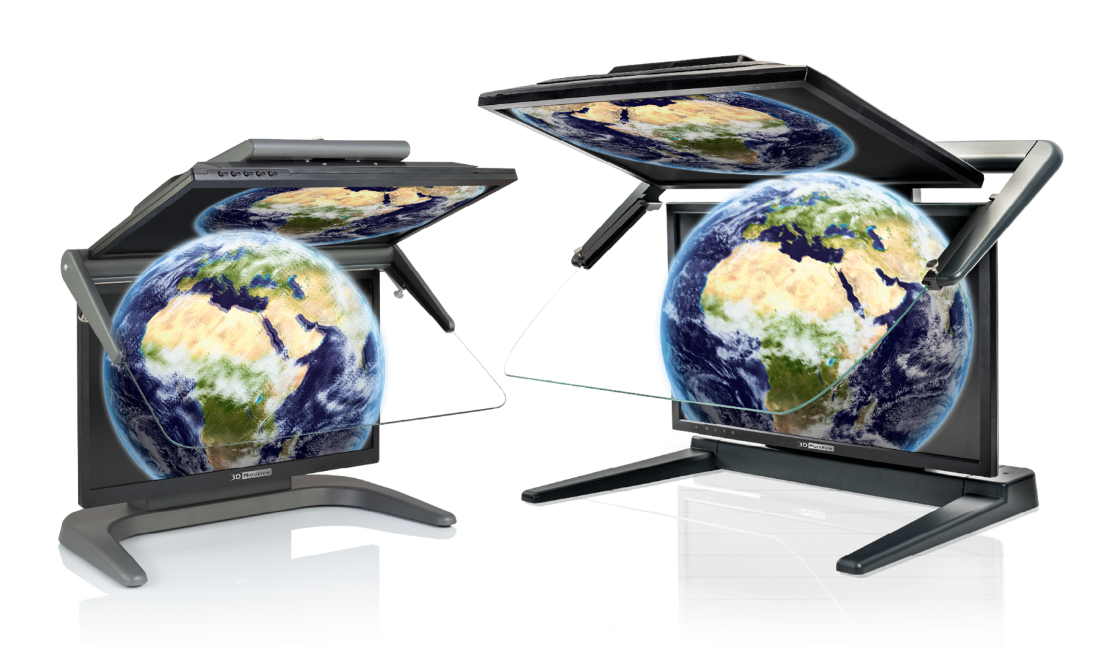
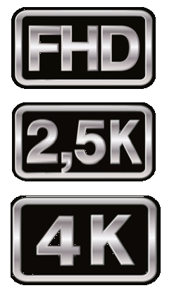
Two assembly sizes, three resolutions, four screen diagonals
22” & 24”
27”
28”

Slide 10
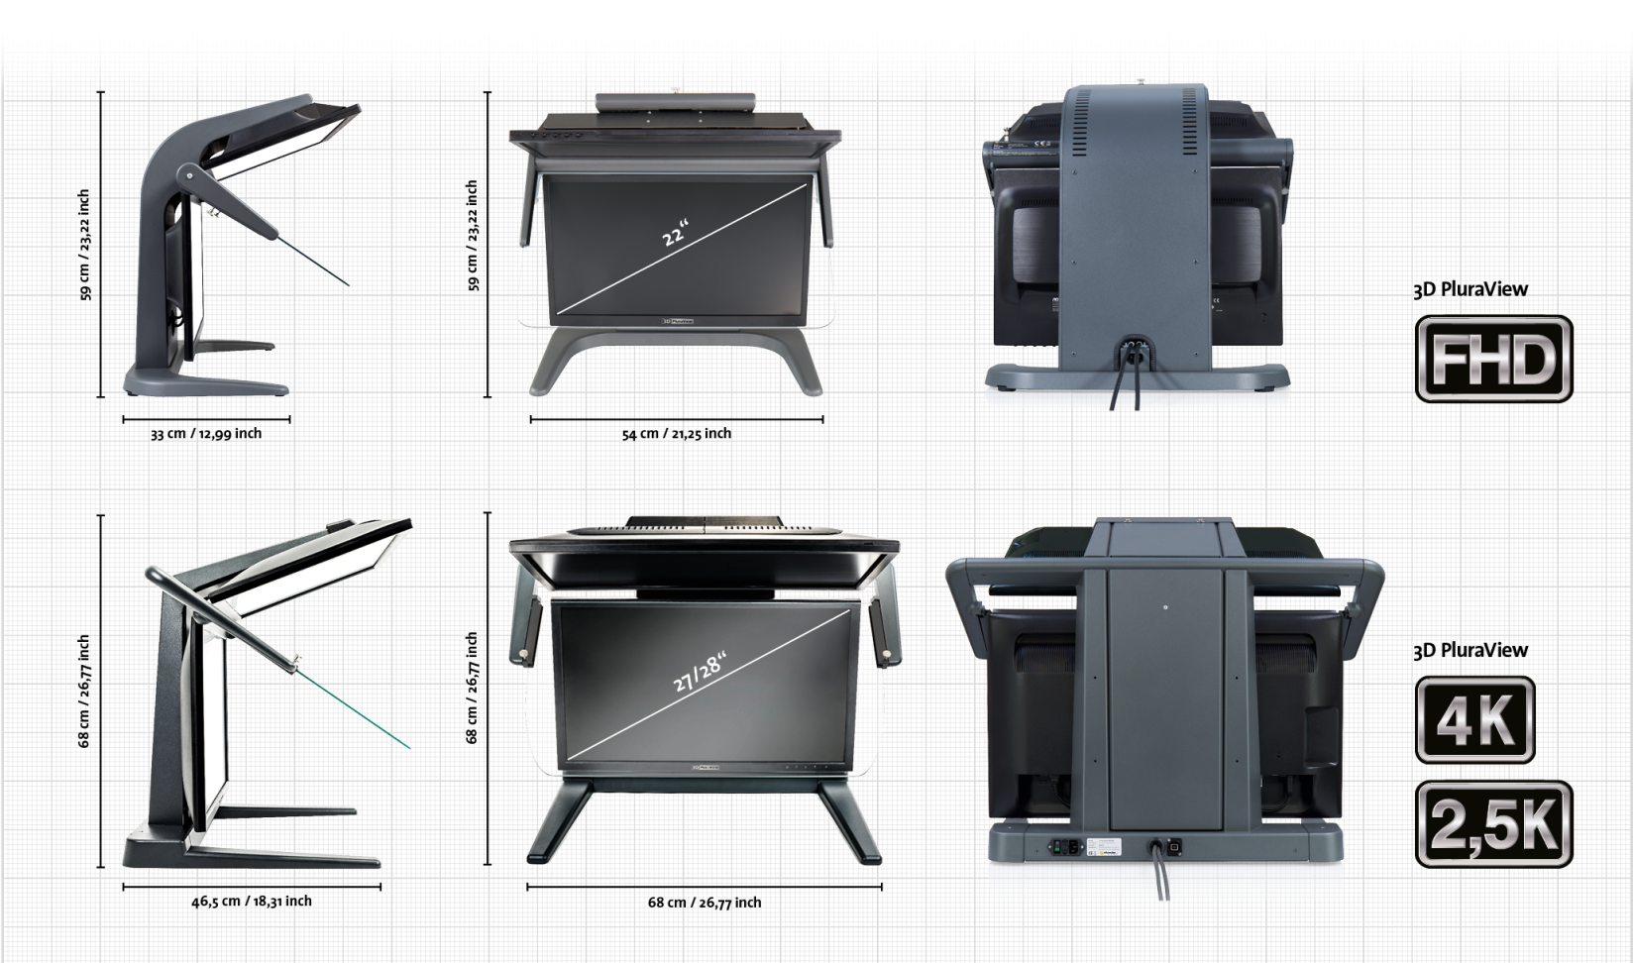
The 3D PluraView Family – Suitable for every requirement

Slide 11
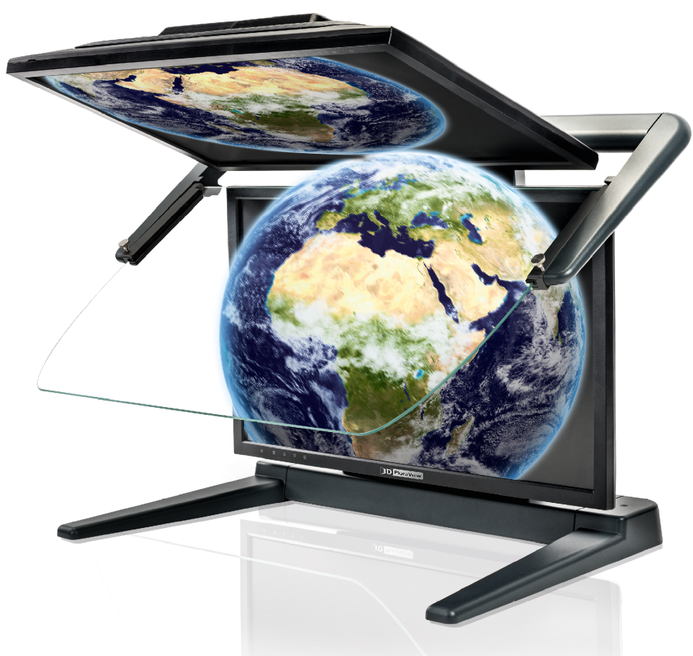

Application Areas
Perfect 3D-Stereo – High brightness & contrast, no flickering - fatigue-free
Biochemistry / Microscopy
Oil & Gas Reservoir Modeling
Simulation & VR Training
CGI / 3D Video Editing
Mechanical Design / CAD
Archeology
3D City Model Visualization
BIM & Laser Scanning (LiDAR)
Photogrammetry / Stereo Imagery
GIS / Mapping, 3D Data Integration
Medical: CT, MRI, Ultrasound for Education & Surgery Planning
Bio-Tech / Molecular Chemistry

Slide 12

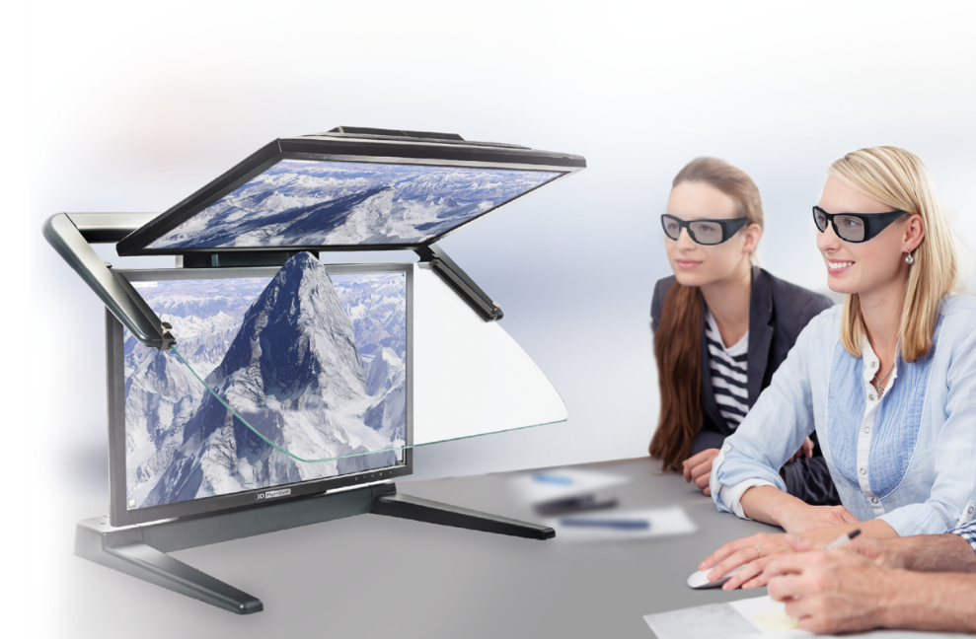
Limitations of alternative 3D Desktop Displays
Active LCD shutter glasses provide a comparatively dark 3D-stereo image → single screen and dark phase when switching
High-frequency shuttering strains the eyes and causes discomfort and fatigue over time
Head-Mounted Displays (HMD) are relatively heavy, can cause motion sickness, professional software currently have no data capture/data editing interfaces working with HMDs
Line-by-line polarized single screens only have 50% vertical resolution, i.e. pixel-accurate work is almost impossible, fonts and menus are hard to read
Autostereoscopic monitors work without glasses but have fixed viewing locations, where the distance and angle to the monitor allow stereo viewing.

Slide 13
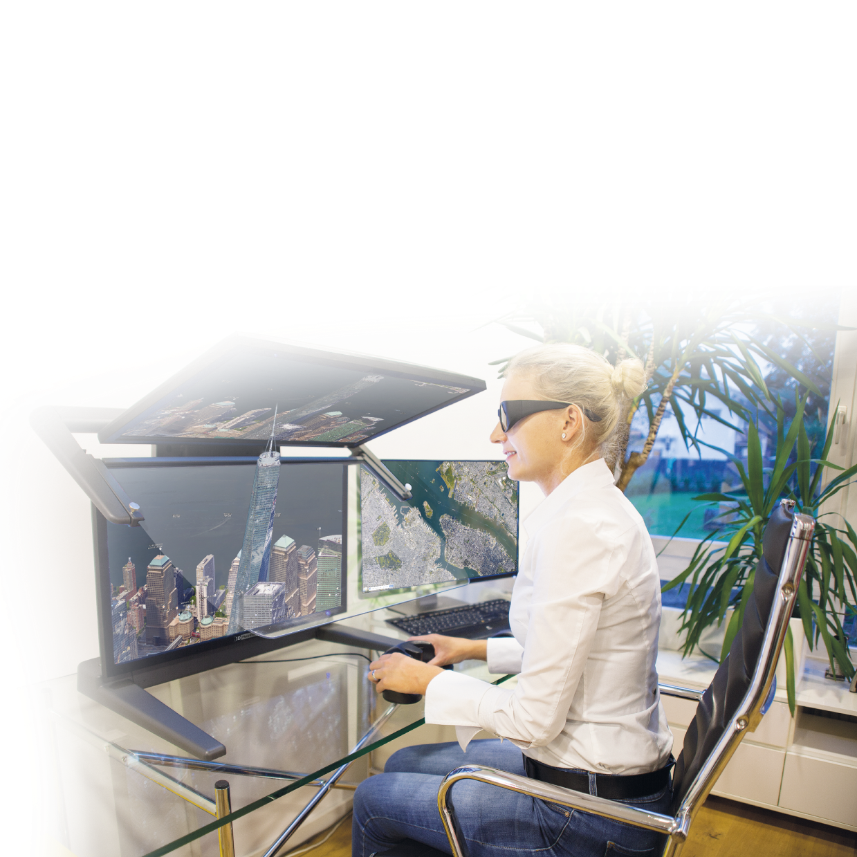
Advantages & Benefits
Choose the reference in stereo visualization!
Passive-stereo displays with dual screens are proven to be the best stereo desktop solution of all systems
3D PluraVIEW users can work relaxed in a normal office environment due to the high image brightness
The flicker-free 3D-stereo display with up to 4K resolution substantially increases user motivation and productivity
Many users have long-term experience with PLANAR and
PluraView stereo monitors since 2005
The 3D PluraView models with up to 4K resolution per screen enable new functionalities in BIM, LiDAR and Medical applications
NEW! The VR PluraView with Head & Object Tracking as a professional addition to Head-Mounted Devices

Slide 14



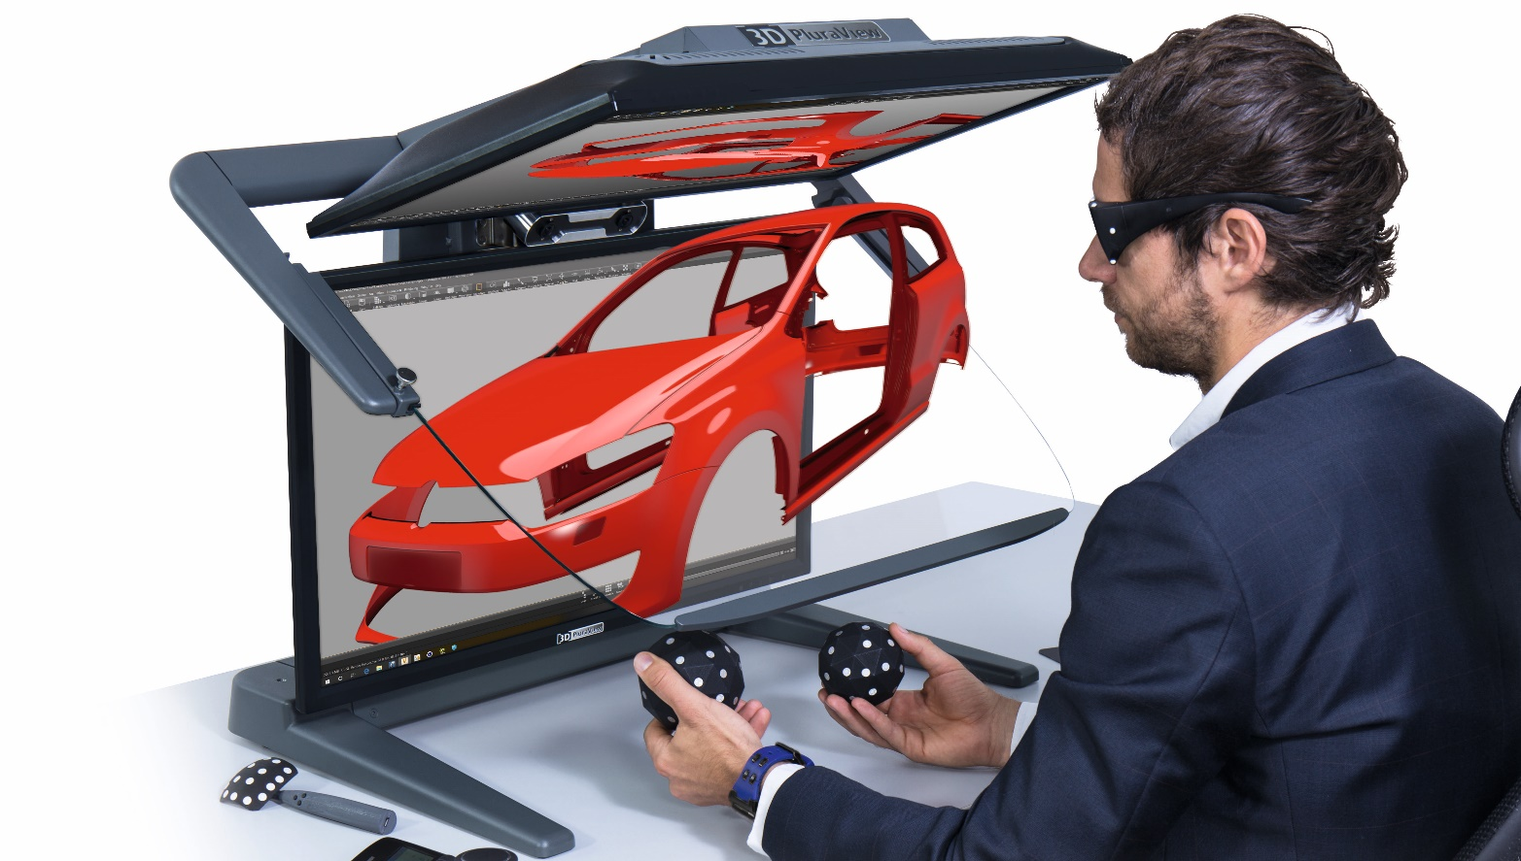
VR PluraView 4K
Multi-User interaction during VR Team-Meetings
Head & data glove tracking for an intuitive VR experience
Object manipulation with spheres and pens
Absolutely flicker-free for fatigue-free interaction
Maximum brightness for normal office environments
Complement the use of Head-Mounted Devices

Slide 15


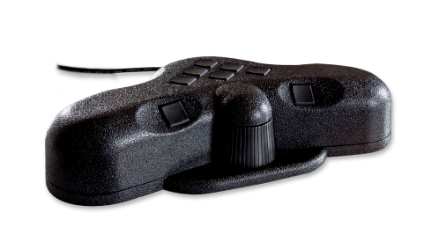
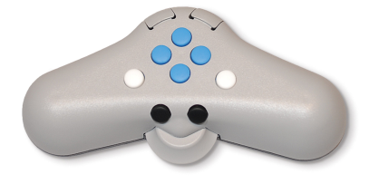
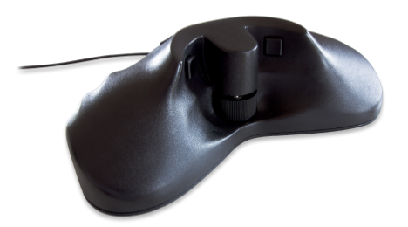
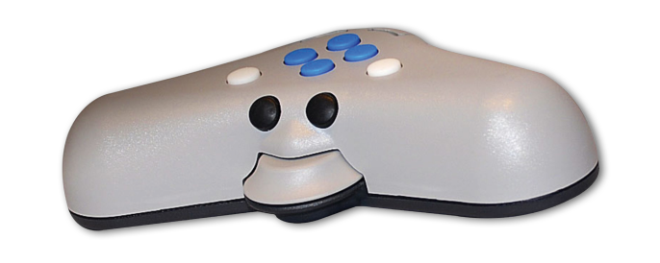
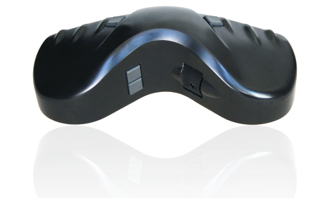
Complete Solutions – 3D Controllers
For GIS and Photogrammetry data capture

Slide 16

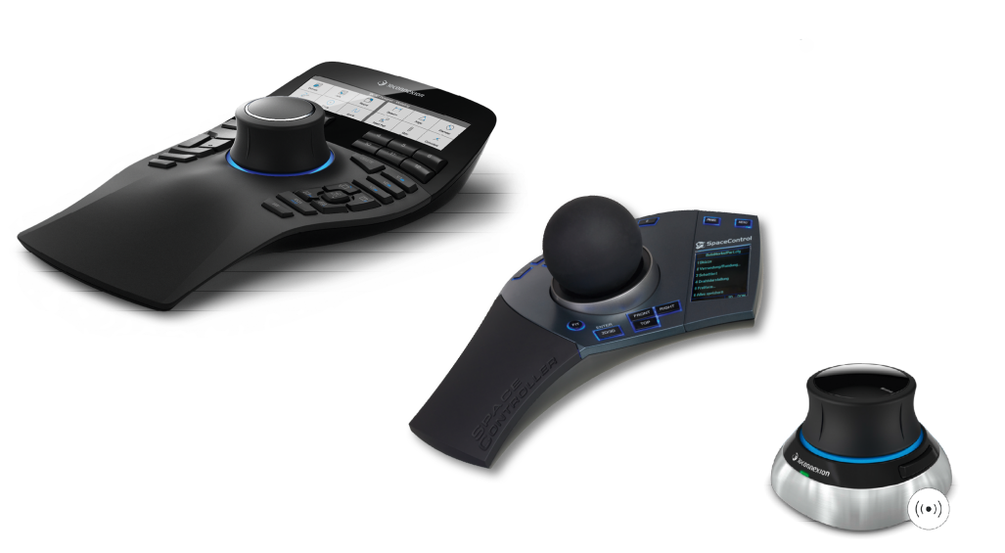
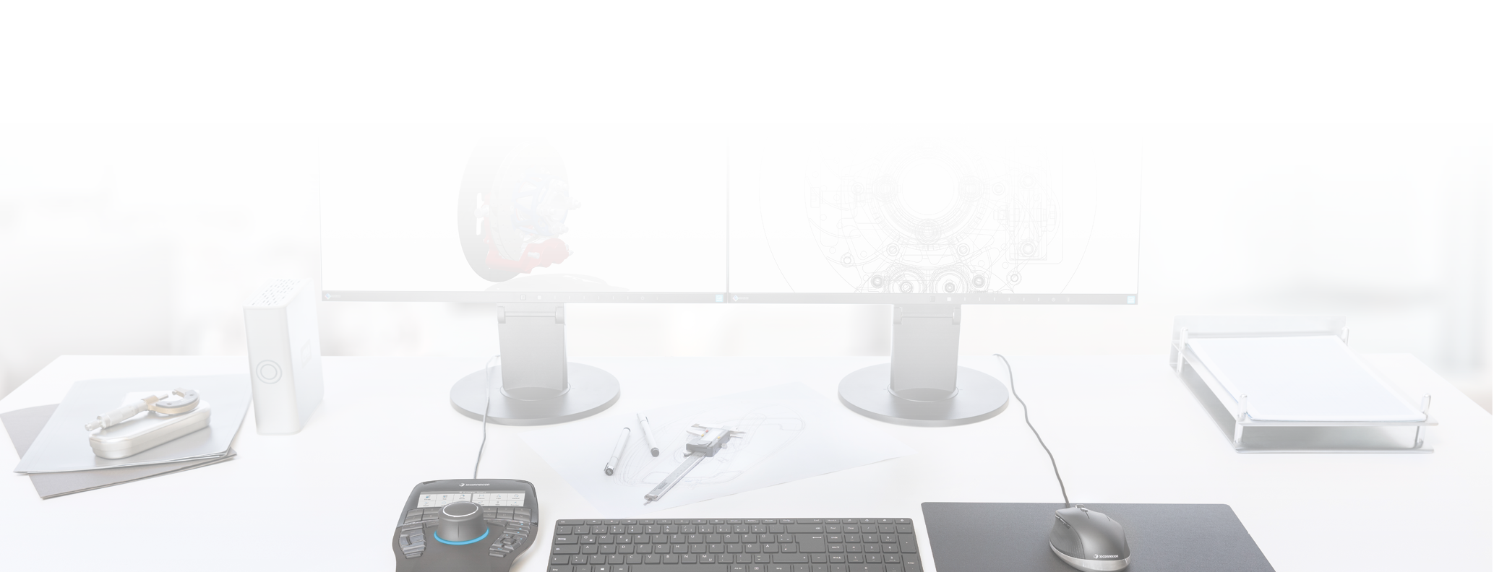


Complete Solutions – 3D Controllers
3D controllers for navigation in CAx and simulation environments

Slide 17
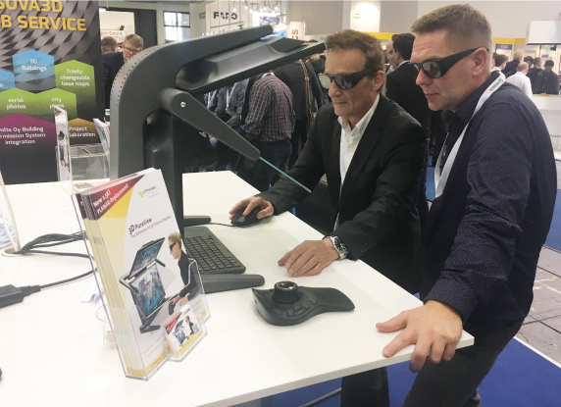
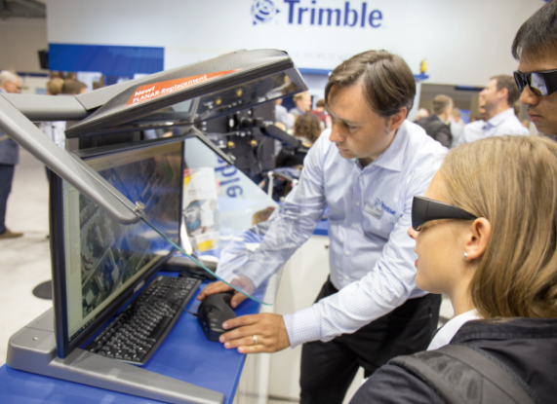
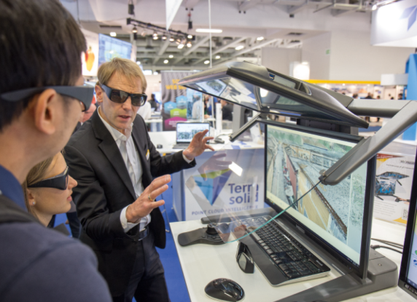
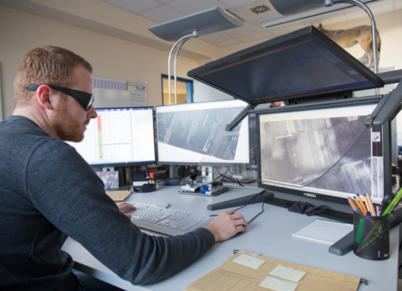
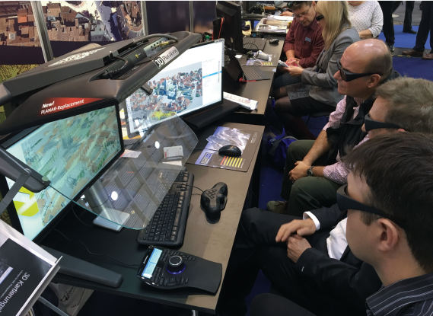
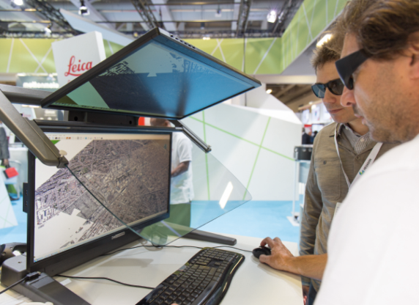
Application Examples & References
RhinoTerrain RhinoCity
Trimble DTMaster
Terrasolid TerraStereo
esri ArcGIS Pro
DAT/EM Summit Evolution
Leica Geosystems HxMap

Slide 18
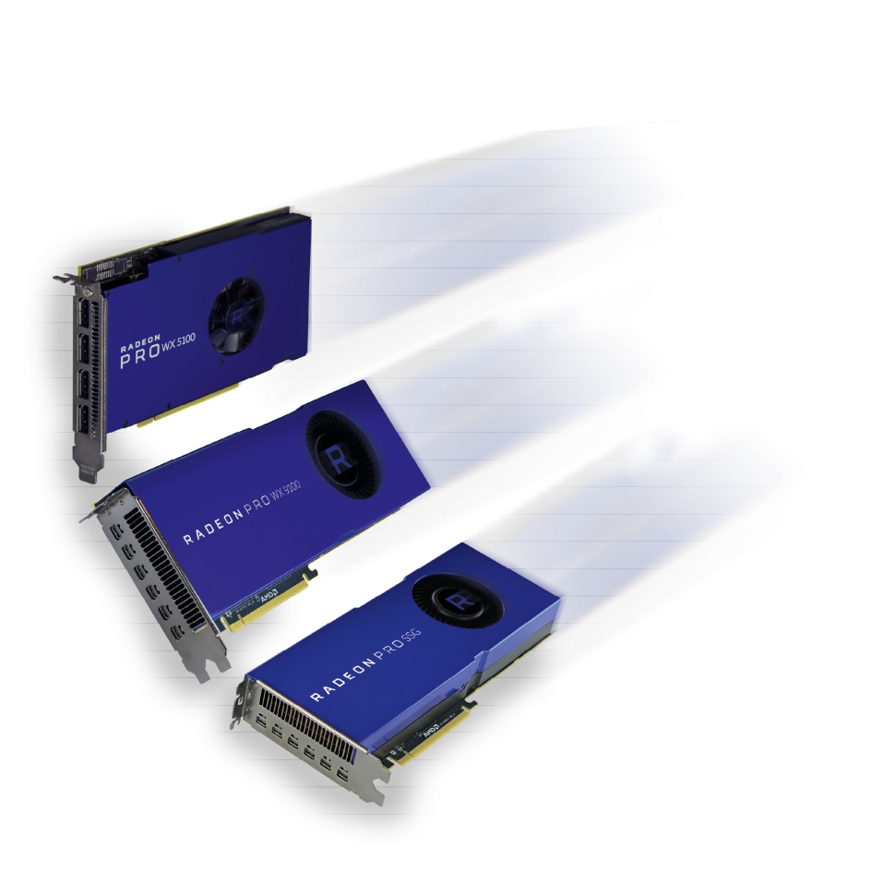
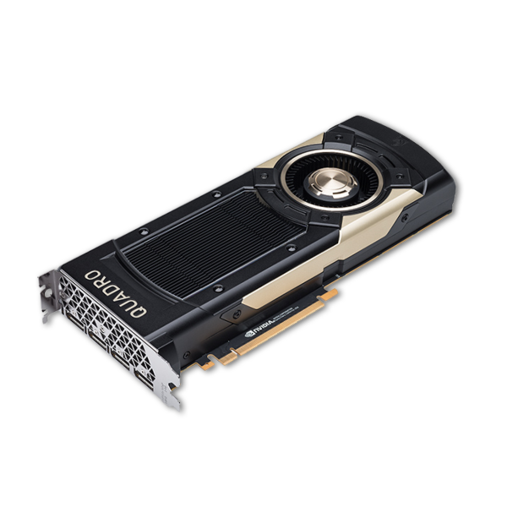

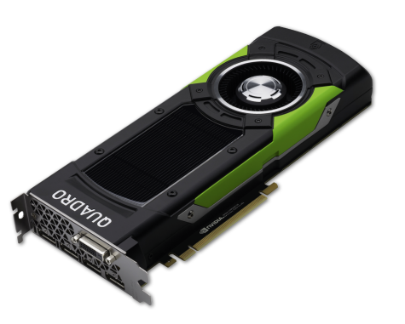






High-end graphic cards
AMD RadeonPRO & NVIDIA Quadro for quad-buffered stereo

Slide 19
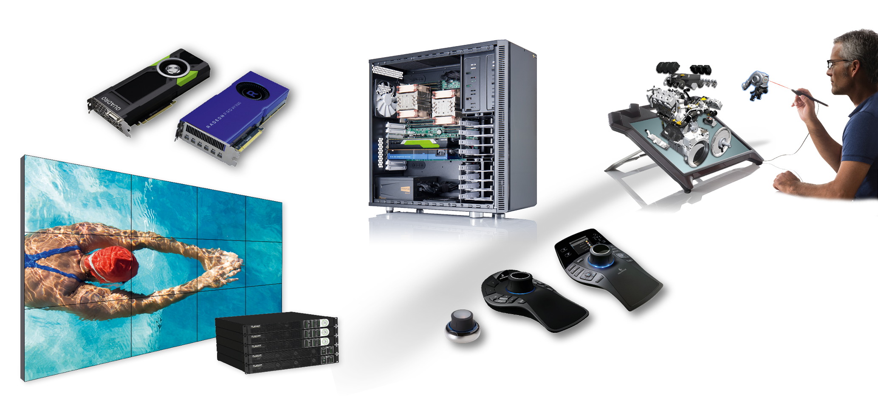
Schneider-Digital, the full-service solution provider for…
… for professional 4K, 3D and VR hardware

Slide 20
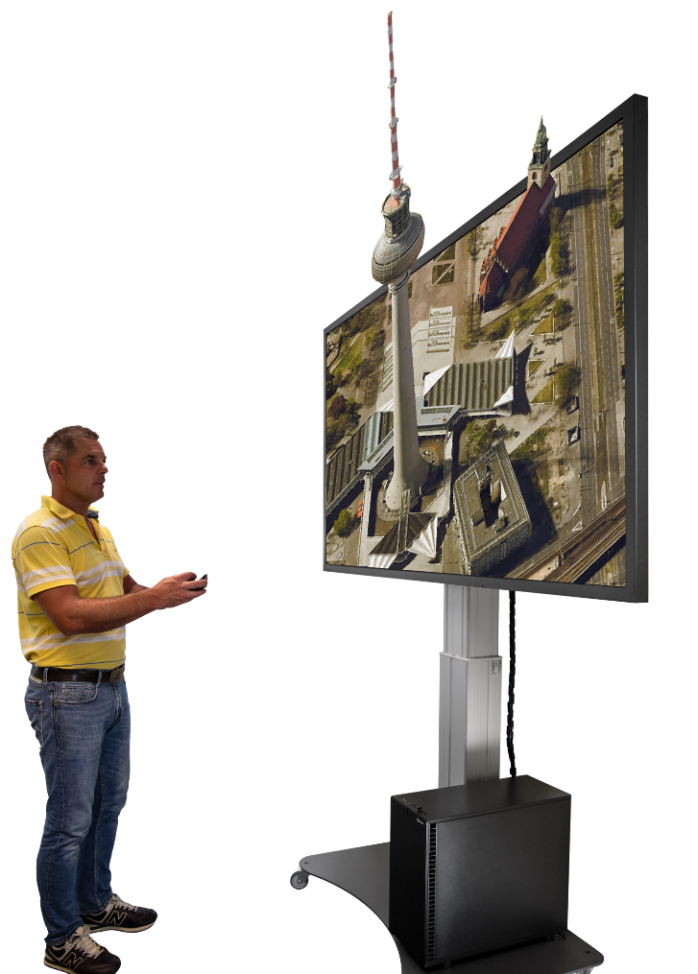

New! – Immersive 3D-Stereo in 4K for Professional Applications
3D GlobeView by Schneider Digital
80“ passive 3D-Stereo Monitor
UHD-resolution, 8 MP (3.840 x 2.160)
Native 4K-Resolution @ 120Hz with 10bit
Circular line-by-line polarization 3D technology
Optional Head-Tracking and gesture control
Innovative, height-adjustable mounting solution

Slide 21
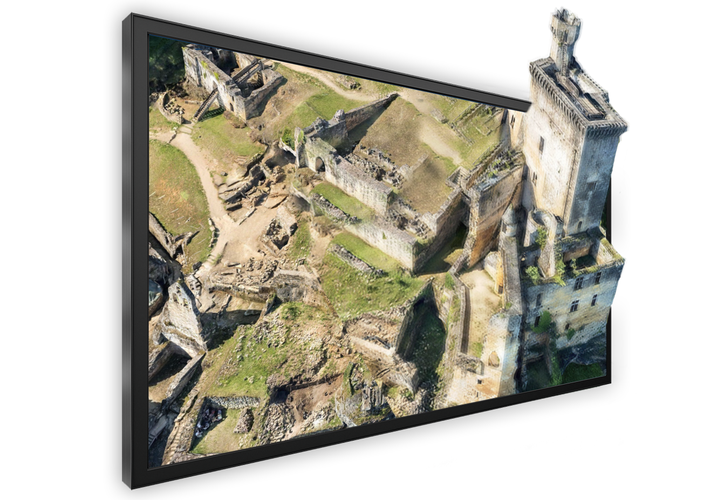

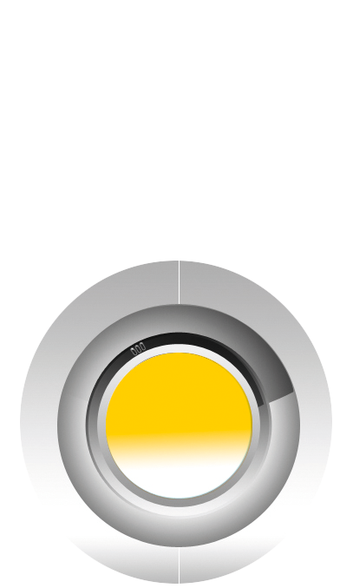
80“ 3D-Stereo Touchscreen (UHD, 4K)
Application areas:
Conference rooms
Events & Trainings
Hardware requirements:
Same as for the 3D PluraViews
Only requires a single DP cable
Software requirements:
Same as for the 3D PluraView
Viewing Distance:
Much more than for the 3D PluraView –
3 – 6 meter!
80“ LCD-Display
Size 2m x 1.05m
Passive 3D-Stereo
Tracking optional
Line-polarized
UHD (3.840 x 2.160) @ 60Hz

Slide 22




LASER smart VR wall (Gen 2)
Cutting-edge laser projection technology for a service life of more than 10 years
5.30 m x 2.25 m (11.9 sq.m) and wider!
Highest brightness, six 4,000 ANSI lumen projectors
120 Hz technology
Full 4K resolution even in 3D stereo
Integrated wireless media control
Freestanding construction, only 70cm depth
for large-format, high-resolution 3D-stereo

Slide 23








Next Generation of Digital Stereoplotters
Complete stereo workplace equipment by Schneider Digital
Photogrammetric Workstations (PW)
Workstations tailored to your specific requirements!
CPUs by Intel or AMD – your choice!
Professional graphic cards by NVIDIA or AMD
All options for internal storage & network connectivity
Ultra-compact to full-size workstation tower
3D Stereo-monitors 22” & 24” 27” & 28”
Stealth 3D-controllers

Slide 24





Performance-Workstations
High-End Workstation-Solutions for professionals
Latest Intel Xeon, AMD EPYC, AMD ThreadRipper processor technology
High-speed CPU´s (up to 56 cores on Intel, up to 96 cores on AMD)
Up to 2-TB fast DDR-5 ECC memory
Up to four (4) high-end graphics cards for CUDA or OpenCL applications in a single workstation
High performance RAID with up to 24-Gb/s. Transfer rate (SAS 4.0 technology) on request also with lightning-fast SSD (Solid State Disks) with up to 96-TB of NVMe disk space per unit
Optionally - ultra-fast 25 or 100-Gbit/s LAN connection to ultra-fast file servers
Highest quality for all components
Server and cluster solutions for your requirements!

Slide 25

Geospatial Data – exponential growth of computing requirements
UltraMap processing equipment by Schneider Digital
UltraMap Processing Clusters
Scalable and upgradable processing nodes (each 16 up to 96 CPU cores)
Each processing node upgradeable with up to 4 HPC GPUs
Fast UM network switch and corresponding network cards (25 or 100-Gbit/s )
Fast File server for UM processing nodes (SSDs)
Backup server for longer-term storage (HDDs)

Slide 26























































SD Stereo Systems – Compatible Software & Partners
A small selection of supported software applications….
3d Zephyr STK Metashape SOCET GXP v4.5 Softpltter/KDSP Sci-X Summit Evolution ESPA 3D PyMOL sView
Stereo Analyst ArcGIS Pro OSGeo PurVIEW Maya MapInfo® Vertical Mapper™ TNTgis syngo.fourSight EON Reality
3DM Content Manager Premiere Pro Blender PMS3D Photomod StereoGIS Spidar JewelSuite RiSCAN Pro
Inpho KomVISH sure aerial / Pro Go2VR / D2P Photosoft GoCAD Kingdom VR Two Unity 3D
Open Source Project LiMON Viewer PRO Vizable uSmart LaserControl StereoCAD ContextCapture DPS / Delta AVIZO
Delmia HIM Creo View MCAD DeltaGen TerraStereo Rhino Precision 3D Topo WinATLAS Scene Micromap
More than 200 software applications supported!

Slide 27




















Schneider Digital – Our International Partners
Aktive Vertriebspartner
TerraStereo DAT/EM Systems SOLITECH AD Agisoft LLC South Schnell Tech GeoDyn Technology
Swift Integrator SARL Rhinoterrain Brisight Technology Wipco 3D Scan ILV Fernerkundung Kelyn TechnologiesD IGI - Integrated
Pte Ltd & Solutions GmbH Geospatial
Innovations
DS Deutsche TP Holdings Japan Steinbacher-Consult AirborneHydroMapping TVISCompany, Geomatika Smolčak
Systemhaus GmbH Ingenieurgesellschaft GmbH LLC. doo
mbH & Co. KG

Slide 29

LASER smartVR and smart3D Wall (Gen 3)
smartVR Wall Gen1
1,500 ANSI Lumen per sq.m.
4K resolution, >8MPx
smartVR Wall Gen2
2,000 ANSI Lumen per sq.m.
4K resolution, >8MPx
smartVR Wall Gen3
2,300 ANSI Lumen per sq.m.
6K resolution, >12 MPx

Slide 30


LASER smart3D - and smartVR Wall Configurations
DP Cable

Slide 31


International References

