Slide 1


Slide 2
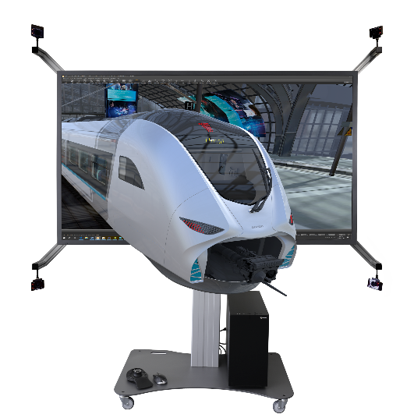
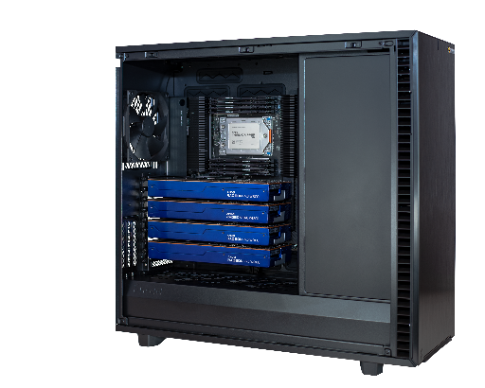
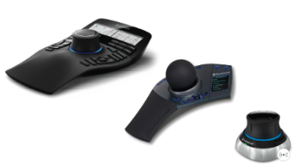
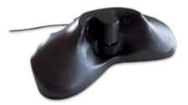
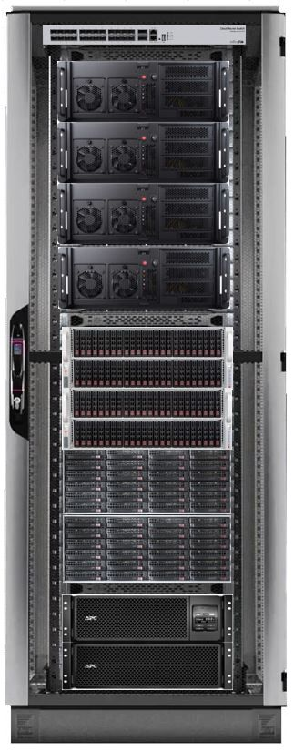
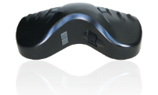
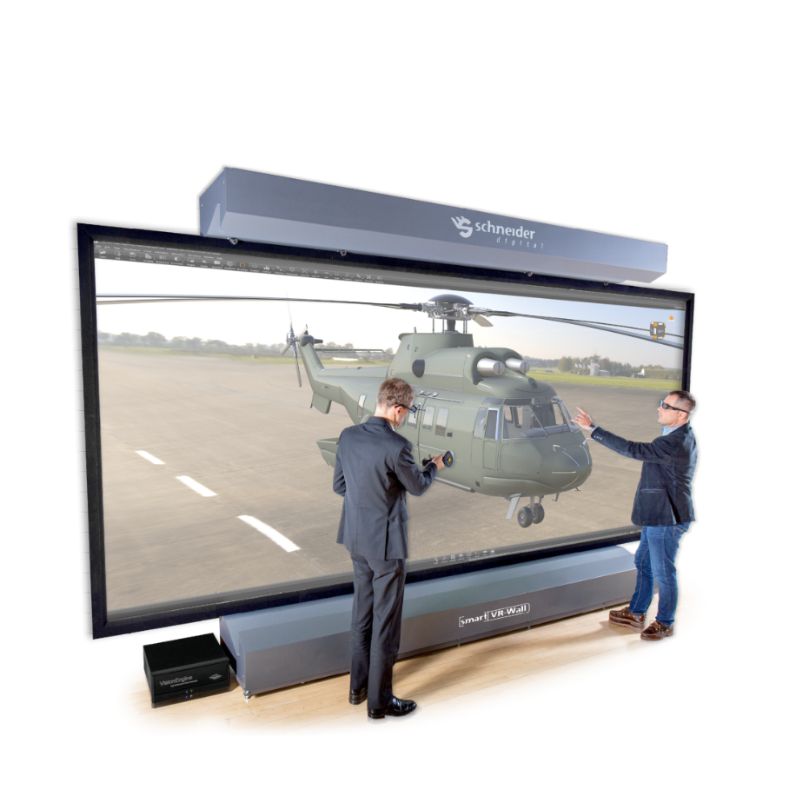
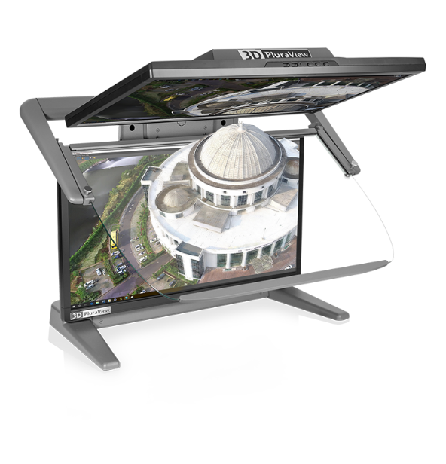
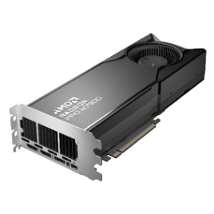
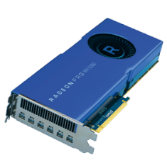
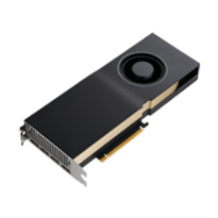
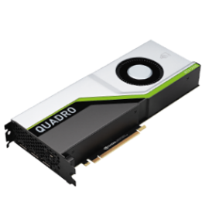
We are – a full-service GeoIT hardware provider
… for professional 4K, 3D-display and GeoIT hardware

Slide 3






















Schneider Digital – Your partner for processing & visualization
As a specialist IT hardware manufacture, we are principal software vendors neutral
We perfectly networked to all major geospatial and hardware vendors
27
Years
Focused to provide best display and processing hardware price/performance,
matching the software requirements to user and project resources
We are passionate about stereoscopic visualization and data interaction,
act as development partner for many software companies!
We are driving development: Bi-directional, active collaboration with soft- and hardware manufacturers, connecting hardware capabilities to geospatial applications.

Slide 4
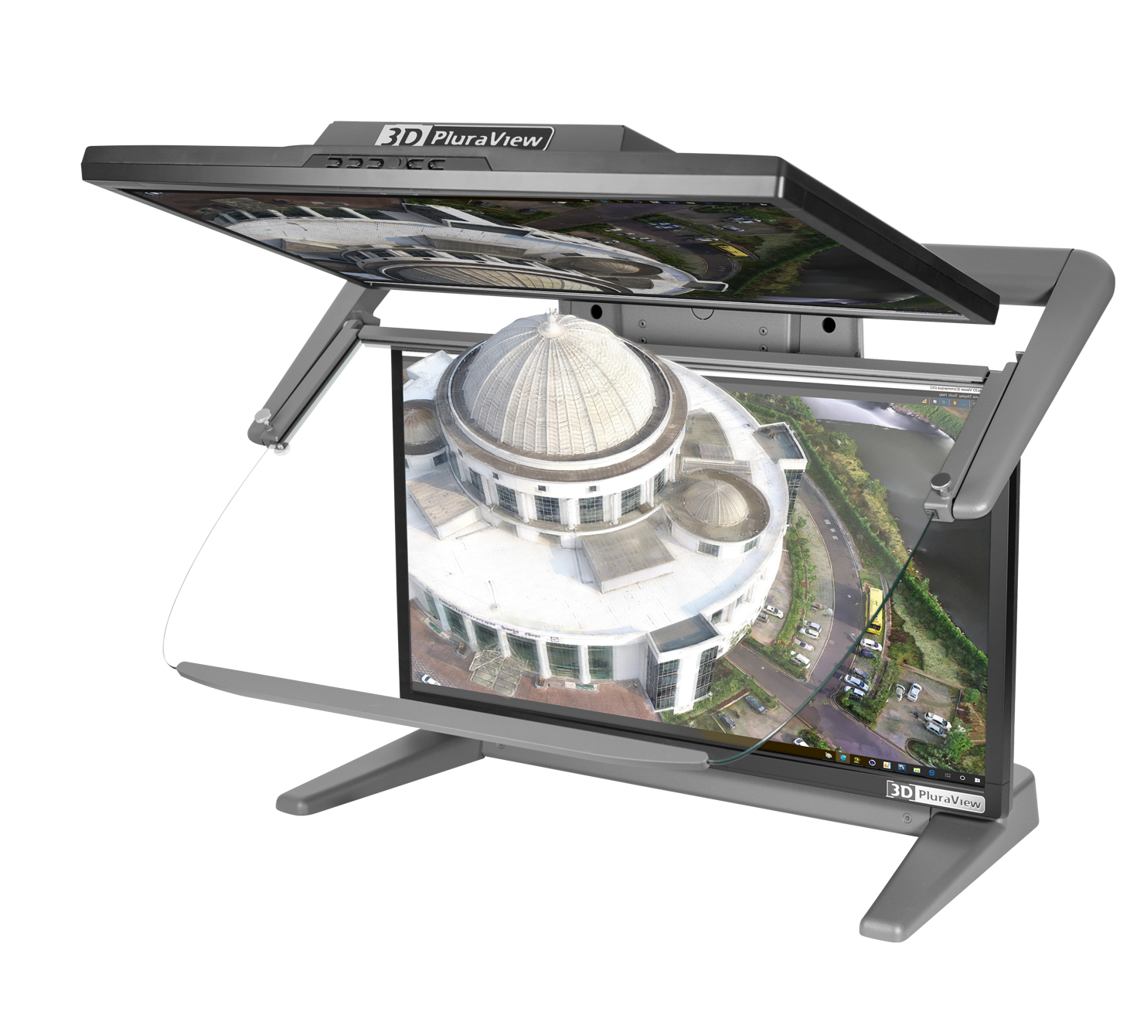
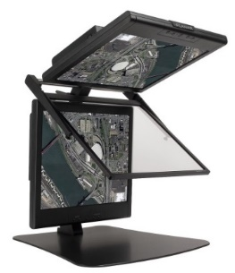
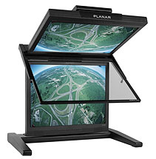
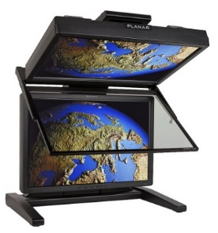
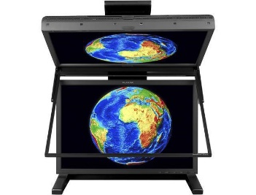


Digital Photogrammetry – 18 years of passive displays… and counting
Compatible with all operating systems – from Windows XP to Windows 11
PLANAR SD monitors and the Schneider Digital 3D PluraView
use the ‚passive Stereo‘ principle with dual screens for full stereo resolution per eye
and passive (no batteries), cross-polarized glasses.
  very light-weight, comfortable glasses no flickering no headaches
  bright & contrast-rich image daylight compatible
2005
2016
^{2022, 2023, 2024,…}
3D PLANAR
SD1710
3D PLANAR
SD2020
3D PLANAR
SD2220
3D PLANAR
SD2420W
22“, 24“ and 27“, 28“

Slide 5
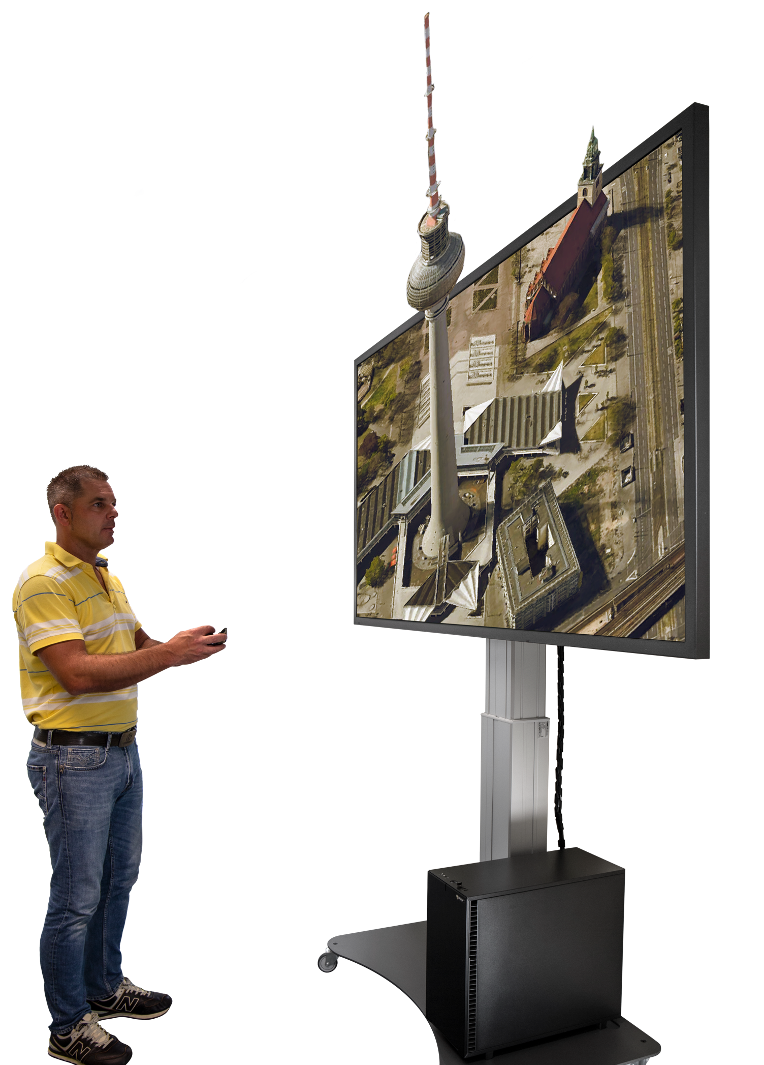

New! – Immersive 3D-Stereo in 4K for Professional Applications
3D GlobeView by Schneider Digital
80“ passive 3D-Stereo Monitor
  UHD-resolution, 8 MP (3.840 x 2.160)
  Native 4K-Resolution @ 120Hz with 10bit
  Circular line-by-line polarization 3D technology
  Optional Head-Tracking and gesture control
  Innovative, height-adjustable mounting solution

Slide 6
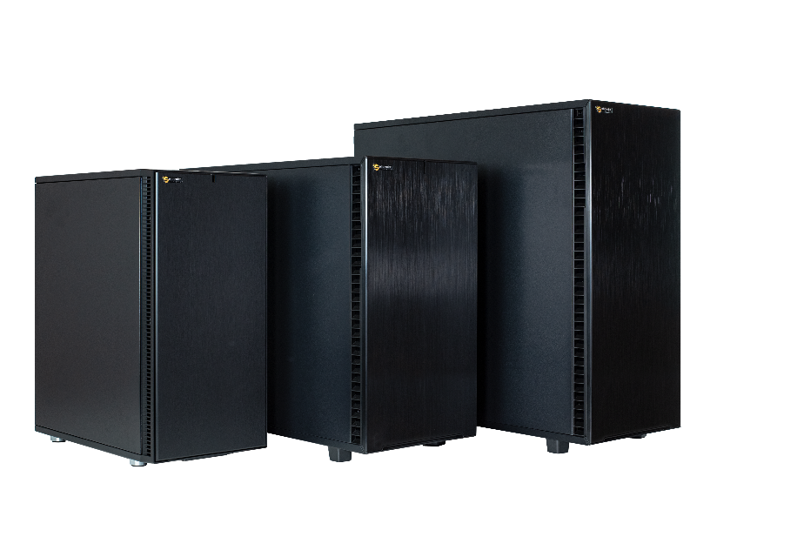
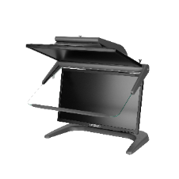
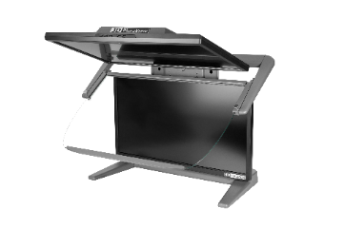

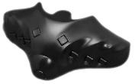
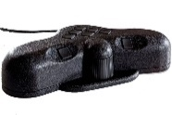
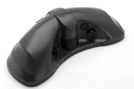

Next Generation of Digital Stereoplotters
Complete stereo workplace equipment by Schneider Digital
Photogrammetric Workstations (PW)
  Workstations tailored to your specific requirements!
  CPUs by Intel or AMD – your choice!
  Professional graphic cards by NVIDIA or AMD
  All options for internal storage & network connectivity
  Ultra-compact to full-size workstation tower
  3D Stereo-monitors 22” & 24” 27” & 28”
  Stealth 3D-controllers

Slide 7
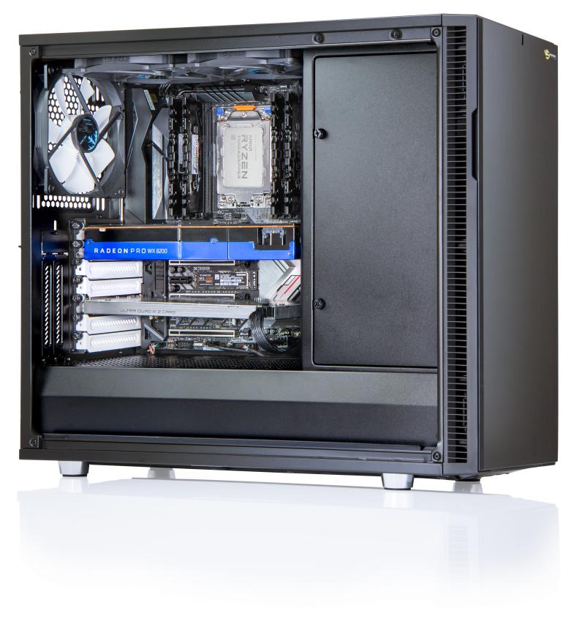




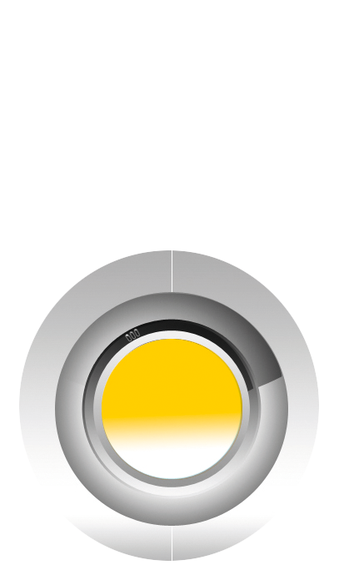
Performance-Workstations
High-End Workstation-Solutions for professionals
Latest Intel Xeon, AMD EPYC,
AMD ThreadRipper processor technology
High-speed CPU´s
(up to 56 cores on Intel, up to 96 cores on AMD)
Up to 2-TB fast DDR-5 ECC memory
Up to four (4) high-end graphics cards for CUDA
or OpenCL applications in a single workstation
High performance RAID with up to 24-Gb/s.
Transfer rate (SAS 4.0 technology) on request also
with lightning-fast SSD (Solid State Disks)
with up to 96-TB of NVMe disk space per unit
Optionally - ultra-fast 25 or 100-Gbit/s LAN
connection to ultra-fast file servers
Highest quality for all components
Server and cluster solutions for your requirements!

Slide 8
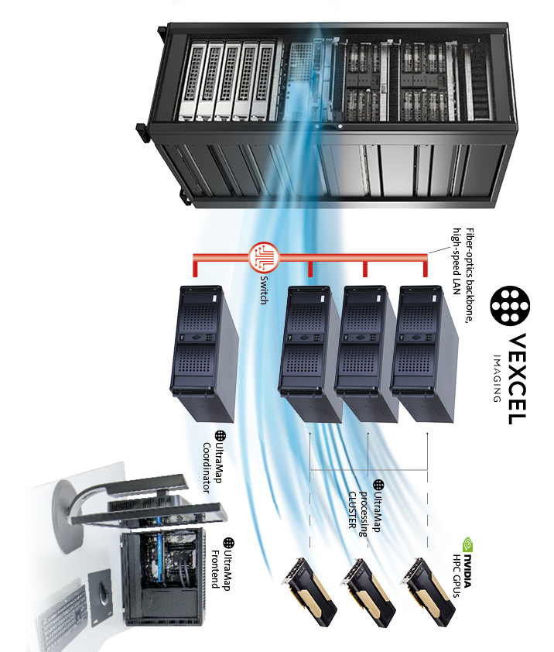
Geospatial Data – exponential growth of computing requirements
UltraMap processing equipment by Schneider Digital
UltraMap Processing Clusters
  Scalable and upgradable processing nodes
  (each 16 up to 96 CPU cores)
  Each processing node upgradeable with
  up to 4 HPC GPUs
  Fast UM network switch and corresponding
  network cards (25 or 100-Gbit/s )
  Fast File server for UM processing nodes (SSDs)
  Backup server for longer-term storage (HDDs)

Slide 9
Geospatial Data – exponential growth of computing requirements
UltraMap Osprey 4.1: Processing load & storage example
Project example: Osprey4.1 flight, AOI 4700 sq.km, 7.5cm nadir resolution
  Approx. 60,000 nadir images, plus 4 x 60,000 oblique images
  Lvl00 nadir+oblique dataset = 3.1-GB on FDU (uncompressed)
    Lvl03 nadir+oblique RGB, 8bit = 2.5-GB / 150-TB for AOI
    Lvl03 Nadir-only RGB-I (288MPx), 14bit = 1.6-GB / 100TB for AOI
  Add multiple products and versions for DTM/DSM, Ortho, 3D mesh – 1 PetaByte storage is realistic!
  Translated to a fast file-server requirement (SSD-based) = 50 to 100-TB (10 to 20 SSD 8-TB drives)
  Translated to a backup server requirement (HDD-based) = 1-PB (50 to 60 HDD 20-TB drives)
    Consider RAID-50 or RAID-60 with data redundancy for backup server
    Consider RAID-0 for higher workloads / high-speed for SSD file-server (>128 UltraMap cores)

Slide 10
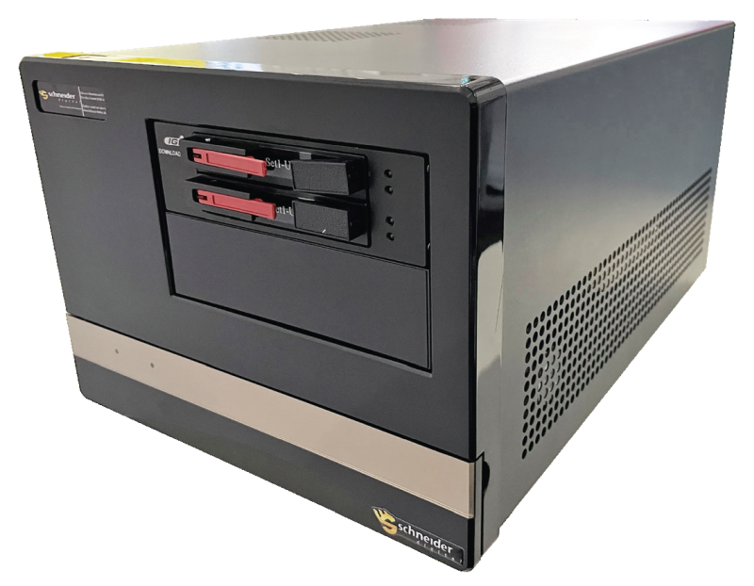
Geospatial Data – exponential growth of computing requirements
CopyStation / CopyStation PRO mobile Workstation
Professionally-built compact workstation for remote area operations
  Hard-shell trolley, easily transportable
  CopyStation: primarily intended to offload/copy FDU to internal NVMe (up to 96-TB internal NVMe)
  CopyStation PRO: adds serious processing capability, e.g. fast LvL00 to Lvl02 (or Lvl03) image copies
    Up to 64-cores @ 3.5GHz and 1-TB of 3200MHz memory
    SAS 12Gbit/s port option for external NAS connectivity
    IPMI remote management onboard
    Professional Stereo graphics card configurable
    270 mm (W) x 212 mm (H) x 393 mm (D)

Slide 11





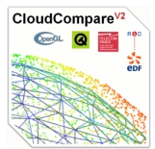























3D PluraView – compatible geospatial stereo-software
Monthly updated list for stereoscopic software & vendors, current PDF on our website!
ArcGIS Pro Metashape SOCET GXP v4.5 Sci-X Summit Evolution ESPA 3D VRTwo TerraStereo Atlas Vexvel UltraMap
ImageStation Stereo Analyst Inpho OSGeo PurVIEW TNTgis Scene LaserControl CloudCompare
3DM Content Photomod Simwright StereoGIS JewelSuite RiSCAN Pro 3d Zephyr STK Petrel DJI Terra
How
about your
software application(s)?
KomVISH sure aerial / Pro Go2VR / D2P Photosoft GoCAD Kingdom Unity 3D DPS / Delta
LiMON Viewer PRO Vizable uSmart StereoCAD ContextCapture Eternix Micromap Manager
Blaze Terra
Delmia Geovia Creo View MCAD DeltaGen Rhino Precision 3D Topo WinATLAS

Slide 12
Thank you for your attention!

