Slide 1





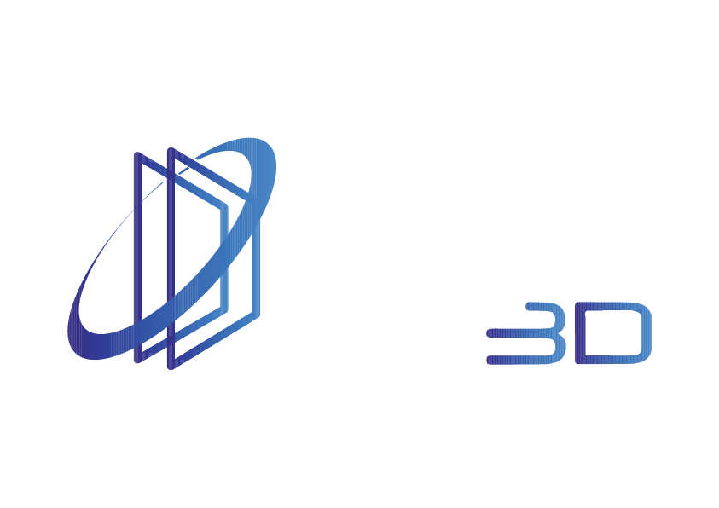
Innovative Stereoscopic 3D Technologies
For Southern Africa

Slide 2
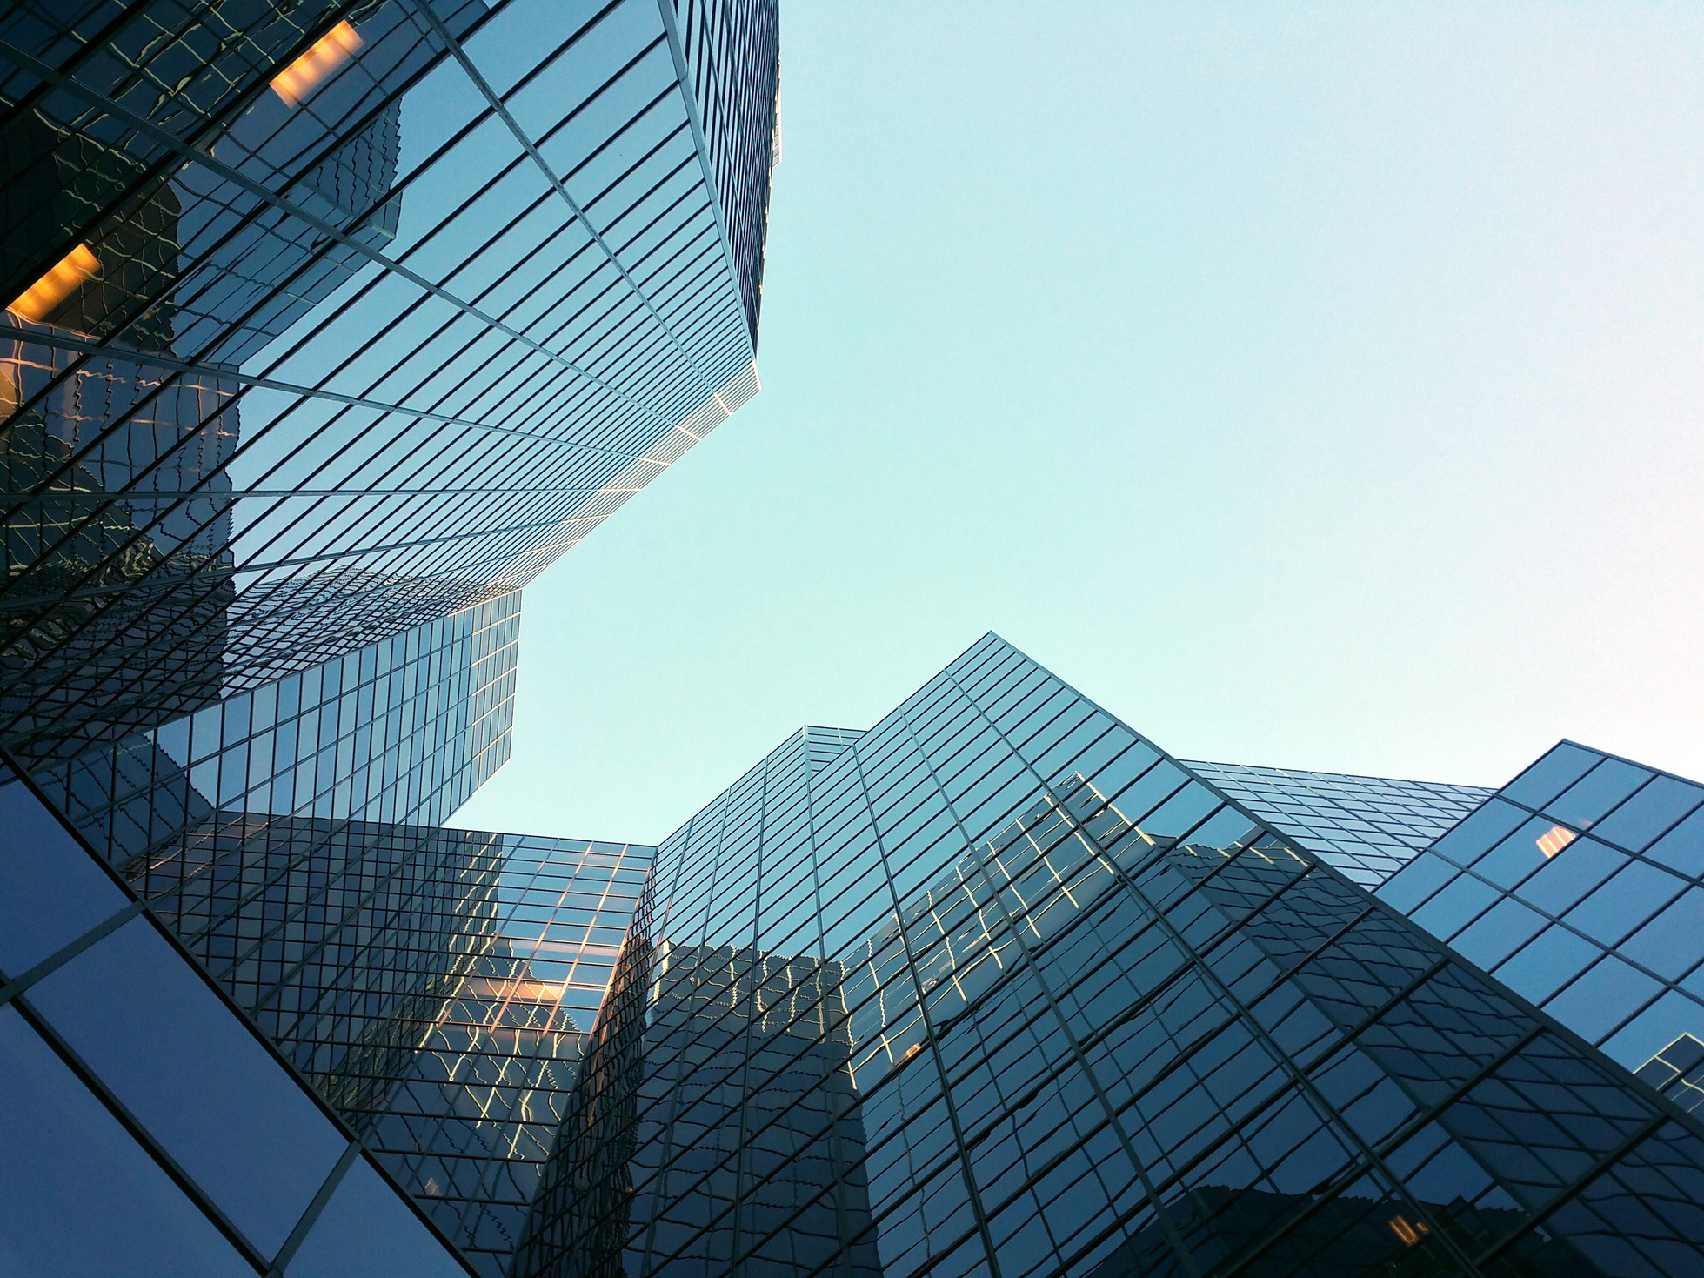








PROFESSIONAL 3D HARDWARE SOLUTIONS
What We Offer
TECHNOLOGY
SYSTEM INTEGRATION
Passive Stereo - 3D PluraView
Passive Stereo - 3D GlobeView
Active, 120Hz Stereo - Smart VR-Wall
High Performance Workstations
Extensive knowledge, capabilities and networks to solve complex 3D data challenges.
INDUSTRIES
B2B CONSULTING
Multiple industries focus for 3D Visualization and high-end workstation requirements.
Provide businesses with application-specific B2B hardware consultation.
29

Slide 3
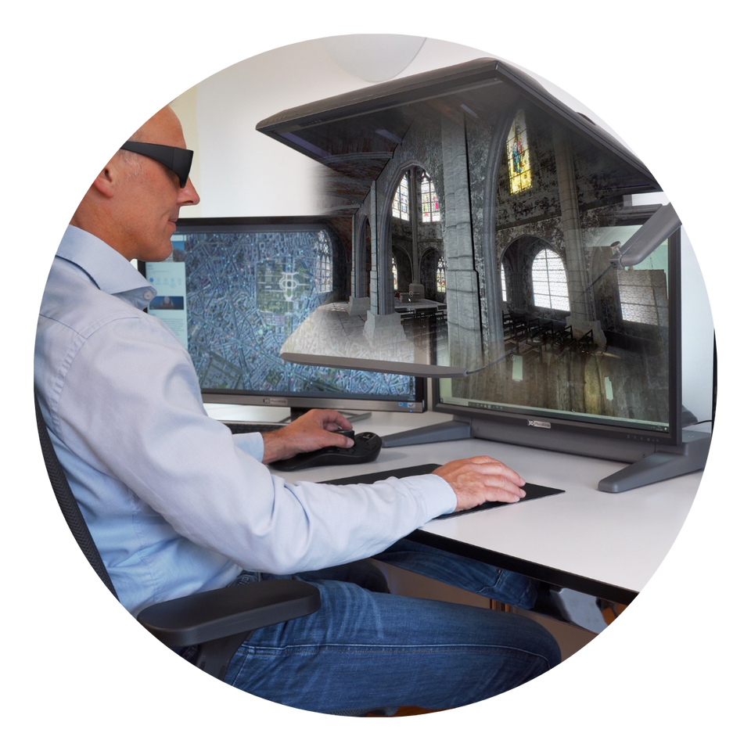
Functioning Principle, linear polarization
STEREOSCOPIC 3D DISPLAY
SOLUTIONS

Slide 4

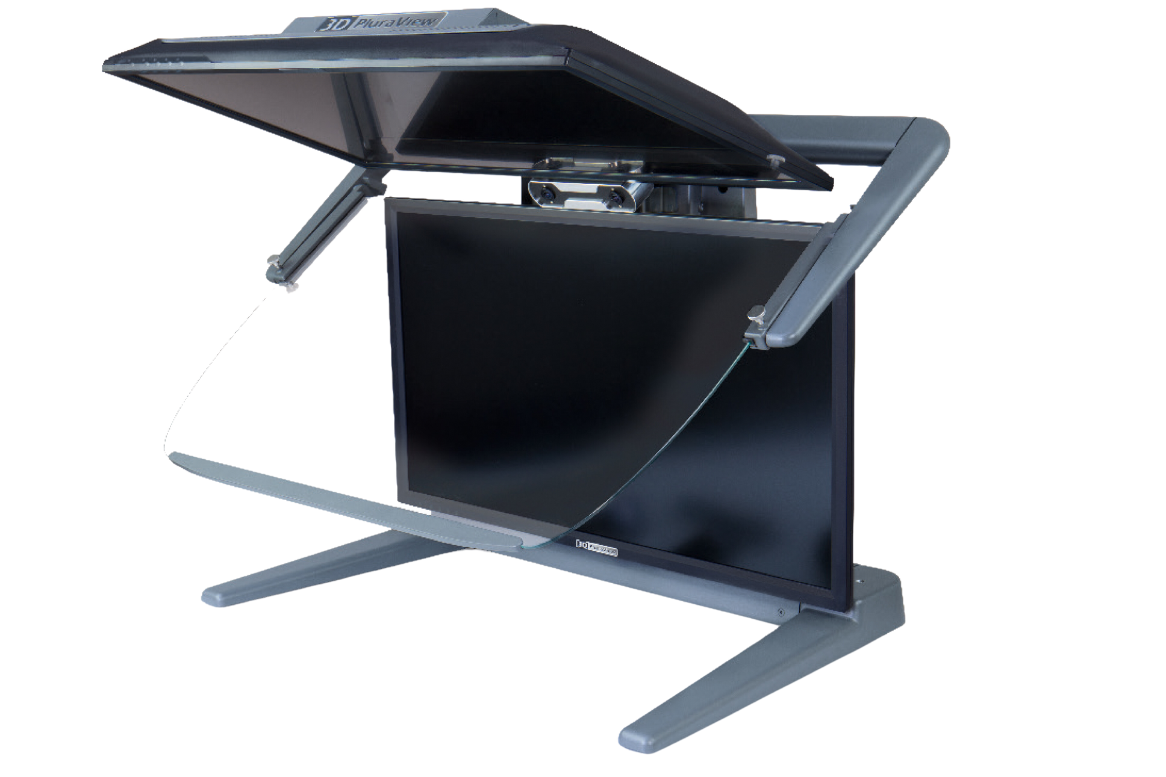

3D PluraView
The proven reference for passive 3D stereo displays
Notes:
Sub-page
12

Slide 5
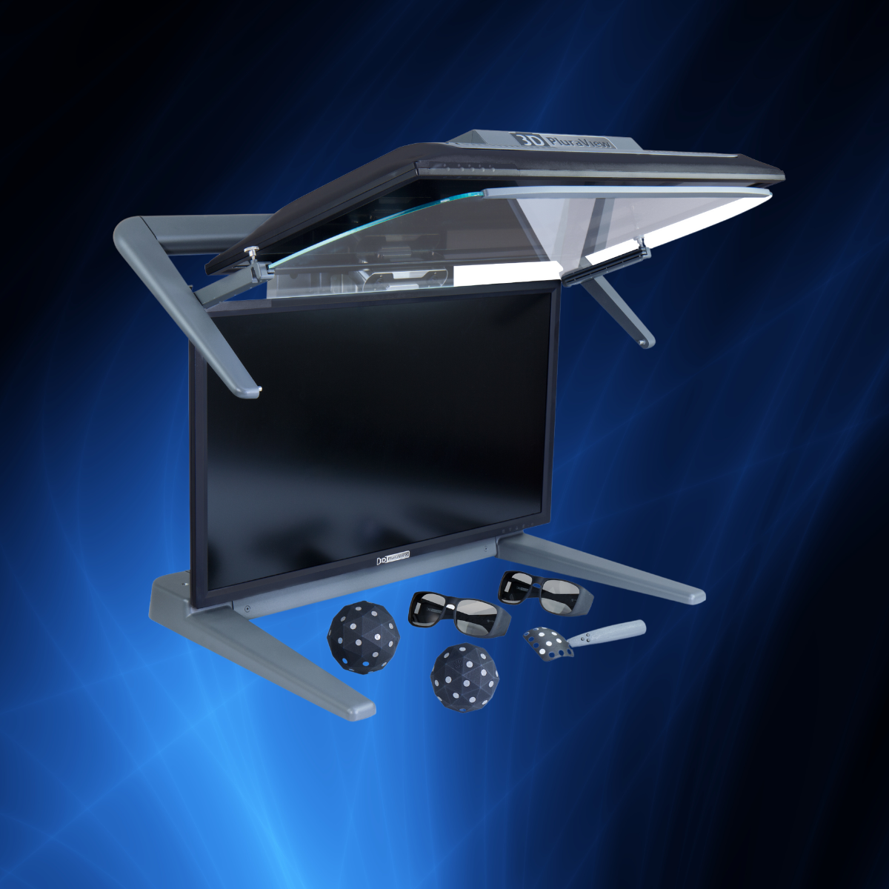




BENEFITS
3D PluraView: Dual-Screen / Passive Stereo
One monitor (up to 4K) for the left and one monitor for the right stereo channel / eye
Linear cross-polarization of both images (45deg / 135deg)
A semi-transparent, beamsplitter glass to precisely overlay both images
Wide (170 degree) stereoscopic viewing angle accommodates group interaction and discussion for up to 6 people
Optional VR model interaction, tracking reflective markers on objects, such as glasses, pens, spheres and gloves
Four screen diagonals – 22”, 24”, 27” and 28”
Three display resolutions (Full HD, 2.5K and 4K UHD) - 3D-Stereo and VR
Native Software Certified, Standard Graphics Card Drivers
Flicker-Free Stereo Displays
Plug & Play with stereo software, no middleware!
Wide viewing angle for up to 6 people
Passive 3D Stereo & VR monitors
Daylight suitable, use in normal office environment
Highest Resolution
(Up to 4K/UHD (8.3 MP per eye) @ 10-bit
Light-weight, comfortable glasses, all-day usability
Four monitor screen sizes (22”, 24”, 27” & 28”)
Notes:
Example of completed Product information slide.
11

Slide 6
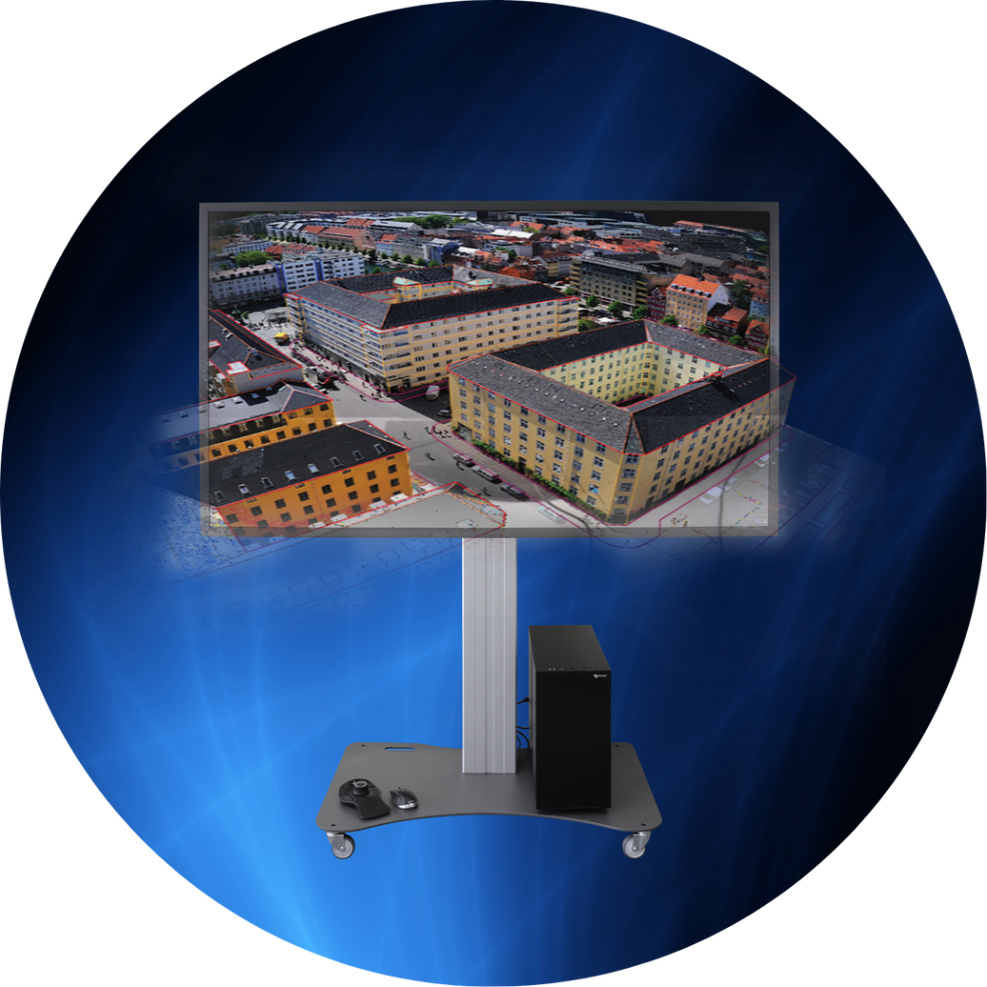

Typical Photogrammetry / GIS Configuration
3D GLOBEVIEW
80” Screen-diameter, passive &
line-polarized LCD Stereo Display
Notes:
Sub-page
10

Slide 7
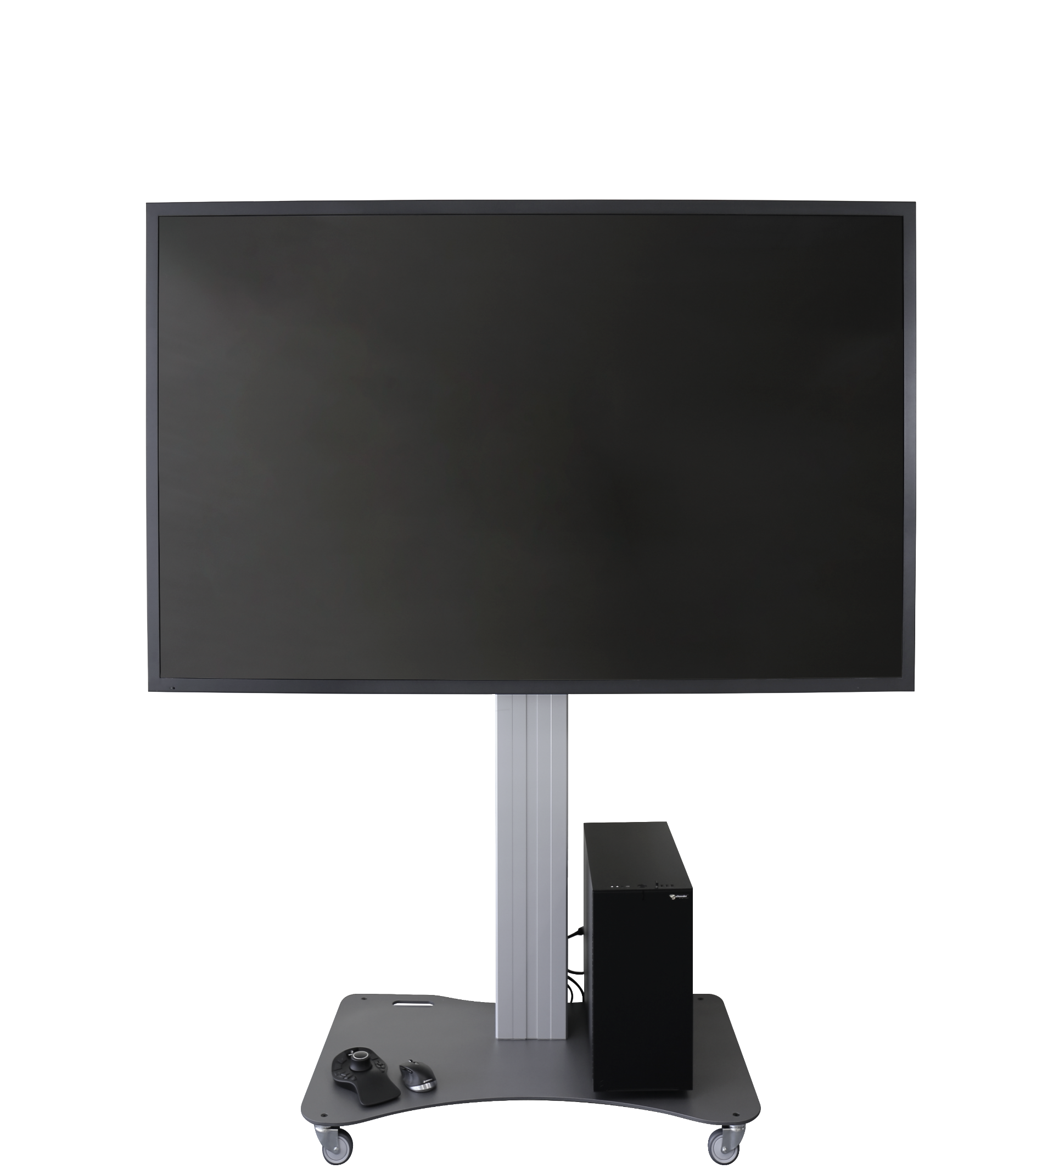
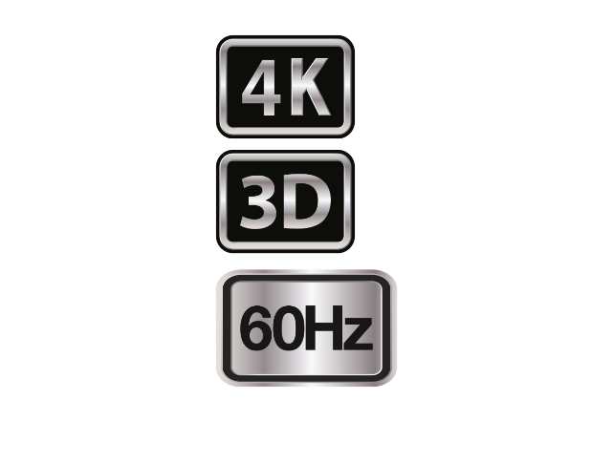

BENEFITS
Multi-functional boardroom / conference LCD Stereo Display
Ultimate visual 3D-stereo or VR-interactive display
Lightweight, comfortable polarization glasses, 170⁰ wide viewing angle
Stereoscopic group visualization for applications such as:
GIS - Smart City models, photogrammetry, C4i, 3D terrain and land cover, architecture and engineering design and BIM
Native 4K-Resolution for standard mono content (3840 x 2160p)
Horizontal-interlaced stereoscopic content (3840 x 1080p)
Innovative tracking solutions available for the 3D GlobeView, e.g. integration with ART tracking hardware
Complete Workstation & Display HW Solution offered by Akili3D
Viewing for up to 20 attendees
Comfortable, light-weight glasses
3840 x 1080p 3D-Stereo
3840 x 2160p (4K) mono
Line-by-line polarized (circular polarization)
Very bright & contrast-rich meeting room display
Large-Format 3D-Stereo
3D-Stereo and / or 2D content simultaneously
Absolutely flicker-free
Typically, 1.5 to 6m viewing distance
Standard graphic cards and drivers by NVIDIA and AMD
Notes:
Example of completed Product information slide.
11

Slide 8
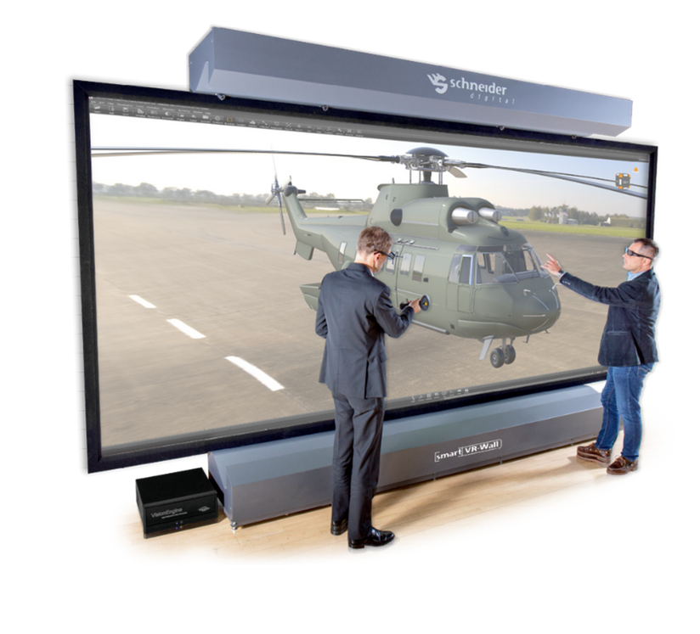

Smart VR-Wall
5.3m x 2.25m / 6K @ 120Hz
Active Stereo Display
Notes:
Sub-page
12

Slide 9
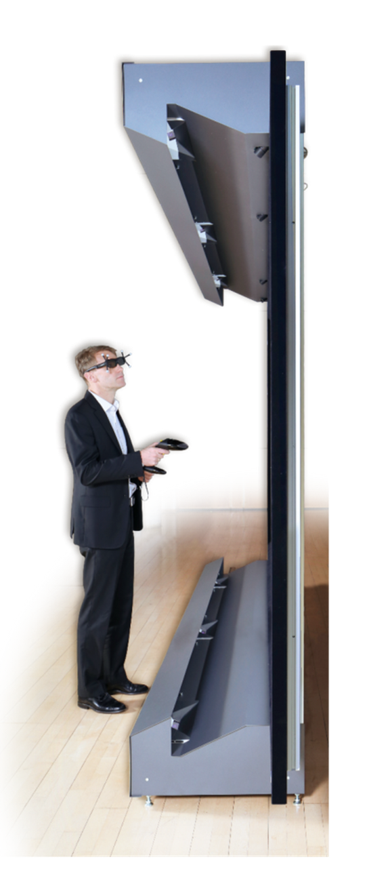
BENEFITS
Multi-Projector / Active-Stereo Theatre Display
Highest usable total resolution of 5,760 x 2,400 pixels, 120Hz stereo technology with full 6K resolution per eye – 0.9mm pixel size
Revolutionary, SLR camera-based color space calibration for the best, homogeneous image display without loss of quality in Laser DLP blend zones
Signal/display latency as low as 1 frame (20 milliseconds), enables VR interaction in real-time
Brilliant front projection, no shadowing by the actor in front of the VR wall, allows unrestricted working and image viewing directly in front of the projection wall
Stereo & Mono Viewing for 50+ attendees
3D-Stereo and/or 2D content simultaneously
120Hz active stereo with dedicated pixel-processor
Mobile & free-standing, no room installation required
6K Resolution in 3D Stereo
Six blended DLP Projectors
Typically, 2 to 10m viewing distance
2270 ANSI lumen brightness per sq. m
Six Laser DLP projectors, no brightness loss in stereo
Standard graphic cards and drivers by NVIDIA and AMD
Notes:
Example of completed Product information slide.
11

Slide 10
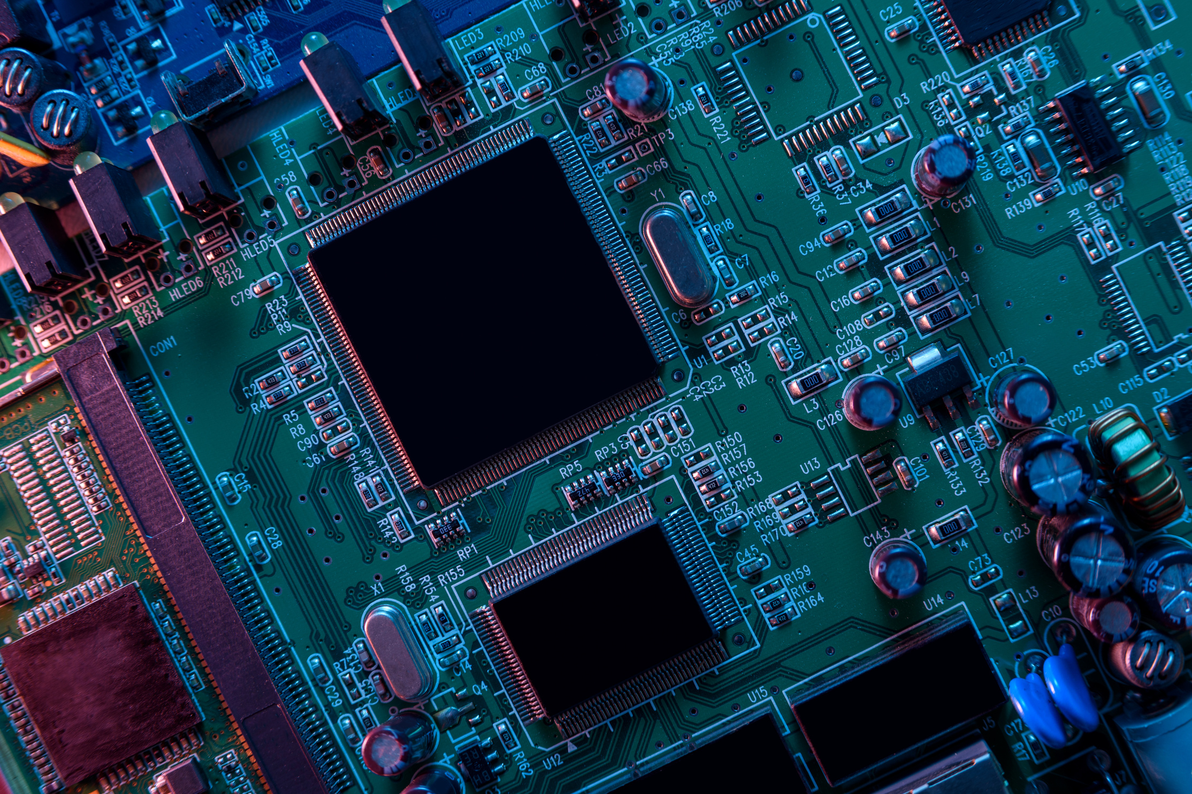
PROFESSIONAL WORKSTATION & SERVER TECHNOLOGY
Functioning Principle, linear polarization

Slide 11
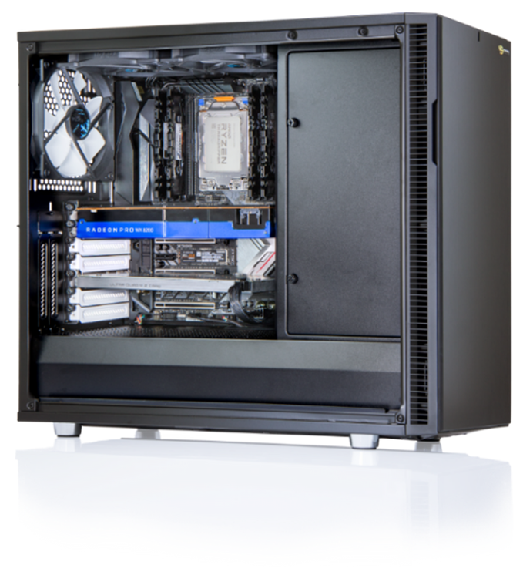

Typical Photogrammetry / GIS Configuration
PROFESSIONAL WORKSTATIONS
Pulsaron, Centuron & Nepturon
(AMD, Intel & Water-Cooled CPUs) - Professional Build Quality -
Notes:
Sub-page
16

Slide 12
BENEFITS
Inhouse Manufacturing Flexibility, Application-Specific Systems
Profound workstation configuration knowledge, pre-sales optimization, matching to customer applications
Best-possible advice, personal pre- & after-sales service
Direct relationships to all major software manufacturers
Productivity scaling for workstation & servers
Complete network installations by qualified engineers
Highest-quality and latest-generation components
Local support by Akili3D in Southern Africa
Best price-performance, matching component performance
Offer mobile, high-end computing (CopyStation), SFF cases
System tailored to your specific requirements
Optimally matched, high-quality components
Three platforms – countless performance possibilities
Performance Upgrades
Server and Cluster solution
Low noise with optimum ventilation, air-filters
Long-term plug & play upgrade capability
Up to 8 high-end graphics cards for CUDA or OpenCL applications in one workstation
Latest Intel Xeon, Intel Core, AMD EPYC, AMD Ryzen Threadripper & AMD Ryzen 7000-series processors
Notes:
Example of completed Product information slide.
11

Slide 13
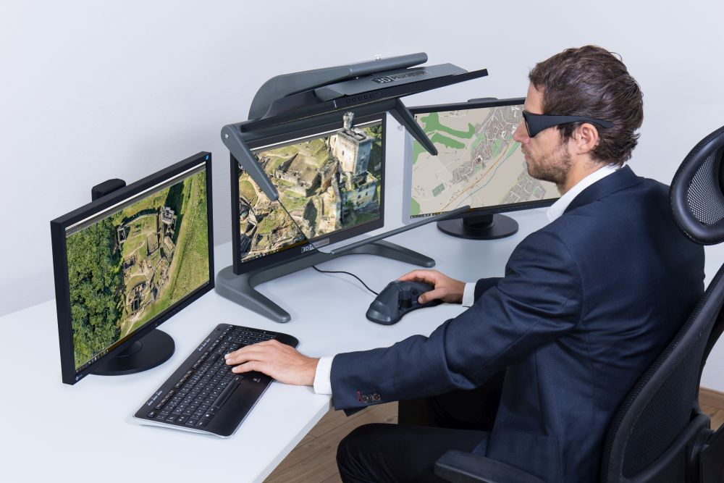

Geosense / GetMapping Integration with Stereoscopic 3D Displays
LET US WORK TOGETHER
Initial Business Case
Geosense to test 3D PluraView inhouse
Support by Akili3D for customer demos
Full hardware cooperation, if & when required
The 3D PluraView displays are ‘best-practice’ and established standard for stereo feature collection with all photogrammetry applications
ArcGIS Pro stereo was developed on the 3D PluraView and is perfect for working with 3D geospatial Mesh, CityGML and voxel datasets
Socet GXP customers use 3D PluraView world-wide for recon (>1000)
Stereo Display via Internet – example Racurs Photomod @ GeoCloud: development opportunity for GetMapping ‘Orbit’ and ‘SmartView’ portals
3D PluraView are ready for Photogrammetry 4.0 / Stereo Mouse Cursor (SMC)
The 3D PluraView offer the best-quality, easy-to-use stereoscopic display for the desktop, absolutely comfortable for all-day use
Approx. 90% of geospatial project cost is for admin, training, field work, and data collection, i.e. for personnel
Only 10% of cost relate to hardware and software, i.e. majority of expenses for geospatial data should be matched by ‘best practice’ equipment for data capture, processing and interpretation/visualization!
The 3D PluraView are fully compatible with both AMD and NVIDIA graphic cards, are independent of special drivers, require no middleware, are plug & play and enable full-day, comfortable use
Ergonomic Workplace Solutions
Notes:
The idea of this slide is to bullet point the way working together
25

Slide 14




THANK YOU
info@akili3d.com
+27 21 830 5410
www.akili3d.com
3D PluraView – supported applications: https://www.3d-pluraview.com/en/application-field#su-software
Notes:
NOTES: THE HAND COLOURING CAN CHANGE TO LIGHT GREY OR WHITE OR GRADIENCE OPTION TO STAND OUT.
26

