Slide 2

Unleashing the Power of 3D Visualization
Introduction to 3D stereo
Humans perceive depth by viewing with both eyes
Stereoscopic 3D visualization uses two slightly offset images to create the perception of depth
Polarized glasses or a polarized filter on the screen separate the eyes, creating the three-dimensional effect in the viewer’s brain

Slide 3
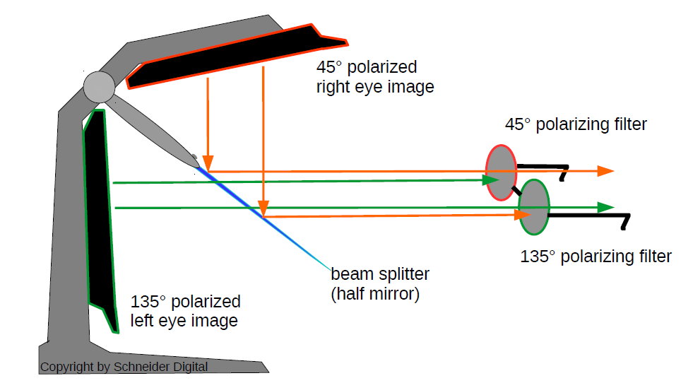
Stereoscopic 3D visualized: two separate displays for left and right image

Slide 4
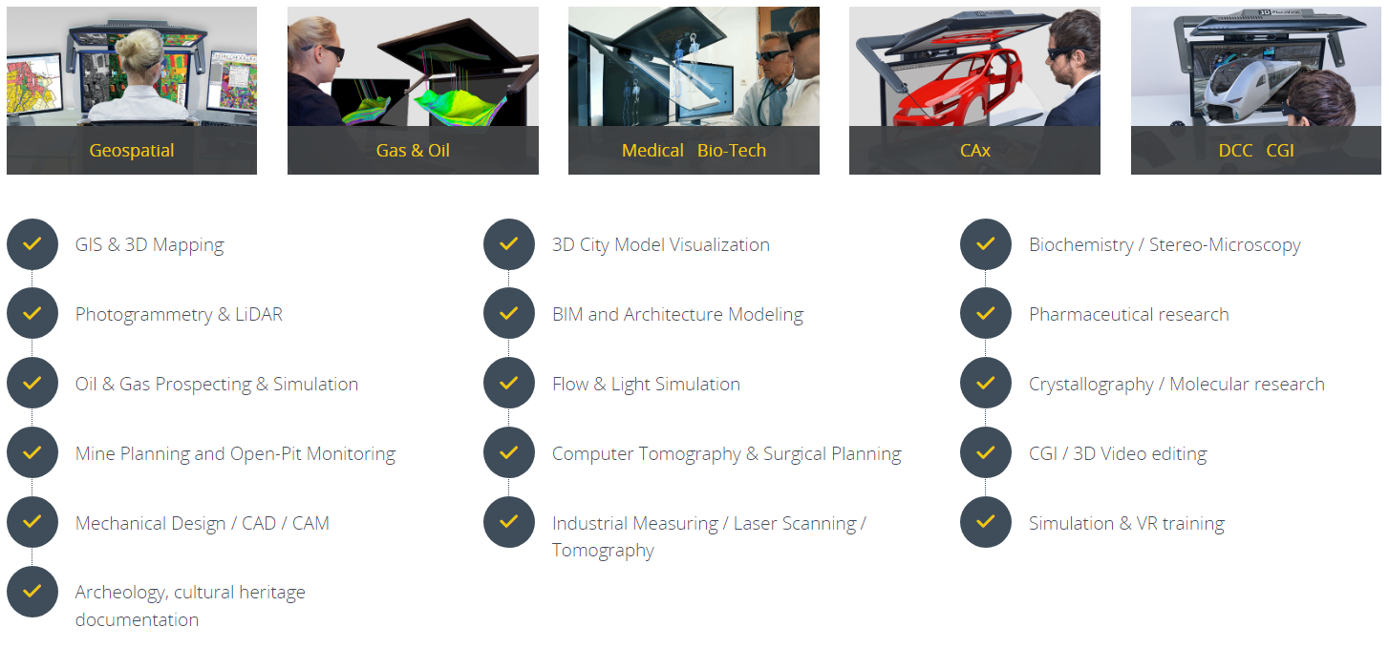
Application areas of 3D Stereo

Slide 5
Benefits of 3D Visualization
Enhanced spatial understanding: provides a more intuitive grasp of topographical and spatial data
Improved data interpretation: accelerates decision-making
Immersive collaboration: enhances situational awareness and decision-making in crisis situations
Integration: Compatible with existing workflows, enhancing rather than replacing current tools

Slide 6
3D Stereo Mouse Cursor (SMC): Completing 3D Stereo Visualization
Traditional 2D cursors lack depth perception, making 3D interaction difficult and unintuitive – even on a 3D screen
Current 2D cursors, such as simple arrows or crosshairs, often lack dynamic scaling, customization options, and real-time feedback
Solution to these shortcomings:
Implementing a dynamic 3D cursor capable of adapting to the scene and camera orientation
Full Integration of 3D visualization into existing applications and workflows
No disruption to an existing workflow, through intuitive functionality

Slide 7
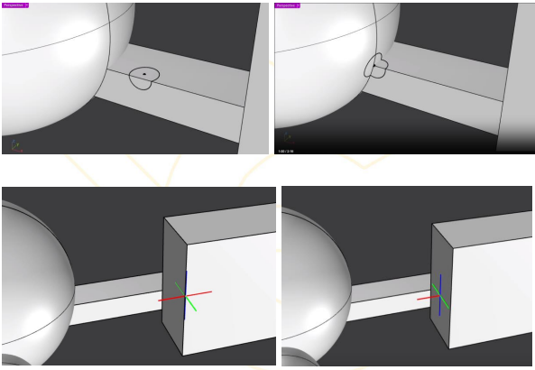
3D Stereo Mouse Cursor (SMC) as Game Changer
Software-based solution. The cursor receives depth information and penetrates the object along the z axle
Improved Navigation: Allows for smooth and precise movement through 3D environments
No additional hardware necessary. The cursor can even be controlled with a cheap no-name mouse

Slide 8
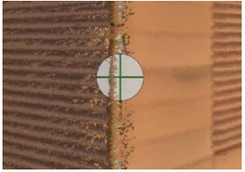
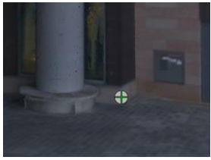
3D Stereo Mouse Cursor (SMC) as Game Changer
Control: Provides fine control over zooming, panning, and rotating maps and models
Effortless Data Cleanup and Processing, e.g. in LiDAR scans
Use Cases: Navigating complex terrains, urban planning, and environmental monitoring

Slide 9
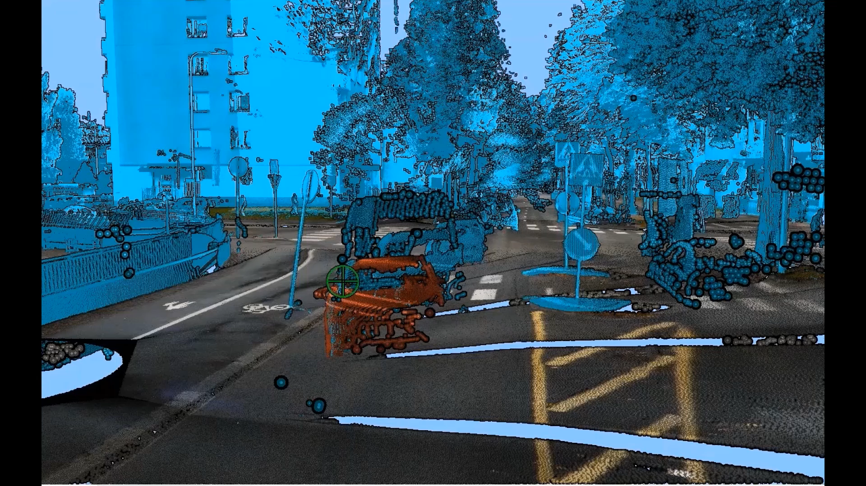
Example of a workflow in 3D Stereo using a 3D Cursor

Slide 10
Conclusion and Future Outlook
Technological Advances: Integration with AI and machine learning, more affordable hardware
Applications: Increased use in education, virtual reality for training, more immersive experiences
Innovations: Development of more user-friendly interfaces and collaborative platforms

Slide 11


Solutions by Schneider Digital
3D Pluraview – the reference for 3D monitors worldwide
Full resolution of up to 4K per eye: two screen technology
Flicker-free – no buffering or shuttering
daylight suitable
Wide viewing angle
Comapct and functional design

Slide 12
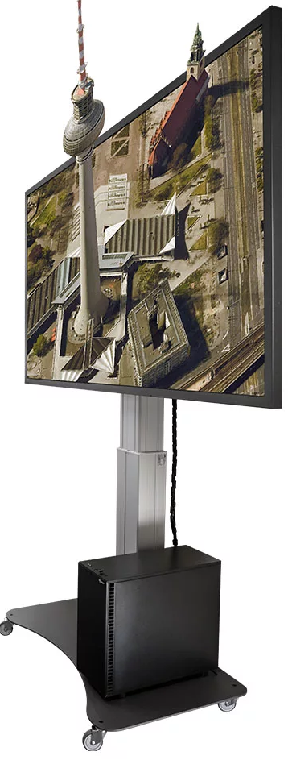
Solutions by Schneider Digital
3D GlobeView – Immersive 3D-Stereo in 4K on a Big Screen
80“ Ultra HD resolution (3.840 x 2.160) LCD display
Supports native 4K at up to 120Hz with HDMI and
DisplayPort connectivity
High resolution (3.840 x 2.160) in 3D-stereo Mode
Move seamlessly between 2D and continuous stereo 3D-stereo passive glasses
Passive glasses deliver hours of comfortable use

Slide 13

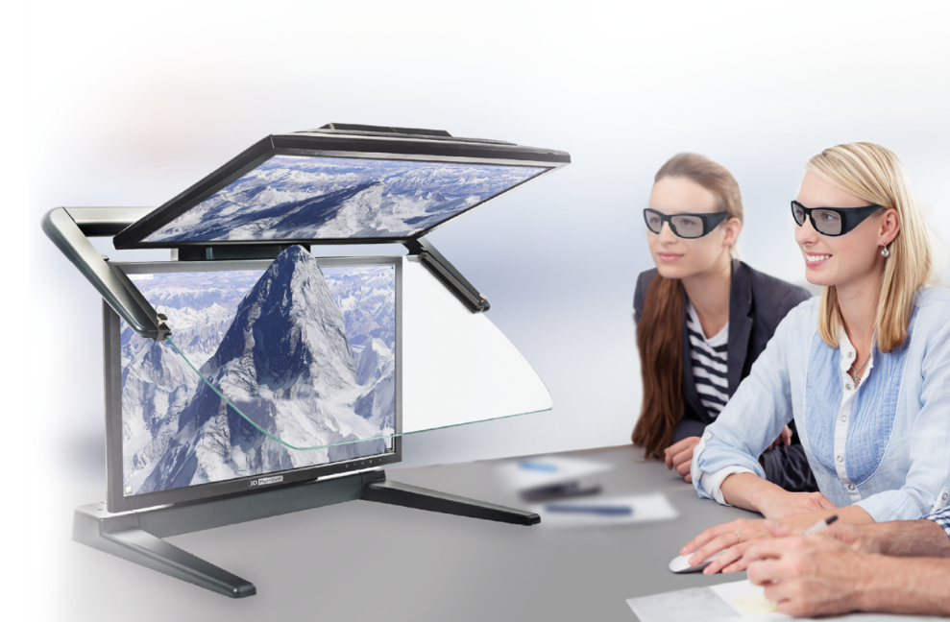
Limitations of alternative 3D displays
Active 3D glasses provide a relatively dark single-screen image. The high-frequency shuttering strains the eyes and leads to rapid fatigue.
Head-Mounted Displays (HMDs) are relatively heavy, can cause nausea and dizziness, professional software currently has no data capture and editing interfaces that work with HMDs.
Autostereoscopic monitors work without glasses but have fixed viewing positions, where the distance and angle to the monitor allow for stereo viewing. Stereo with eye-tracking only works for a single user!

Slide 14
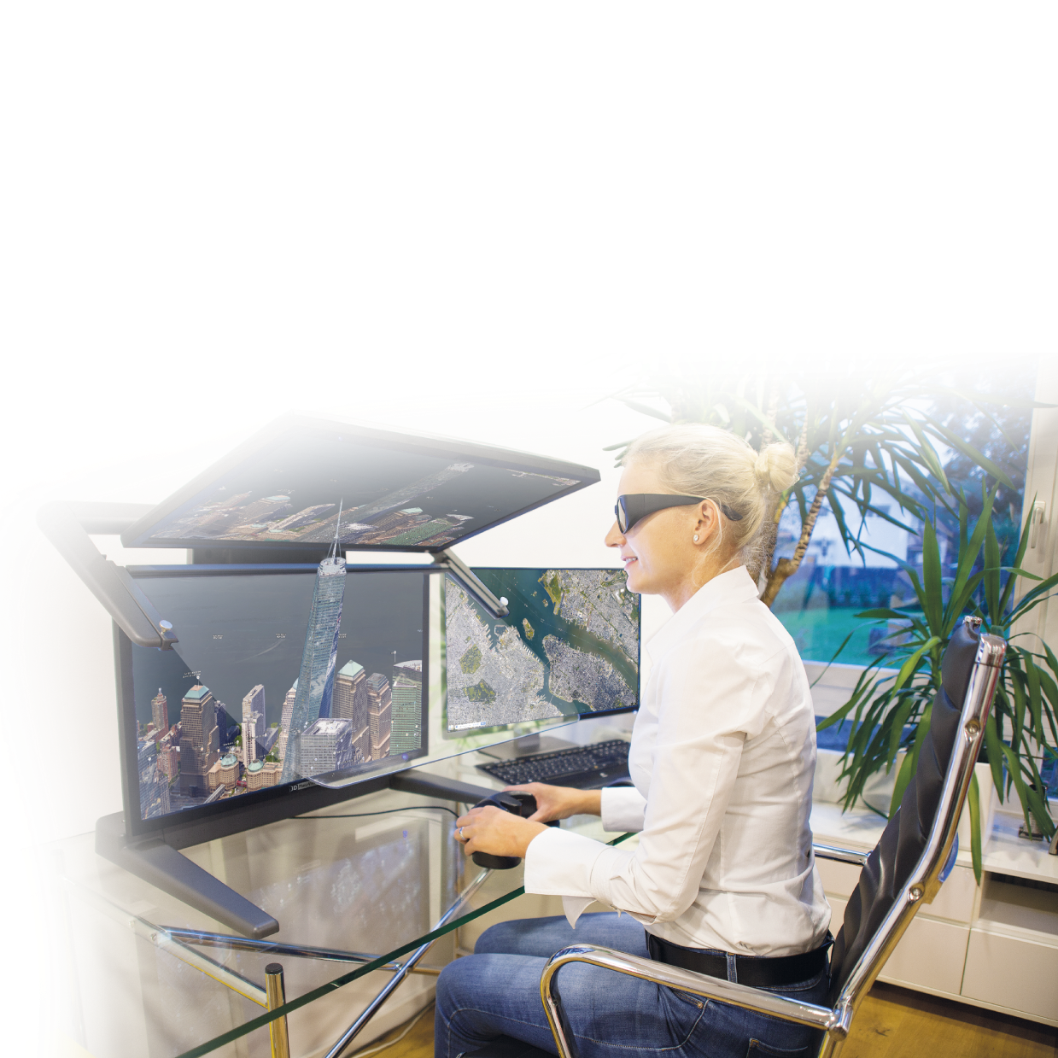
Advantages of passive 3D
Choose your reference in 3D Stereo
Dual screen passive stereo displays have proven to be the best desktop stereo solution of all
3D PluraView users can work in a normal office environment thanks to high image brightness
Flicker-free 3D stereo display with resolutions up to 4K substantially increases users' motivation and productivity
Many users have long experience with PLANAR monitors and PluraView since 2005
PluraView 3D models with up to 4K resolution per screen enable new capabilities in geomatics applications, BIM and LiDAR

Slide 15
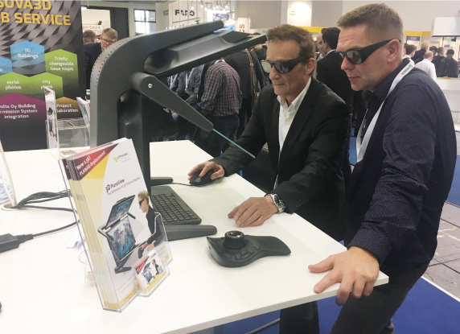
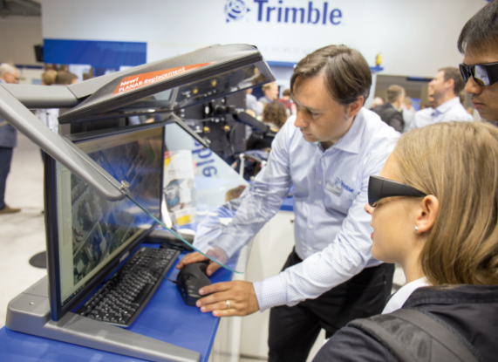
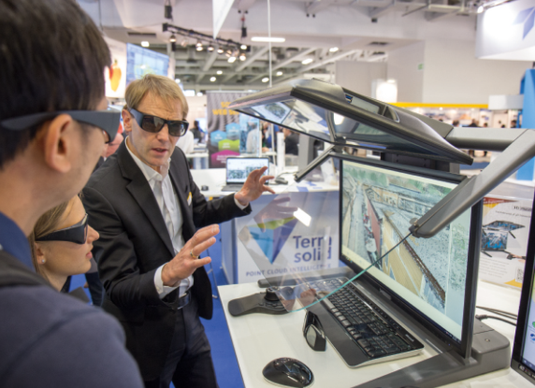
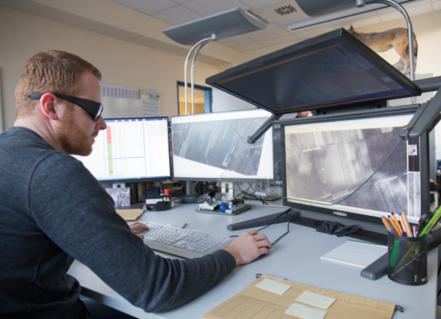
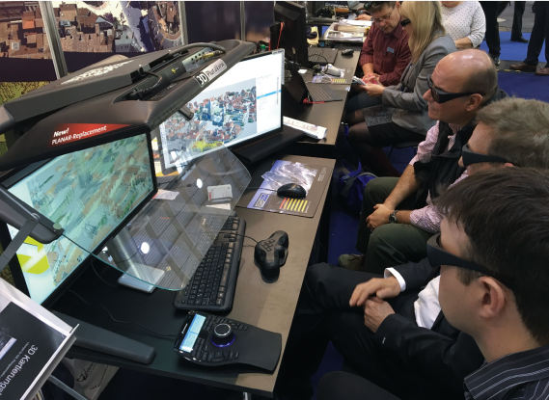
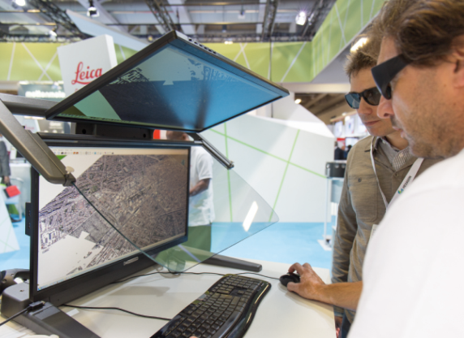
Applications
ERDAS IMAGINE and Stereo Analyst
Trimble DTMaster
Terrasolid TerraStereo
esri ArcGIS Pro
DAT/EM Summit Evolution
Leica Geosystems HxMap

Slide 16
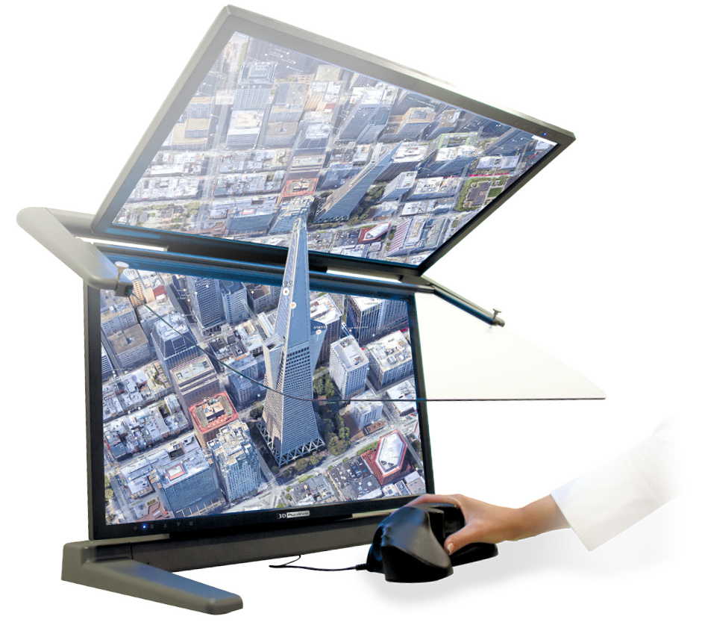


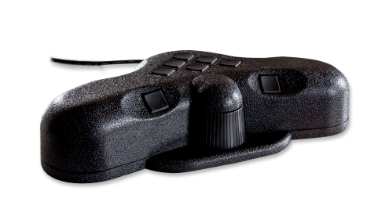
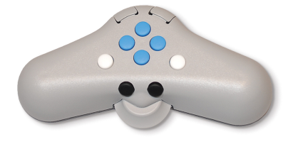
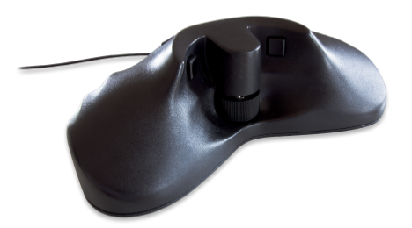
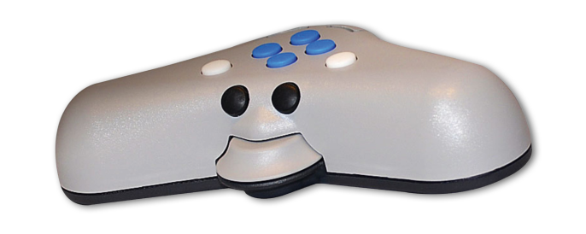
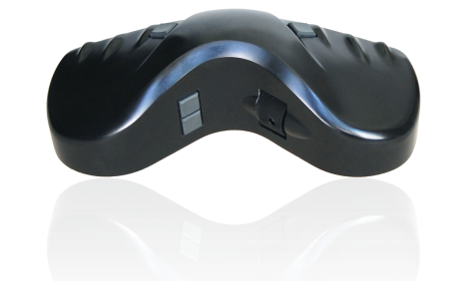
Complete Solutions – 3D controllers
For Photogrammetry

Slide 17

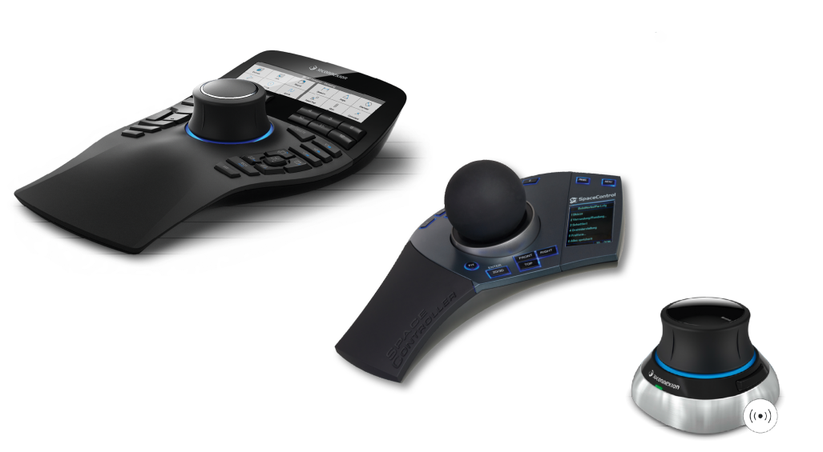
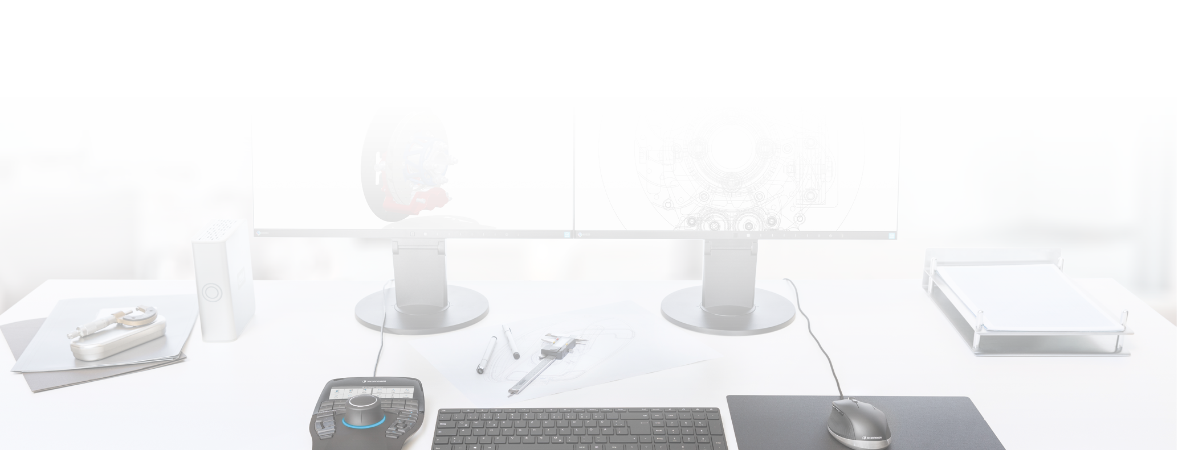


Complete Solutions – 3D controllers
CAD controllers

Slide 18

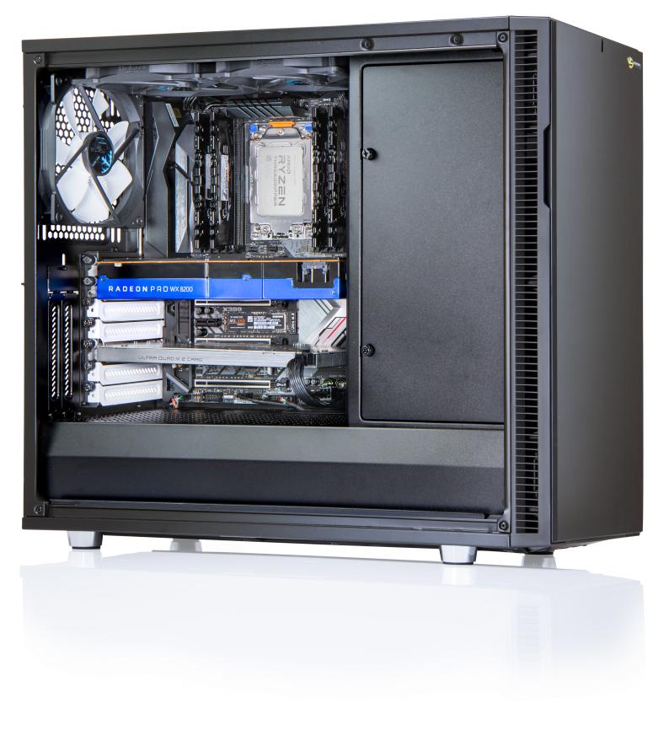



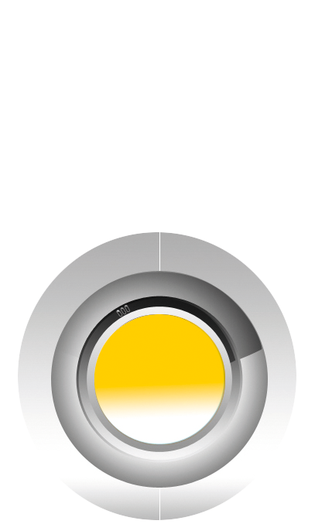
Workstation
Professional Workstations
Available as desktop or 19” rackmount versions
Latest Intel Core I7/I9, Xeon, AMD Ryzen, EPYC or AMD Threadripper technology
High-speed processors (up to 2x 144 cores with XEON 6 on Intel platform, up to 2x 128 cores on AMD EPYC)
Up to six high-end graphics cards PCIe 5.0 x16 for CUDA or OpenCL applications in one workstation
High-performance RAID with up to 24 GB/s. Transfer rates (SAS 4.0 technology) on demand also with fast SSDs (Solid State Disks) with up to 8 TB of disk space per drive
Ultra-fast 200 GBit LAN for connection to file servers

Slide 19
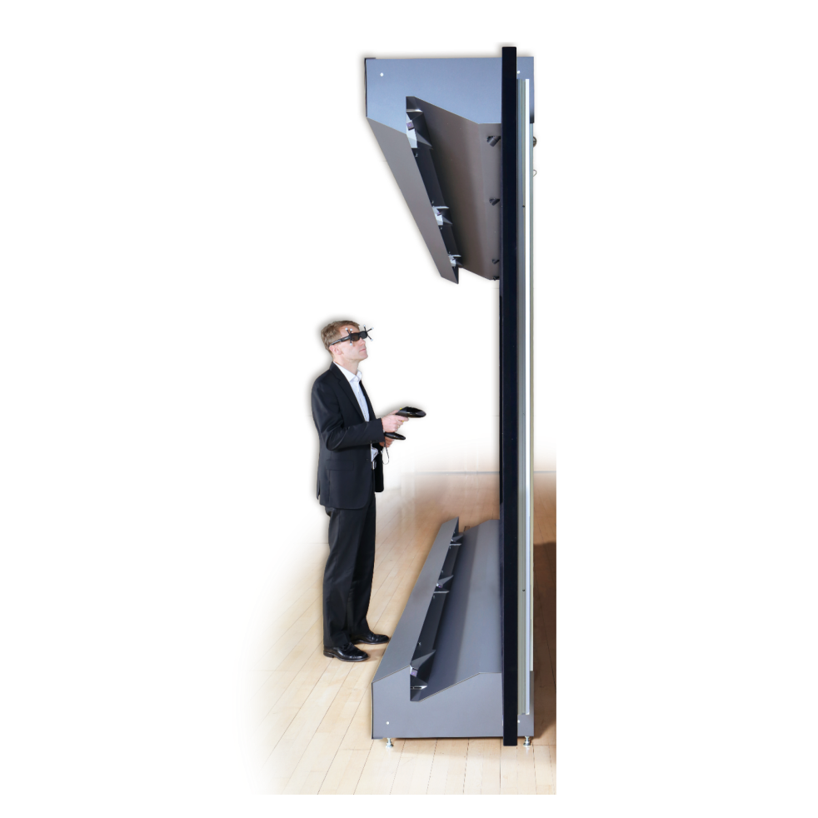
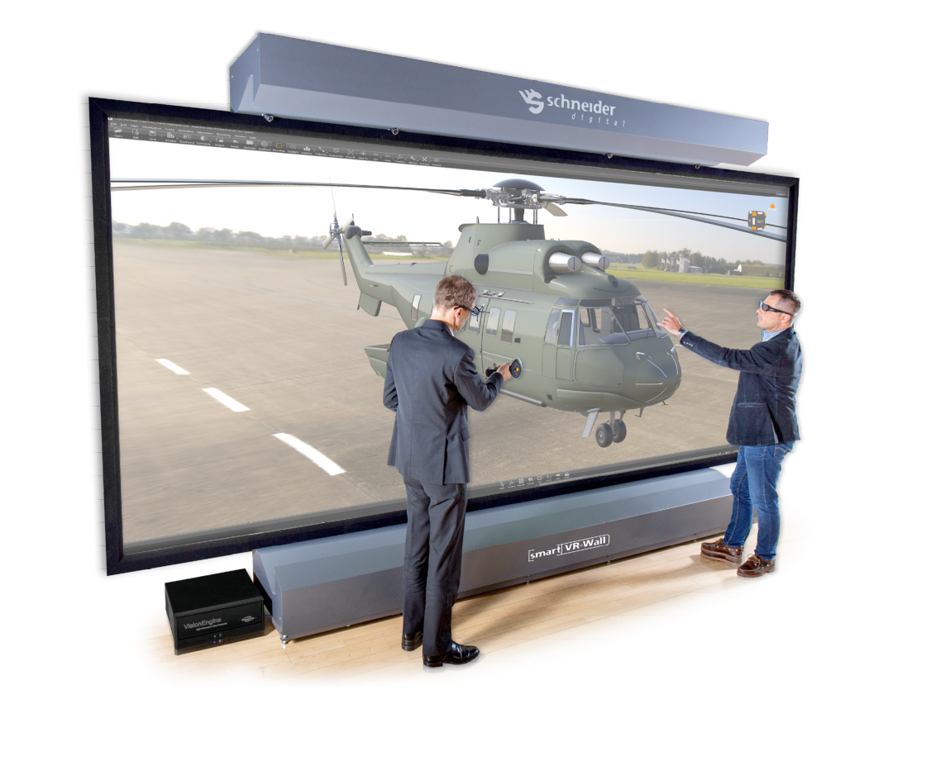

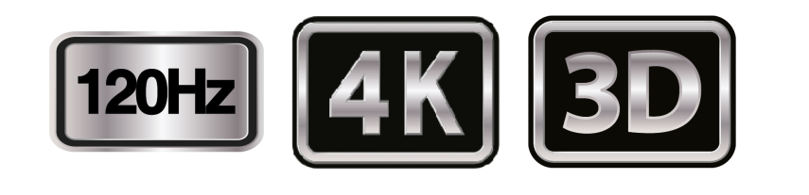
LASER smart VR Wall
State-of-the-art laser projection technology
Highest brightness, six 4,000 ANSI lumens projectors
120 Hz technology
Full 6K resolution even in 3D stereo
Tablet control
Freestanding construction without wall mounting or ceiling mounting
For large-format, high-resolution 3D stereo

Slide 20























































3D PluraView – Software Partners
3d Zephyr STK Metashape SOCET GXP v4.5 Softpltter/KDSP Sci-X Summit Evolution ESPA 3D PyMOL sView
Stereo Analyst ArcGIS Pro OSGeo PurVIEW Maya MapInfo® Vertical Mapper™ TNTgis syngo.fourSight EON Reality
3DM Content Manager Premiere Pro Blender PMS3D Photomod StereoGIS Spidar JewelSuite RiSCAN Pro
Inpho KomVISH sure aerial / Pro Go2VR / D2P Photosoft GoCAD Kingdom VR Two Unity 3D
Open Source Project LiMON Viewer PRO Vizable uSmart LaserControl StereoCAD ContextCapture DPS / Delta AVIZO
Delmia HIM Creo View MCAD DeltaGen TerraStereo Rhino Precision 3D Topo WinATLAS Scene Micromap
More than 200 software applications supported!

Slide 21



















3D PluraView –Partners
TerraStereo DAT/EM Systems SOLITECH AD Agisoft LLC South Schnell Tech GeoDyn Technology
Swift Integrator SARL RhinoTerrain Brisight Technology Wipco 3D Kelyn Technologies IGI – Integrated Geospatial
Pte Ltd & Solutions Innovations
DS Deutsche TP Holdings Japan Steinbacher-Consult AirborneHydroMapping TVISCompany, Geomatika Smolčak
Systemhaus GmbH Ingenieurgesellschaft GmbH LLC. doo
mbH & Co. KG

Slide 22
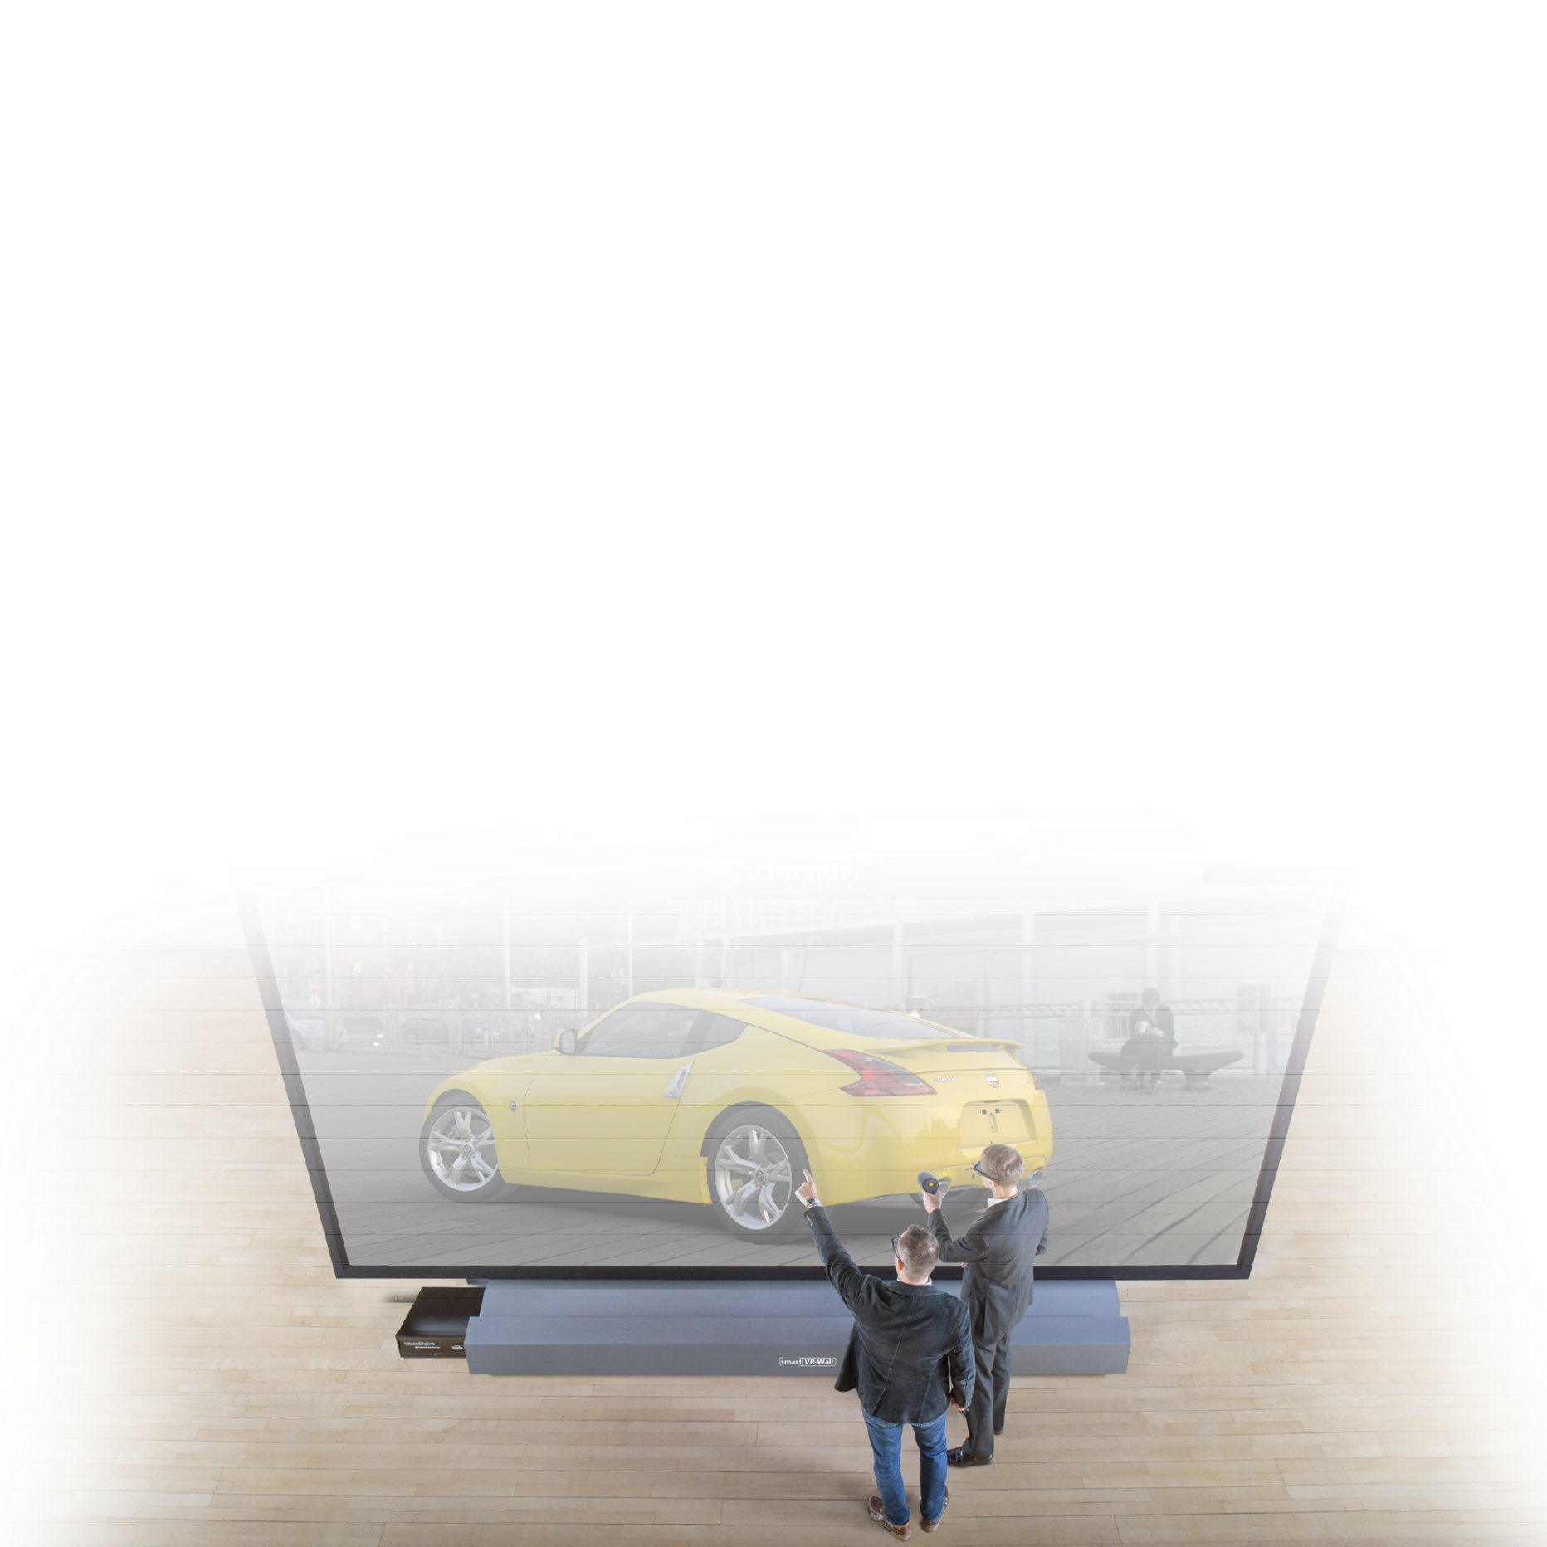

References

